Slide 1
Florida Grasshopper Sparrow

Slide 2
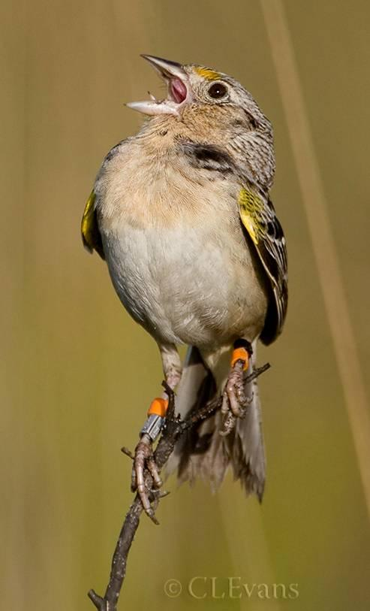
… perhaps the most endangered bird in the United States…”

Slide 3
https://www.youtube.com/watch?v=In0nX8sE4sc
https://www.youtube.com/watch?v=c-UX2_QCPzI
https://www.youtube.com/watch?v=n_DMSu9Pahk
https://www.youtube.com/watch?v=-p_X9OvDQvQ

Slide 4
Federally endangered sub-species of grasshopper sparrow (widespread species in North America)
Florida populations are considered unique and face a very uncertain future

Slide 5
Range
Dry prairies of central and south Florida (~ 90% habitat reduction)

Slide 6
Biology
Males hold and defend a territory (by calling/patrol)
Cryptic spp. and males are often the only visible members of populations when calling to defend territory/attract mates
Mating and nesting is in the spring (April-June)
Nesting is on the ground under palmetto or in grass clumps
Clutches are 3-5 eggs and second clutches may be laid

Slide 7
Biology
Diet is arthropods (spiders, orthopterans, etc.) and sometimes seeds
Movement is limited (individuals typically born and die in the same area), although some dispersal among remaining patches (separated by tens of miles) has been documented

Slide 8
Ecology
Birds are sensitive to habitat change/degradation
Hydrology, vegetative structure, burning regime all matter
Predation of adults and juveniles is primarily by snakes

Slide 9
Problems

Slide 10
Steady, recent declines

Slide 11
Habitat requirements are quite strict
Dry prairie
Prairie burned within 2 years
No trees or dense brush
>400 m from a forest edge
Pasture/rangeland is suboptimal and may be contributing to declines

Slide 12
Land management matters
Burning regime must include frequent burning and should only take place later in the spring/early summer season to avoid destroying nests
Little or no grazing is tolerable (and presence of exotic grasses may be problematic)
Predation pressure is constant and emerging threats (e.g. fire ants) may be contributing to recent declines

Slide 13
Other threats
Disease (TB)
Inbreeding

Slide 14
Going forward
Captive breeding: http://www.orlandosentinel.com/news/os-captive-raising-grasshopper-sparrow-20150526-story.html
Improved habitat management (burning regime, tree removal, fire ant reduction) are seen as critical on public and private lands that have birds remaining on them (Three Lakes WMA, Kissimmee Prairie State Preserve).
Monitoring for disease prevalence, inbreeding.

