Slide 1
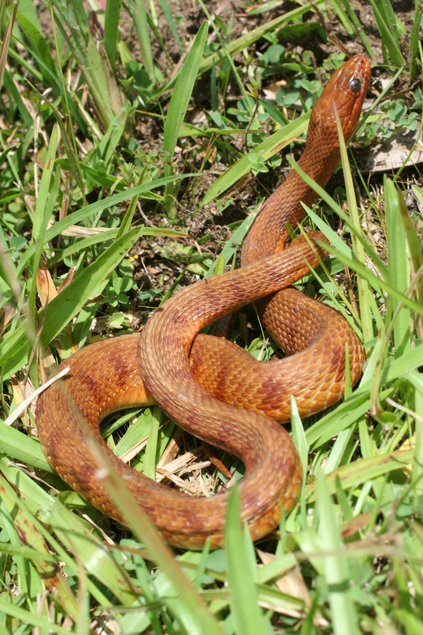
Analysis of count data
With the kind help or data provided by
Gregory Territo
and
Shaila Morales

Slide 2
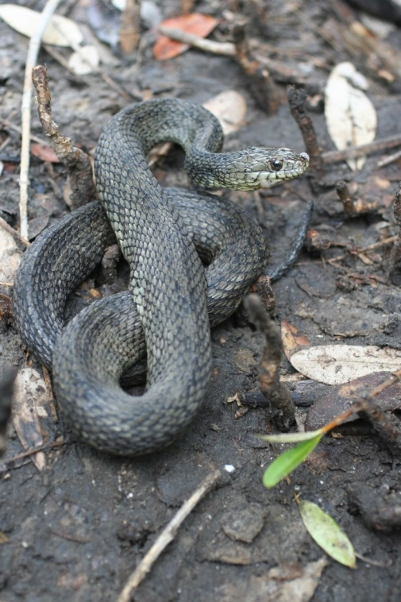
Abundance changes with salinity in the Mangrove Salt Marsh Snake, N. clarkii

Slide 3
> model1 <- glm(d_c ~ sal*sp, family = poisson)
Warning message: In model.matrix.default(mt, mf, contrasts) : variable 'sp' converted to a factor
> summary(model1)
Call:
glm(formula = d_c ~ sal * sp, family = poisson)
Deviance Residuals:
Min 1Q Median 3Q Max
-2.4345 -1.2173 -1.0171 0.6468 3.9516
Coefficients:
Estimate Std. Error z value Pr(>|z|)
(Intercept) 2.853143 0.237389 12.019 < 2e-16 ***
sal -0.037690 0.008917 -4.227 2.37e-05 ***
spf 0.608123 0.289701 2.099 0.0358 *
spq -1.783507 0.339976 -5.246 1.55e-07 ***
sal:spf -0.178313 0.027435 -6.500 8.05e-11 ***
sal:spq 0.032300 0.013745 2.350 0.0188 *
---
Signif. codes: 0 ‘***’ 0.001 ‘**’ 0.01 ‘*’ 0.05 ‘.’ 0.1 ‘ ’ 1
(Dispersion parameter for poisson family taken to be 1)
Null deviance: 238.78 on 38 degrees of freedom
Residual deviance: 107.18 on 33 degrees of freedom
AIC: 227.64
Number of Fisher Scoring iterations: 5

Slide 4
> model2 <- glm(d_c ~ sal*sp, family = quasipoisson)
Warning message:In model.matrix.default(mt, mf, contrasts) : variable 'sp' converted to a factor
> summary(model2)
Call:
glm(formula = d_c ~ sal * sp, family = quasipoisson)
Deviance Residuals:
Min 1Q Median 3Q Max
-2.4345 -1.2173 -1.0171 0.6468 3.9516
Coefficients:
Estimate Std. Error t value Pr(>|t|)
(Intercept) 2.85314 0.47305 6.031 8.8e-07 ***
sal -0.03769 0.01777 -2.121 0.04150 *
spf 0.60812 0.57730 1.053 0.29981
spq -1.78351 0.67748 -2.633 0.01279 *
sal:spf -0.17831 0.05467 -3.262 0.00258 **
sal:spq 0.03230 0.02739 1.179 0.24671
---
Signif. codes: 0 ‘***’ 0.001 ‘**’ 0.01 ‘*’ 0.05 ‘.’ 0.1 ‘ ’ 1
(Dispersion parameter for quasipoisson family taken to be 3.971014)
Null deviance: 238.78 on 38 degrees of freedom
Residual deviance: 107.18 on 33 degrees of freedom
AIC: NA
Number of Fisher Scoring iterations: 5

Slide 5
 | Estimate | Std.Error | t value | Pr(>|t|)
Poisson
(Intercept) | 2.853143 | 0.237389 | 12.019 | <0.00002 ***
sal | -0.03769 | 0.008917 | -4.227 | 2.37E-05 | ***
spf | 0.60812 | 0.289701 | 2.099 | 0.0358 | *
spq | -1.78351 | 0.339976 | -5.246 | 1.55E-07 | ***
sal:spf | -0.17831 | 0.027435 | -6.5 | 8.05E-11 | ***
sal:spq | 0.0323 | 0.013745 | 2.35 | 0.0188 | *
Quasipoisson
(Intercept) | 2.85314 | 0.47305 | 6.031 | 8.80E-07 | ***
sal | -0.03769 | 0.01777 | -2.121 | 0.0415 | *
spf | 0.60812 | 0.5773 | 1.053 | 0.29981
spq | -1.78351 | 0.67748 | -2.633 | 0.01279 | *
sal:spf | -0.17831 | 0.05467 | -3.262 | 0.00258 | **
sal:spq | 0.0323 | 0.02739 | 1.179 | 0.24671

Slide 6
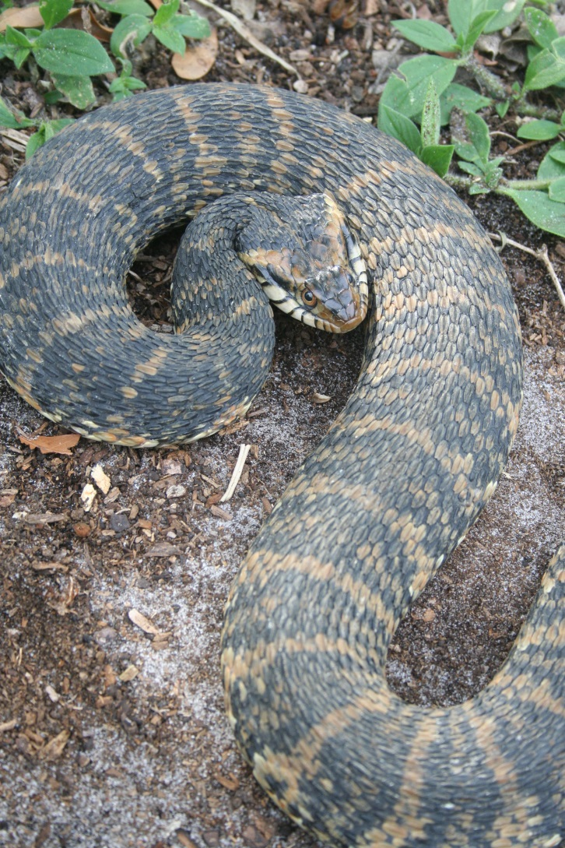
Model

Slide 7
> summary(model3)
Call:
glm(formula = d_c ~ sal + sp, family = quasipoisson)
Deviance Residuals:
Min 1Q Median 3Q Max
-2.9486 -1.7524 -0.6882 0.6169 6.1301
Coefficients:
Estimate Std. Error t value Pr(>|t|)
(Intercept) 2.88005 0.50451 5.709 1.87e-06 ***
sal -0.03894 0.01706 -2.283 0.0286 *
spf -0.57515 0.50947 -1.129 0.2666
spq -1.25011 0.50293 -2.486 0.0179 *
---
Signif. codes: 0 ‘***’ 0.001 ‘**’ 0.01 ‘*’ 0.05 ‘.’ 0.1 ‘ ’ 1
(Dispersion parameter for quasipoisson family taken to be 6.417679)
Null deviance: 238.78 on 38 degrees of freedom
Residual deviance: 168.81 on 35 degrees of freedom
AIC: NA
Number of Fisher Scoring iterations: 5

Slide 8
### Fitting the model
# Write model
Ancova<-function()
## Priors
{
c ~ dlnorm(0,1.0E-6)
for (i in 1:3)
{
a[i] ~ dlnorm(0,1.0E-6)
}
## Likelihood
for (i in 1:n)
{
mean[i] <- a[z[i]] + c*x[i]
Y[i] ~ dpois(mean[i])
}
}
write.model(Ancova,"Ancova.txt")

Slide 9
results
Iterations = 1001:10000
Thinning interval = 1
Number of chains = 3
Sample size per chain = 9000
1. Empirical mean and standard deviation for each variable,
plus standard error of the mean:
Mean SD Naive SE Time-series SE
a[1] 2.645e+00 0.381013 2.319e-03 2.173e-02
a[2] 6.609e+00 0.908557 5.529e-03 5.702e-03
a[3] 6.984e+00 0.829348 5.047e-03 5.047e-03
c 5.648e-04 0.001934 1.177e-05 2.569e-05
deviance 3.122e+02 2.571152 1.565e-02 7.128e-02
2. Quantiles for each variable:
2.5% 25% 50% 75% 97.5%
a[1] 1.902e+00 2.398e+00 2.617e+00 2.914e+00 3.400e+00
a[2] 4.956e+00 5.978e+00 6.565e+00 7.197e+00 8.521e+00
a[3] 5.457e+00 6.404e+00 6.946e+00 7.523e+00 8.710e+00
c 1.178e-09 1.358e-07 4.501e-06 1.472e-04 5.876e-03
deviance 3.092e+02 3.103e+02 3.116e+02 3.136e+02 3.187e+02

Slide 11
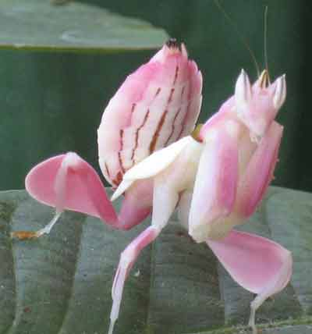

Visitation rate?
Hanlon, et al. 2014. Pollinator deception in the Orchid Mantis. American Naturalist 183

Slide 13
8.12 6.06 0.45

Slide 14
> model1 <- glm(total ~ type, family = poisson)
> summary(model1)
Call:
glm(formula = total ~ type, family = poisson)
Deviance Residuals:
Min 1Q Median 3Q Max
-4.0302 -0.9535 -0.8928 0.6971 6.4671
Coefficients:
Estimate Std. Error z value Pr(>|z|)
(Intercept) 1.80181 0.07071 25.481 < 2e-16 ***
typeTotal_Mantid 0.2927 0.09344 3.132 0.00174 **
typezTotal_Control -2.5903 0.26771 -9.676 < 2e-16 ***
---
Signif. codes: 0 ‘***’ 0.001 ‘**’ 0.01 ‘*’ 0.05 ‘.’ 0.1 ‘ ’ 1
(Dispersion parameter for poisson family taken to be 1)
Null deviance: 585.14 on 98 degrees of freedom
Residual deviance: 296.44 on 96 degrees of freedom
AIC: 554.08
Number of Fisher Scoring iterations: 6

Slide 15
> model2 <- glm(total ~ type, family = quasipoisson)
> summary(model2)
Call:
glm(formula = total ~ type, family = quasipoisson)
Deviance Residuals:
Min 1Q Median 3Q Max
-4.0302 -0.9535 -0.8928 0.6971 6.4671
Coefficients:
Estimate Std. Error t value Pr(>|t|)
(Intercept) 1.8018 0.1353 13.312 < 2e-16 ***
typeTotal_Mantid 0.2927 0.1789 1.636 0.105
typezTotal_Control -2.5903 0.5124 -5.055 2.06e-06 ***
---
Signif. codes: 0 ‘***’ 0.001 ‘**’ 0.01 ‘*’ 0.05 ‘.’ 0.1 ‘ ’ 1
(Dispersion parameter for quasipoisson family taken to be 3.663778)
Null deviance: 585.14 on 98 degrees of freedom
Residual deviance: 296.44 on 96 degrees of freedom
AIC: NA
Number of Fisher Scoring iterations: 6

Slide 16
### Fitting the model
# Write model
Anovam<- function()
## Priors
{
for (i in 1:3)
{
c[i] ~ dlnorm(0.0,1.0E-6)
}
## Likelihood
for (i in 1:n)
{
mean[i] <- c[x[i]]
Y[i] ~ dpois(mean[i])
}
}
write.model(Anovam,"Anovam.txt")

Slide 17
> results<-summary(reg.coda)
> results
Iterations = 501:5000
Thinning interval = 1
Number of chains = 3
Sample size per chain = 4500
1. Empirical mean and standard deviation for each variable,
plus standard error of the mean:
Mean SD Naive SE Time-series SE
c[1] 6.0630 0.4285 0.003688 0.0036881
c[2] 8.1220 0.4968 0.004275 0.0043329
c[3] 0.4546 0.1169 0.001006 0.0009949
deviance 551.0826 2.4689 0.021249 0.0214720
2. Quantiles for each variable:
2.5% 25% 50% 75% 97.5%
c[1] 5.2550 5.7680 6.0520 6.3510 6.9200
c[2] 7.1800 7.7830 8.1120 8.4480 9.1285
c[3] 0.2533 0.3717 0.4446 0.5265 0.7113
deviance 548.3000 549.3000 550.4000 552.2000 557.4000

