Slide 1
Chemistry Department Advising

Slide 2
Meet your Department Advisor
When Can I Go For Advising?
Starting August 2020
Who? Dr. Rex, Matthew.Rex@ucf.edu
Where? CHEM 208
When? Office hours will be posted on the advising page
Reasons to see your department advisor
Major Specific Questions
Class Scheduling
Research & Internships
Independent Study
Career Information

Slide 3
Meet your College of Sciences Advisor
When Can I Go For Advising?
Where? CSB 250
When? Hours are posted on the COSAS website:
https://sciences.ucf.edu/cosas/
Who? Mrs. Thompson, jillian.Thompson@ucf.edu
Reasons to see your college advisor
Undergraduate Policies and Procedures
General Advising for GEP
Grade forgiveness and withdrawals
Questions about readmission
Help with your myKnight Degree Audit
Graduation Procedures
Academic Standing and Probation
Transfer credits & course evaluations
How to apply as transient
Forms: SAP, URA, ARC, ROTC, University waiver

Slide 4
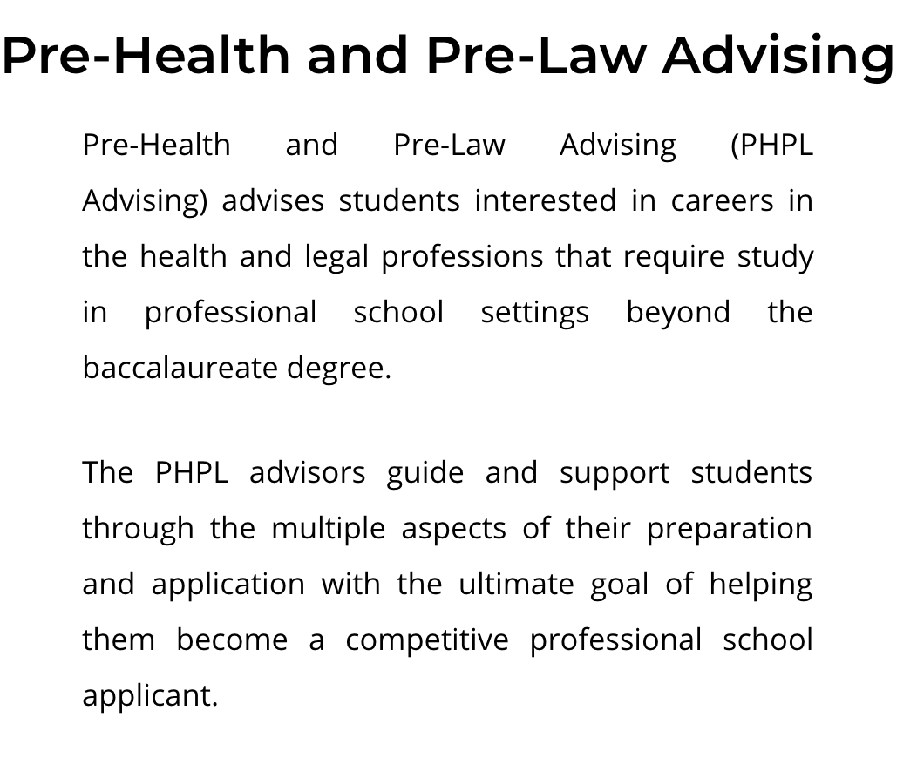
https://phpladvising.ucf.edu/
When Can I Go For Advising?

Slide 5
How Can I Get Involved?
ACS
American Chemical Society student chapter
http://www.acsatucf.com/
FSA
Forensic Science Association
https://sciences.ucf.edu/chemistry/fsa/
Knight Connect
Campus student organizations
https://ucf.campuslabs.com/engage/

Slide 6
Advising Packet Handouts
Pg 1
Flow Chart
Pg 2
General Education Program
Pg 3-6
Degree Requirements
Pg 7-8
Course Plan Sheet
Pg 9
Tutoring & Resources

Slide 7
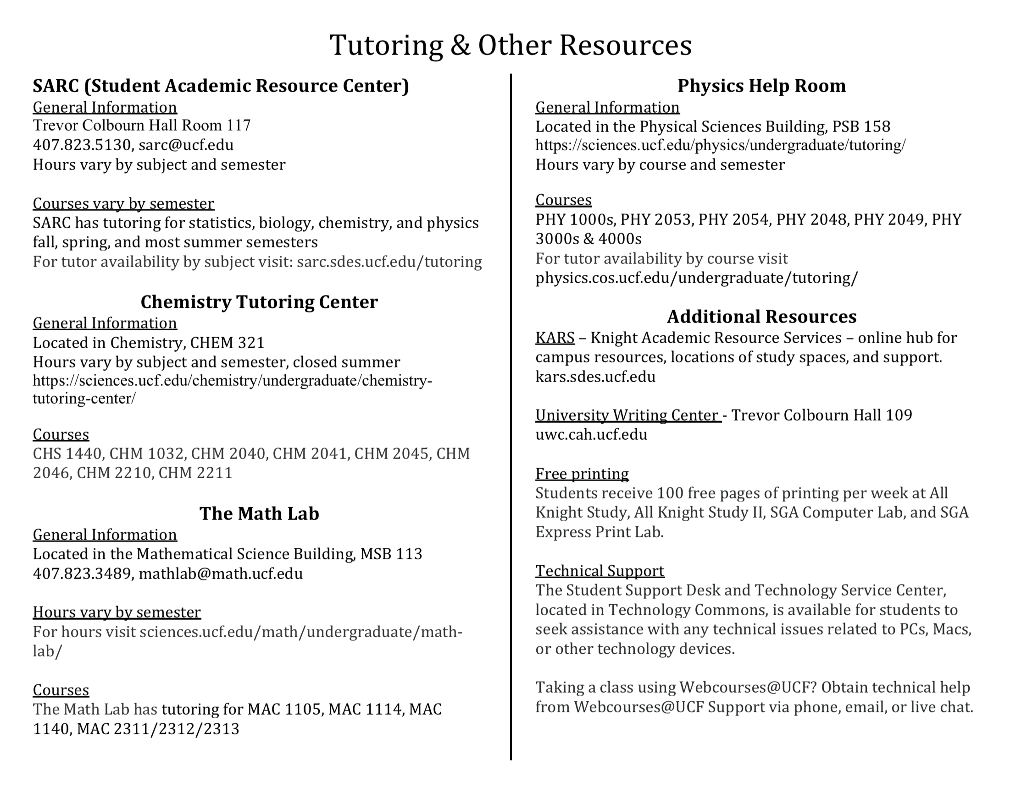

Slide 8
What Track Should I Choose?
Chemistry B.S.
Chemistry
Biochemistry
When you go to register for classes, check you myKnight Audit to be sure you have the correct track declared.

Slide 9
What Classes Should I Take?
1. Chemistry
2. Math
3. GEP
4. Restricted Elective
Chemistry Majors

Slide 10
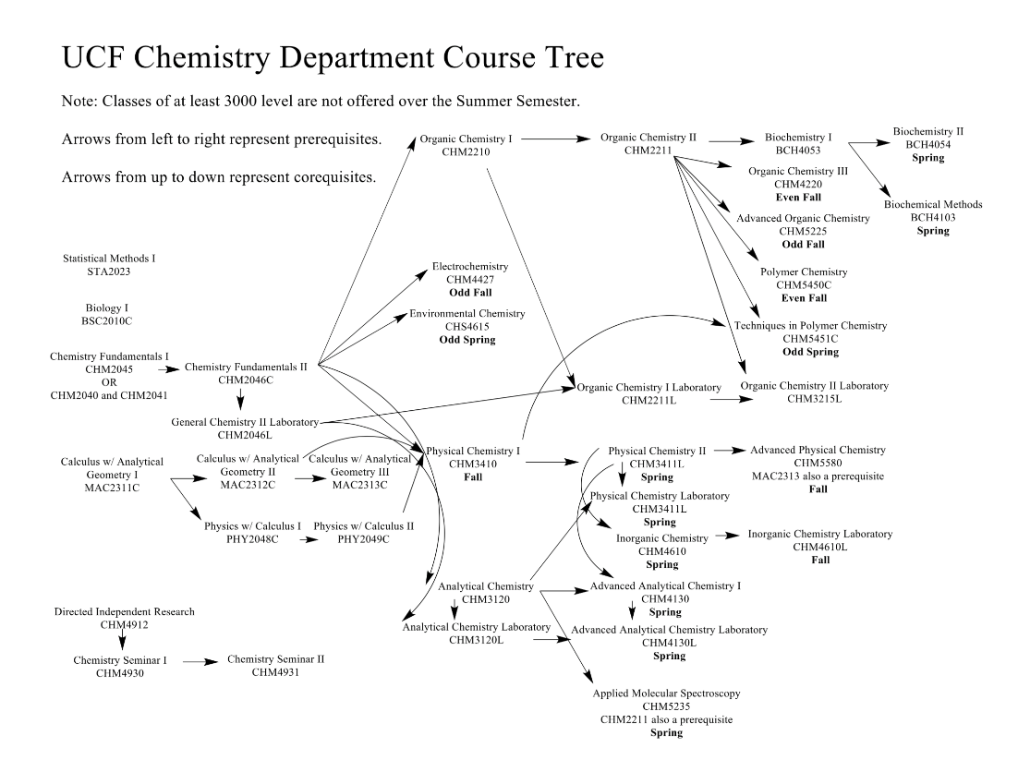
Chemistry

Slide 11
1. Chemistry Courses
Slow-paced General Chemistry
CHM 1025
CHM 2045
CHM 2046
CHM 2046L
Fast-paced General Chemistry
CHM 2045C*
CHM 2046
CHM 2046L
* To register for CHM 2045C you must place into the course by completing the chemistry placement test, OR receive a C or better in CHM 1025. Email: chemplacement@ucf.edu to get access to the test. You also must have credit or placement for MAC 1105C or higher.
Orgo I CHM 2210
Orgo II CHM 2211
Orgo Lab CHM 2211L
Analytical CHM 3120
Analytical Lab
CHM 3120L

Slide 12
2. Math Courses
Transferring in math courses
Take the next class in the sequence
Not transferring in math courses
Take the math placement test
https://utc.sdes.ucf.edu/math/
Col. Algebra MAC
1105
Trig
MAC
1114
Pre-Calc MAC 1140
Calc I MAC 2311
Calc II MAC 2312
Calc III MAC 2313
Chemistry majors only
Statistics: STA 2023

Slide 13
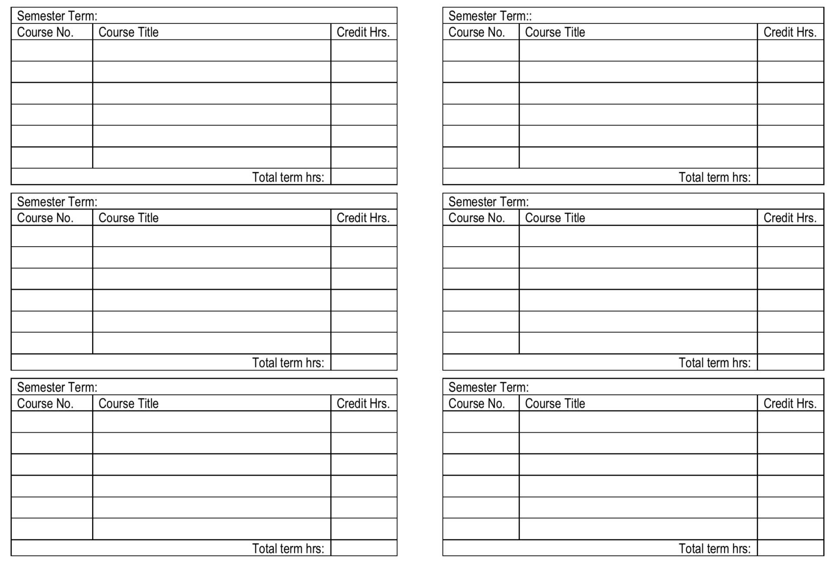

Slide 14
How Do I Know When Courses are Offered? Pre-requisites?
Course offerings and pre-requisites can be accessed through:
mySchedule Builder
https://registrar.ucf.edu/myschedule-builder/
The Undergraduate Catalog
http://catalog.ucf.edu/index.php?catoid=3

Slide 15
Research & Internships
Chemistry Majors
Minimum 2 semesters of undergraduate research
Minimum of 4 credit hours of CHM 4912

Slide 16
Questions?
Schedule-planning related to the Chemistry major email Dr. Rex: Matthew.Rex@ucf.edu
All other questions email: COSTransfer@ucf.edu – Transfer Students
COSFTIC@ucf.edu – FTIC students

