Slide 1
Welcome!

Slide 2
A few things before we start:
The questions are brain teasers, its okay if you don’t solve all of them on your own
This is not a competition, just do your best and have fun
If you attend more than 4 sessions, then you will get a certificate
Please type your first name and last name and “hi” in the chat to record your attendance and type “bye” when we are done for the day

Slide 3
Introduce Yourselves
Your name
What school do you go to (or are you homeschooled)?
What is something you like? Why? (hobby, food, animals, sports, singers, video games, etc.)

Slide 4
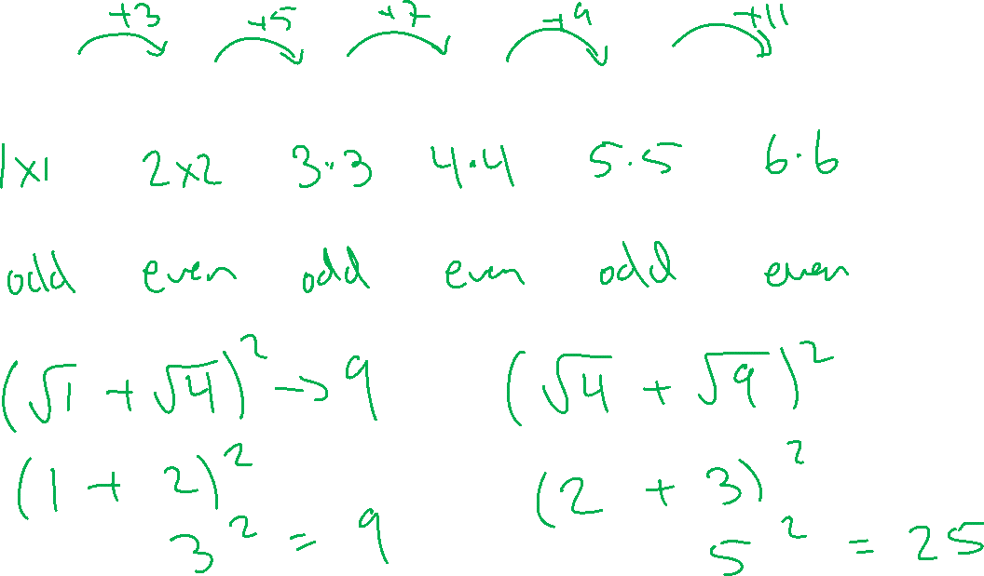
What is common in the following numbers?
1 4 9 16 25 36

Slide 6
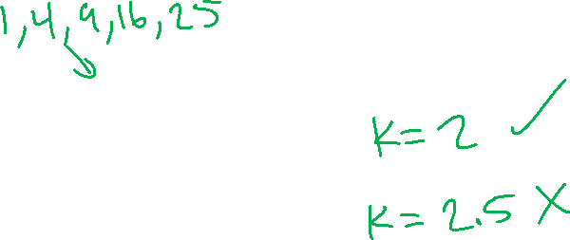
We use a letter to represent an unknown number
An integer n is a perfect square if
$$n=k^{2}$$
k is a natural number

Slide 7
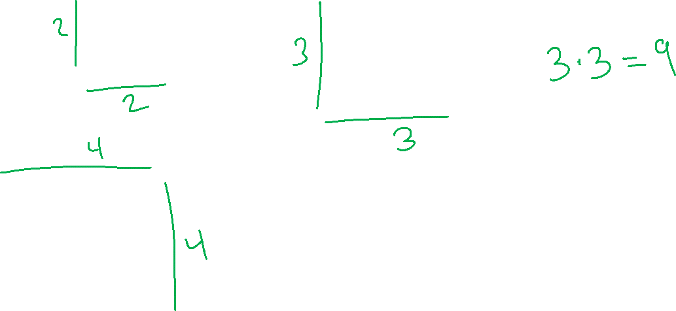
Let’s visualize the perfect squares
1
4
9
1 x 1
16

Slide 8
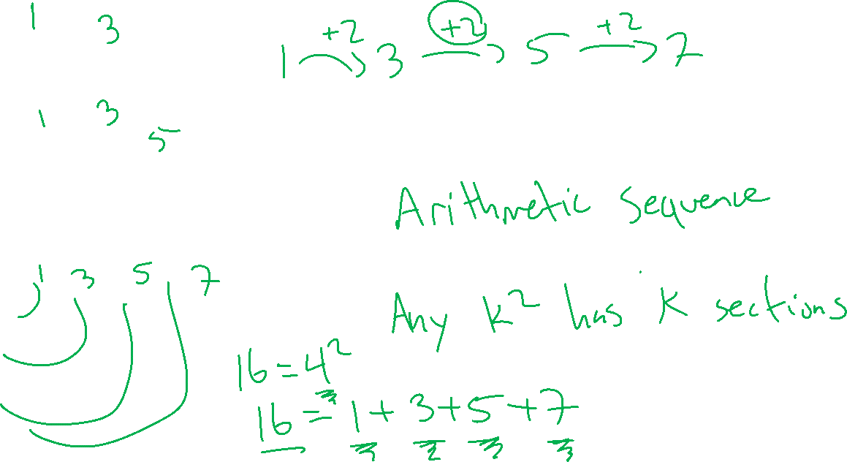
If we organize these differently, do you see a pattern?

Slide 9
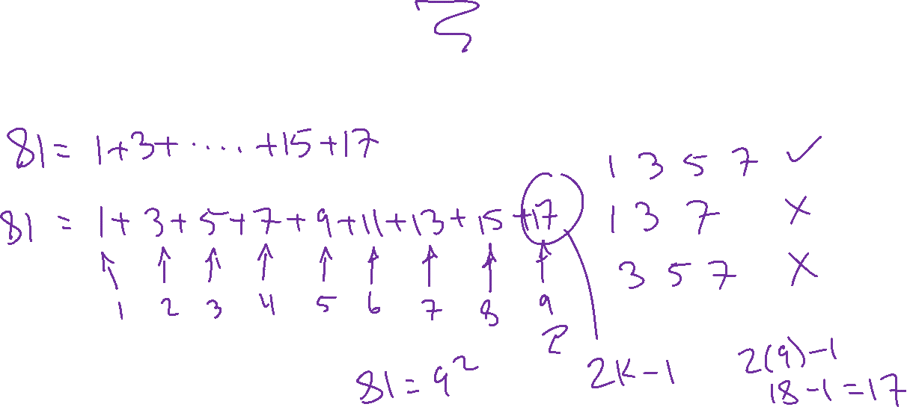
1) 81 is a perfect square ($81=9^{2}$). This means we can express 81 as the sum of first consecutive odd numbers.
Write 81 as the sum of first consecutive odd numbers.
Doesn’t skip any odd numbers and starts with the number 1

Slide 10
81 = 1 + 3 + 5 + 7 + 9 + 11 + 13 + 15 + 17
Is there a pattern to how many numbers each perfect square sum has?

Slide 11
If we have
$$n=k^{2}$$
Then
n = 1 + 3 + 5 + … + (2k - 1)
K pieces
or
K consecutive odd numbers

Slide 12
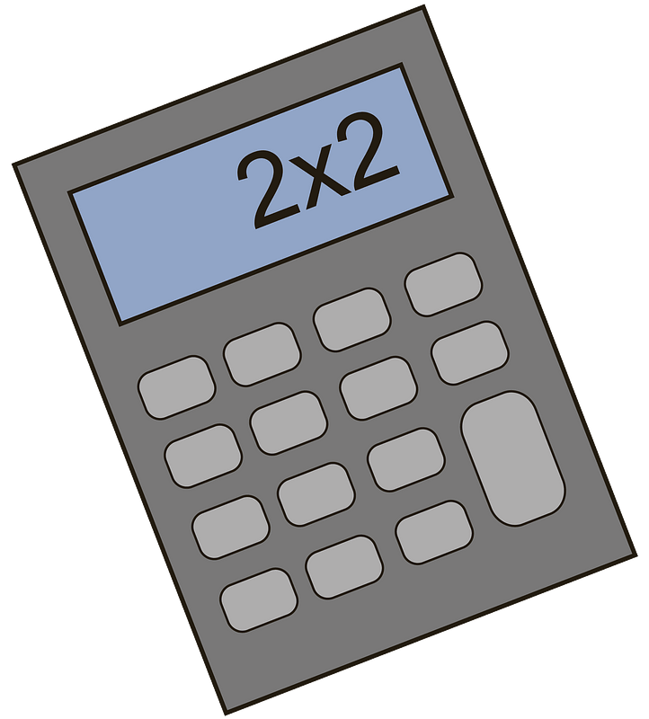
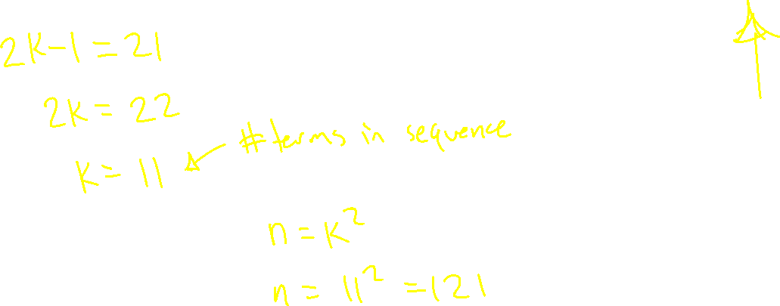
2) What is
1 + 3 + 5 + 7 + … + 21

Slide 13
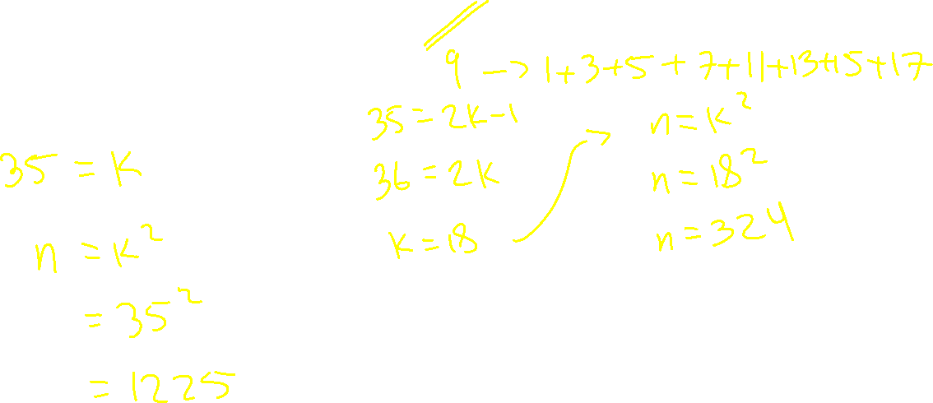
3) What is the sum of the first 35 consecutive odd numbers?

Slide 14
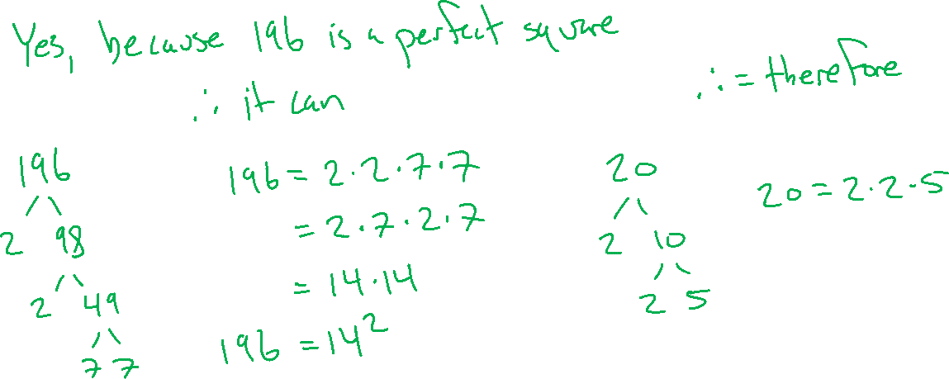
4) Can you express 196 as the sum of consecutive odd numbers which start at 1? Why or why not?
Hint: perform prime factorization/ make a factor tree

Slide 15
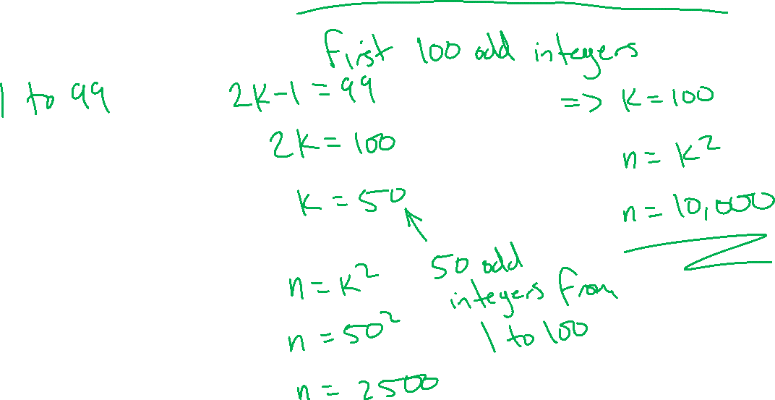
5) What is the sum of the odd integers from 1 to 100?

Slide 16
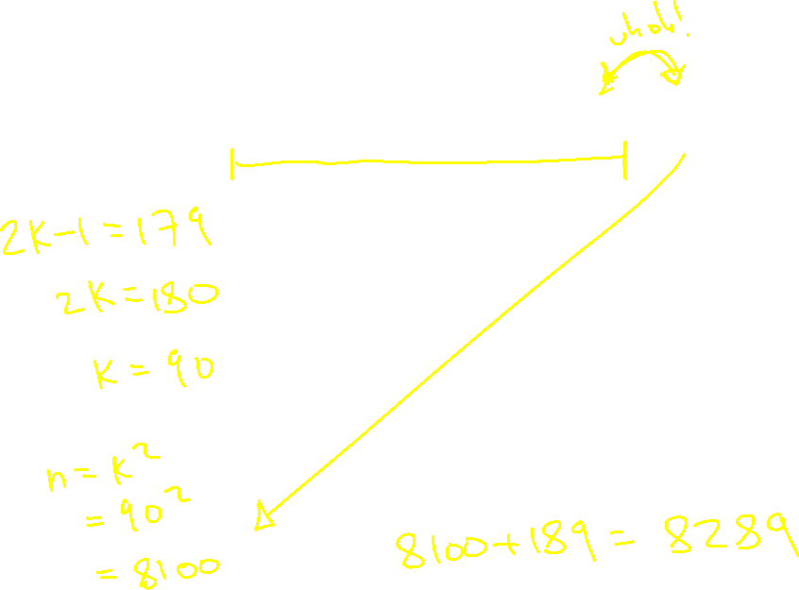
6) What is the sum of
1 + 3 + 5 + … + 179 + 189

Slide 17
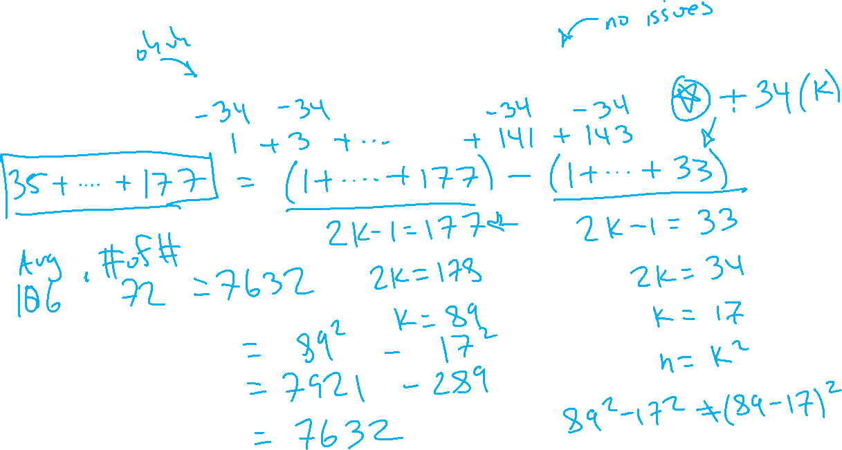
7) What is the sum of
35 + 37 + 39 + … + 175 + 177

