Slide 1
All about angles! Athanasios Dimitriadis
30º
160º
90º

Slide 2
Warm up!
What is an angle? How would you describe it?
An angle is formed when two rays meet at a common point, called the vertex.
We usually measure angles in
degrees, denoted by °.

Slide 3
Warm up!
Which of the following angles is bigger?
The yellow or the red?
It is irrelevant how much we extend
the rays of the angle, the angle
is still the same!

Slide 4
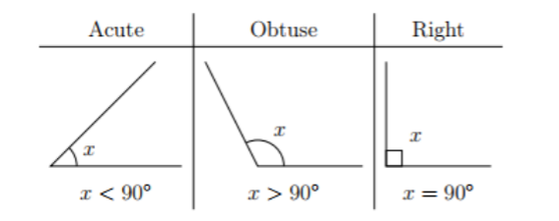
Acute/Obtuse/Right angles
A 90-degree angle is called a right angle. It is usually denoted by a small box instead of an arc.

Slide 5
Acute/Obtuse/Right angles
An angle smaller than 90 degrees is called acute, and an angle larger than 90 degrees is called obtuse.

Slide 6
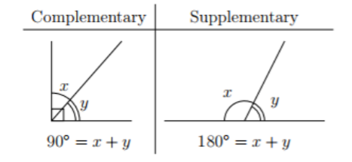
Complementary and Supplementary angles
Two angles are called complementary if they add up to 90°, and supplementary if they add up to 180°.

Slide 7
Complementary and Supplementary angles
150°
30°
Note that two angles can be supplementary/complementary, without even having the same vertex!

Slide 8
Complementary and Supplementary angles
150°
30°
Note that two angles can be supplementary/complementary, without even having the same vertex!

Slide 9
Complementary and Supplementary angles
Exercise 1
(a) What is the complementary angle of 30°?
(b) What is the complementary angle of 17°?
(c) What is the supplementary angle of 25°?
(d) What is the supplementary angle of 111°?
(e) What is the supplementary angle of 90°?
(f) If 𝑥 is supplementary to 42°and 𝑦 is complementary to 42°what is 𝑥 + 𝑦?

Slide 10
Opposite angles
How could we prove that opposite angles are equal?

Slide 11
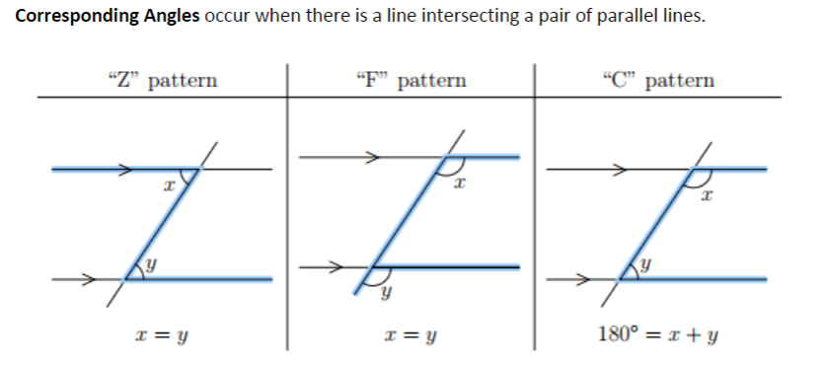
Corresponding angles
Z- and F-pattern angles are equal.
C-pattern angles are supplementary.

Slide 12
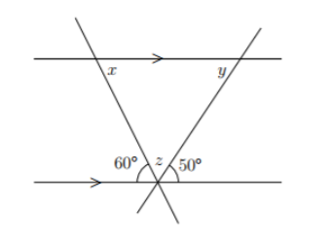
Corresponding angles
Exercise 2
Find the angles x , y and z.

Slide 13
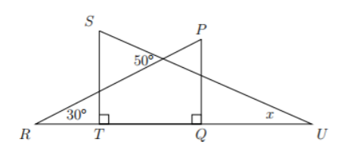
Corresponding angles
Exercise 3:
In the diagram, ∆PQR and ∆STU overlap so that RTQU forms a
straight line segment. What is the value of 𝑥? (Hint: What do you
remember about the sum of the interior angles in a triangle?)

Slide 14
Sum of interior angles of a polygon
The interior angles of a polygon are the angles that are formed by any two adjacent sides.
We want to try and find the sum
of those angles for any given
polygon with n sides.

Slide 15
Sum of interior angles of a polygon
You may have seen before that the sum of the interior angles in a triangle is 180°.
∠A+∠B+∠C=180°
Α
Β
C

Slide 16
Sum of interior angles of a polygon
Here’s how we could see this intuitively:
∠A+∠B+∠C=180°
Α
Β
C

Slide 17
Sum of interior angles of a polygon
Here’s how we could see this intuitively:
∠A+∠B+∠C=180°
Α
Β
C

Slide 18
Sum of interior angles of a polygon
Here’s how we could see this intuitively:
∠A+∠B+∠C=180°

Slide 19
Sum of interior angles of a polygon
This fact is not obvious, however we could see it intuitively:
∠A+∠B+∠C=180°

Slide 20
Sum of interior angles of a polygon
Let’s try to give a formal proof:
∠A+∠B+∠C=180°
Α
Β
C

Slide 21
Sum of interior angles of a polygon
First, we draw the line that passes
through A and is parallel to BC, and extend
all sides of the triangle:
∠A+∠B+∠C=180°
Α
Β
C

Slide 22
Sum of interior angles of a polygon
First, we draw the line that passes
through A and is parallel to BC, and extend
all sides of the triangle:
∠A+∠B+∠C=180°
Α
Β
C

Slide 23
Sum of interior angles of a polygon
We notice that D and B are Z-pattern angles,
and are thus equal.
Similarly, the angles C and E are equal.
∠A+∠B+∠C=180°
Α
D
E
Β
C

Slide 24
Sum of interior angles of a polygon
It follows that ∠A+∠B+∠C
= ∠A+∠D+∠E = 180°.
∠A+∠B+∠C=180°
Α
D
E
Β
C

Slide 25
Sum of interior angles of a polygon
Next, we would like to find the sum of the interior angles of a quadrilateral.

Slide 26
Sum of interior angles of a polygon
How can we use the result we found for triangles?

Slide 27
Sum of interior angles of a polygon
If we connect two non-adjacent vertices, two triangles are formed.
Therefore, the sum of the interior angles is 2*180=360°.

Slide 28
Sum of interior angles of a polygon
What about a pentagon?

Slide 29
Sum of interior angles of a polygon
Similarly as before, we split it into triangles.
This process is called a triangulation.

Slide 30
Sum of interior angles of a polygon
We thus see that the sum of the interior angles in 3*180=540°.

Slide 31
Sum of interior angles of a polygon
What would change if we used a different triangulation?

Slide 32
Sum of interior angles of a polygon
Finally, let’s calculate the sum of the interior angles of this star:

Slide 33
Sum of interior angles of a polygon
After all the work that we did, what would be a logical argument for the sum of the interior angles of a polygon with n sides?
It generally holds that for a polygon with n sides, the sum of the interior angles is
(n-2)*180

Slide 34
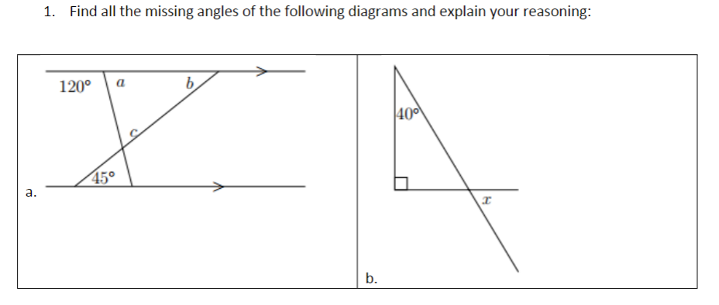
Problem Set:

Slide 35
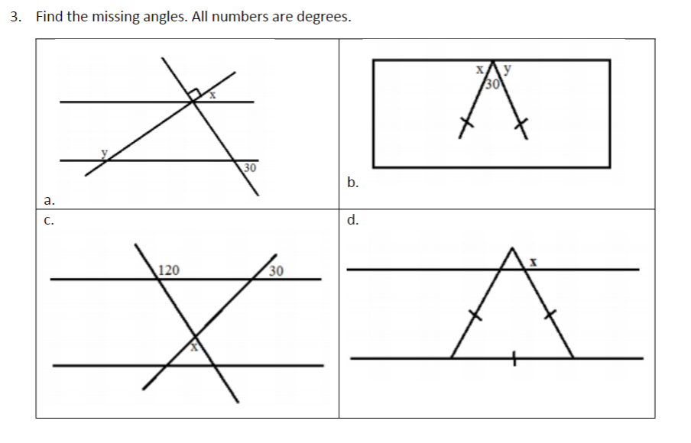
Problem Set:

Slide 36
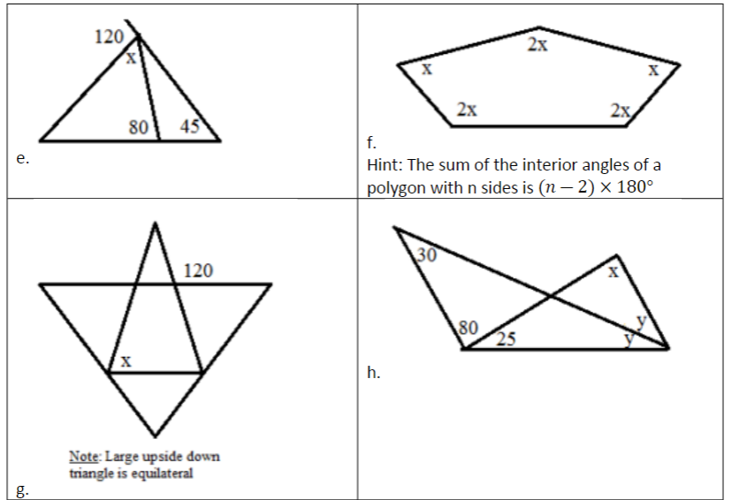
Problem Set:

Slide 37
Problem Set:

