Slide 1
Alpha 3
Virtual Level Theory of Alpha Decay

Slide 2



























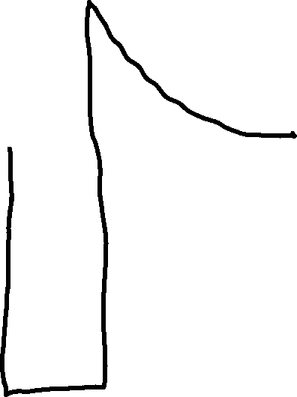





Slide 3




Slide 4











Slide 5


Slide 6





Slide 8



Slide 9












Slide 10








Slide 11























Slide 12












Slide 13
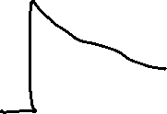














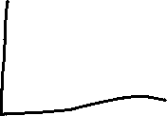












Slide 14























Slide 15











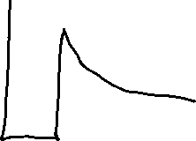



















Slide 16









































Slide 17




























Slide 18























Slide 19



















Slide 20




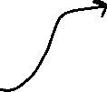















Slide 21














Slide 22





























Slide 23









Slide 24








Slide 25












Slide 26
















