Slide 1
BP 1.2,3 Coupled superconductors

Slide 2

















































Slide 3





















Slide 4


























Slide 5



















































Slide 6

















Slide 7














































Slide 8

























Slide 9



































Slide 10














































Slide 11









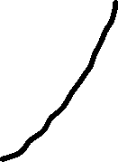



















Slide 12
































Slide 13





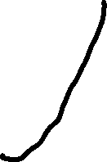





























Slide 14














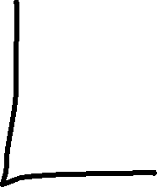

















Slide 15
























