Slide 1
Graphene band structure

Slide 2











Graphene is the name for a single sheet of graphite. It is a pure carbon material with the carbon atoms arranged into a two-dimensional honeycomb lattice. One C atom is at each vertex of the honeycomb.

Slide 3
















The fundamental translation vectors of the graphene lattice are
Figure 2:(a) Sketch of the lattice vectors a1 and a2 and one possible unit cell.
Note that there are two sublattices. The vectors a1 and a2 do not connect the central C site to its near-neighbor positions, which are on the other sublattice.
A unit cell, or primitive cell, is the cell of smallest volume that can fill all space by suitable crystal translations. One C atom is located at each vertex of every unit cell. Each C atom is shared by 4 unit cells, making one atom per unit cell. The “volume” of the graphene unit cell is V_{c} = a₁ x a₂.
One simple way to construct the unit cell is sketched in Fig. 2(a). This unit cell has the shape of a rhombus. However, this unit cell is not the Wigner-Seitz unit cell.

Slide 4
The Wigner-Seitz unit cell has the same volume V_{c}. To construct the Wigner-Seitz unit cell, draw lines to connect a given lattice point to all nearby lattice points. At the midpoint and normal to these lines, draw new lines. The smallest volume enclosed in this way is the Wigner-Seitz primitive cell. All space may be filled with these cells, just as before.
We find all near-neighbor sites within the same sublattice by integral combinations of a₁ and a₂. This is sketched in Fig. 2(b). There are six of them. The distance is a to each of these sites from the central site.
Then, to draw the Wigner-Seitz unit cell, we draw the perpendicular bisectors of each of these line segments (or arrows). This is sketched in Fig. 2(c). The perpendicular bisectors are extended until they meet the perpendicular bisectors of the neighboring lines (arrows). The Wigner-Seitz unit cell is thus the regular hexagon sketched in Fig. 2(c).
Figure 2 (b). Sketch of the vectors between near-neighbor sites in the same sub-lattice used to define the Wigner-Seitz unit cell.
Figure 2(c) Sketch of the Wigner-Seitz unit cell.
a₁
a₂

Slide 5




All physical quantities which describe the properties of graphene must have the same periodicity of the lattice itself. Let U(r) be such a quantity. Its periodicity implies that
U(r + n₁ a₁ + n₂ a₂) = U(r)
for any integers n₁, n₂. The function can be expanded as a double Fourier serires
U = Σ_{G} U_{G} exp[iG.r],
where summation is over all possible values of the vector G. Due to the periodicity condition, the exponential factors must be left unchanged when r is replaced by r + a, where a is any lattice vector. Then, it is necessary that G.a always be an integer multiple of 2π. Letting a be either one of the unit vectors,
a₁.G = 2π p₁ and a₂.G = 2π p₂,
where p₁ and p₂ are positive or negative integers or zero. The solution of these two equations has the form
G = p₁ G₁ + p₂ G₂.
The vectors G_{i} are given by

Slide 6







a sqrt[3] G₁/4π
a₁/a
The reciprocal lattice vectors are

Slide 7
In Fig. 2(d), these reciprocal lattice vectors and integral combinations of
them leading to equivalent points in the reciprocal lattice are shown. The distance
to each of these six points neighboring the central reciprocal lattice point (from
which the arrows originate) is
Angle between reciprocal lattice basis vectors is twice that between lattice vectors.

Slide 8
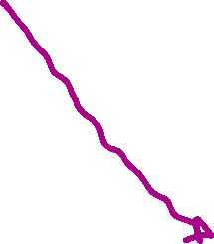
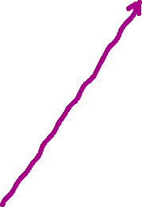

Figure 2(d). Sketch of the reciprocal lattice vectors and additional near-neighbor reciprocal lattice vectors within the same reciprocal sub-lattice.

Slide 9
A Brillouin zone is defined as a Wigner-Seitz cell in the reciprocal lattice. This is the only construction used in electron energy band theory and in the expression of the elementary excitations of crystals.
To form the BZ, we draw the perpendicular bisectors of each of these reciprocal lattice vectors. We extend those bisectors until they meet the bisectors of the neighboring arrows. This is sketched in Fig. 2(e). The resulting BZ is a regular hexagon. Note that this hexagonal BZ is rotated by 30 deg from the hexagonal Wigner-Seitz unit cell, Fig. 2(c).
Note: The corner at the zone edge is the K point, and the center of the face on
the BZ is the M point.

Slide 10
Each carbon atom forms covalent bonds with its three nearest neighbors. Of carbon’s four valence electrons, three per carbon atom are in the σ bands and completely occupy the available states. These states are formed from the s, p_{x}, and p_{y} orbitals of each C atom. Electrons in these bands are not available for conduction and form the valence band.
The remaining valence electron per atom goes into states of the π-bands. These states are formed from the the p_{z} orbitals of each C atom. They are orthogonal to the xy plane of graphene. These bands are not filled, so that the electron is available for conduction.
Since the p_{z} orbitals are the same on each site, one can calculate the electronic structure of the π-bands using an isotropic tight-binding model.

Slide 11










Fig. 2(f) presents a sketch of the graphene lattice. The origin (0,0) of the coordinates is placed at the position of the leftmost C atom on the A sublattice. All three of its near-neighbors are on the B sublattice. Their position vectors are
(f) Sketch of the scheme for evaluating the
π-bands of graphene.

Slide 12
Now, since there are two sublattices, we can write the coefficients of the wave functions expanded in terms of the near-neighbor sites as
See lecture on tight binding approximation for derivation of these two formulae.
E_{pz} = energy of p_{z} atomic orbitals
E(q) = band energy TBD
t = <n|υ_{n}|n+δ> = matrix elements of the potential between the p_{z} orbitals on neighboring sites
C_{A,B} = coefficients in reciprocal space of the relevant components of the wave functions of the two sublattices.

Slide 13
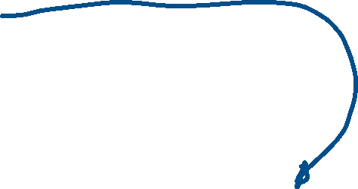
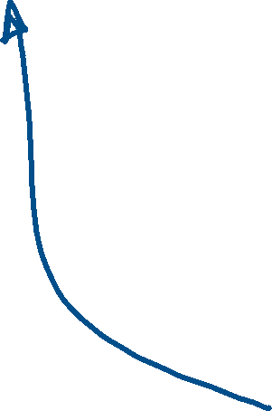

Slide 14
G1
K
M
G2

Slide 15
The dispersions along Γ to M are given by

Slide 18

G1
K
M
G2

Slide 19
Actual plot looks much more linear near K than sketch

Slide 21
The dispersion along Γ -> K is sketched in Fig. 2(h). Note that near to the K point, the dispersion is linear in the independent variable qxa. This linearity of the band dispersions near to the K points is similar to that of relativistic electrons in the Dirac equation, so that the K points have been designated as “Dirac points”, even though the Fermi velocity of the electrons at the Fermi energy is much less than that for particles traveling at relativistic speeds, and have been an intensive subject of recent study. We note further that for one electron per carbon atom that is in the π bands, the Fermi energy EF , equivalent to the chemical potential, is at the K points.

