Slide 1
Electricity and Magnetism I
Griffiths Chapter 1
Vector Analysis

Slide 2
The basic vector is the position vector, which locates a point in space with respect to an origin.
(Same as a displacement vector.)
P
r
O

Slide 3

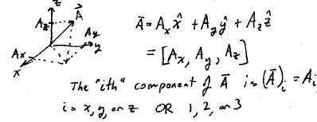
Vectors. Have a magnitude and a direction, but no location.
A vector is uniquely determined by its 3 components
An ordinary number, scalar
Any three quantities that transform like the components of the position vector under rotations, reflections, and inversion of the coordinate system is a vector.

Slide 4
How does r = (x,y,z) transform under inversion?
Under reflection in the yz plane?
(Rotations will be considered later.)
Is (x², y, z) a vector?

Slide 5
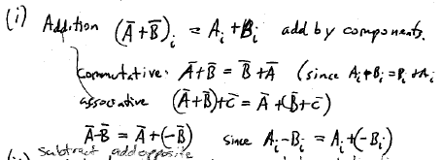
Vector operations
Subtracting B from A is the same as adding the opposite of B to A

Slide 6

(ii) Multiplication. Changes magnitude, but not direction of a vector

Slide 7
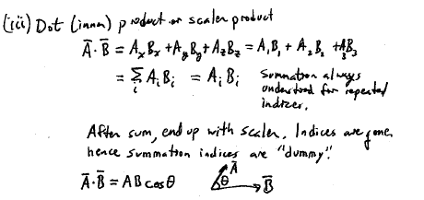

Slide 8
If r = (x,y,z), what is r_{i}r_{i}?
What about r_{m}r_{m}?
What is r₁r₃?

Slide 9
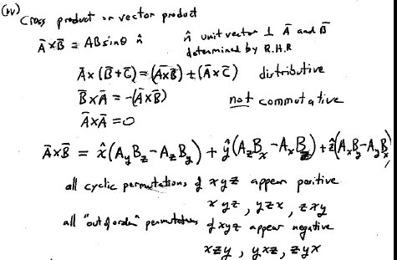
Memorize this and stop using the Determinant method!

Slide 10
What is (A x B)_{y}?

Slide 11
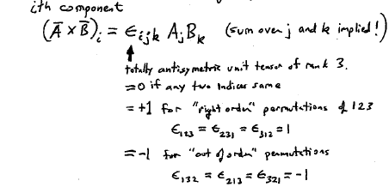
(A general component a vector, whichever you want)

Slide 12
What are
ε₃₁₂?
ε₃₂₁?
ε₃₂₂?
A_{i} ε_{32i}?

Slide 13
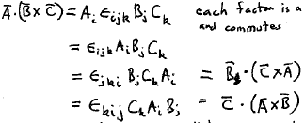
Scalar Triple Product
Each factor is a scalar and commutes
= the volume of a parallelepiped generated by vectors A, B, C.

Slide 14
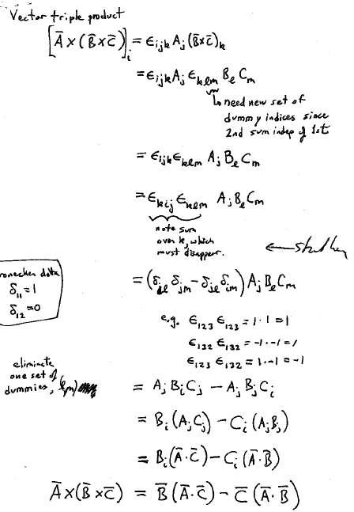
Vector triple product
Dummy index k will disappear after sum
Use Kronecker delta to eliminate one set of dummies: l,m

Slide 15
Any vector identity takes half a page of algebra using the eijk method.
No need for tables or memorization.
Derive them every time.
Learn it!

Slide 16
The position vector defines a point in space.
An infinitesimal displacement is given by
P
r
O

Slide 17
A separation vector between two points is
Source point
Field point

Slide 18
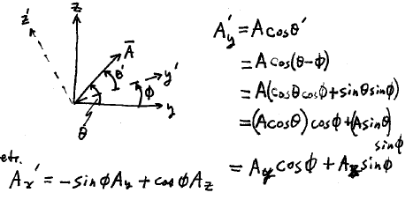
The location of the origin is up to you.
The orientation of the coordinates is also up to you.
How does a vector transform when the coordinates are rotated?

Slide 19
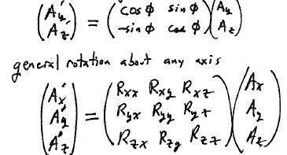
Now write the transformation using linear algebra
Rotation in the yz plane
A vector is transformed by means of a rotation matrix, which is a collection of numbers enumerated by two indices.

Slide 20
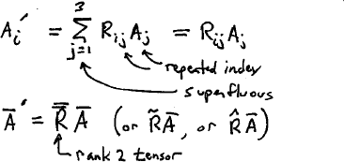
If three quantities comprise a vector, they must transform under rotations by this rule, with the same matrix as for the position vector

Slide 21
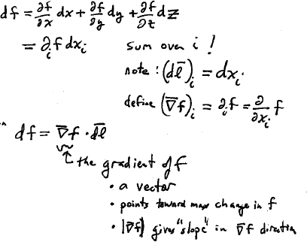
Let f(x,y,z) be some function of the coordinates.
How does f change when we move to a nearby position?
This is just the chain rule!
Then
“Uphill”

Slide 22
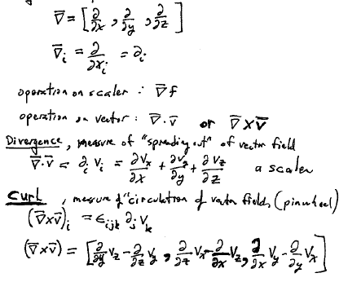
Gradient operator

Slide 23
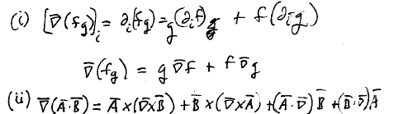
Product rules

Slide 24
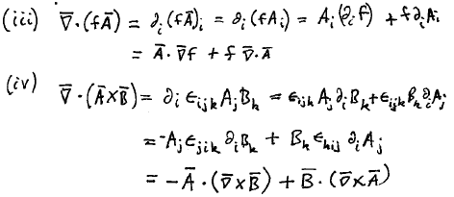
More product rules

Slide 25
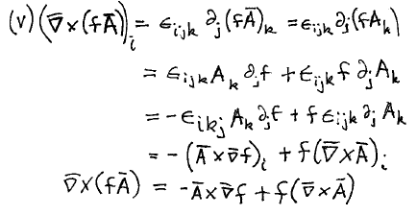
Yet another product rule

Slide 26
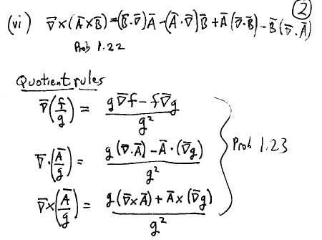
Last product rule

Slide 27
Quotient rules

Slide 28
What are the three types of useful first derivatives?

Slide 29
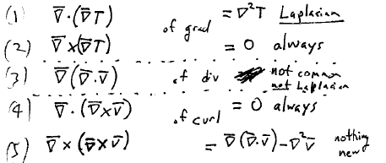
The three useful first derivatives were grad, div, & curl.
What about second derivatives?
Five possibilities.
The Laplacian operator is the most important second derivative.

Slide 30
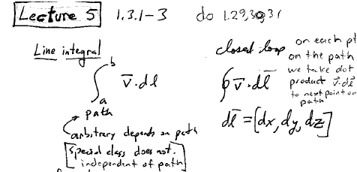
There are three types of integrals in 3D space.
Line integral
At each point on the path, evaluate the dot product v.dl, where dl = (dx, dy, dz) is the displacement to the next point on the path.
Generally, the line integral depends on the path taken between end points, but in some very important special cases it doesn’t.
Closed loop

Slide 31
Give an example from classical mechanics of a line integral that does not depend on the path taken.

Slide 32
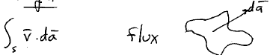
Surface integral
Generally, the integral depends on the surface. For some important special cases it does not.

Slide 33
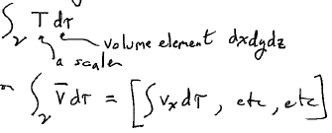
Volume integral
Of a scalar
Of a vector

Slide 34
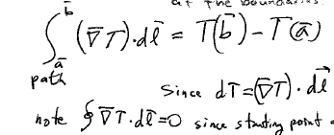
Gradient Theorem
The integral of a total differential is given by the value of the function at the end points, independent of the path
by chain rule
Since starting and ending points are the same.

Slide 35
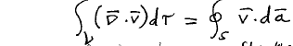
Divergence Theorem (Gauss’s Theorem)
= flux of v through the surface S that bounds the volume v

Slide 36
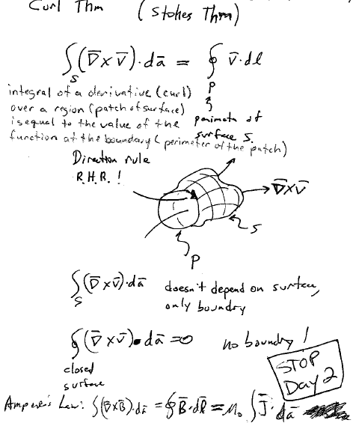
Curl Theorem (Stokes Theorem)
P
Perimeter of surface S
A “sock”
Direction rule:
Right hand rule
Closed
surface

Slide 37
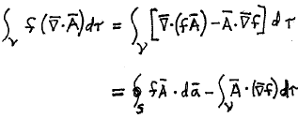
Integration by parts
Generally turns one integral into two. Useful when one of the integrals vanishes.
Example
By product rule #5
By div theorem
If v is all space, then S is at infinity, and then the surface integral will usually vanish.

Slide 38
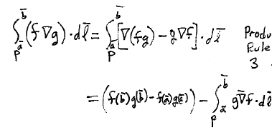
Another example of integration by parts
Product rule
Grad theorem

Slide 39
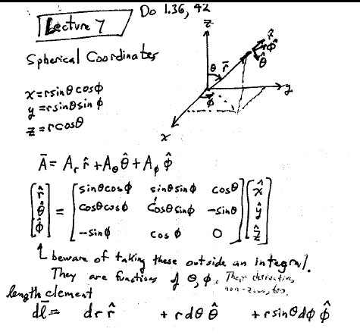
Spherical
Coordinates
Beware: These unit vectors are functions of θ and φ!

Slide 40
Length element in spherical coordinates.
Draw a line element in each of the directions in spherical coordinates.

Slide 41
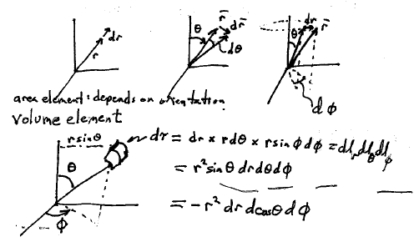
Expression of an area element depends on its orientation.
Vertical plane: dr * rdθ = r dr dθ
Horizontal plane:
Plane perpendicular to a radius vector:

Slide 42
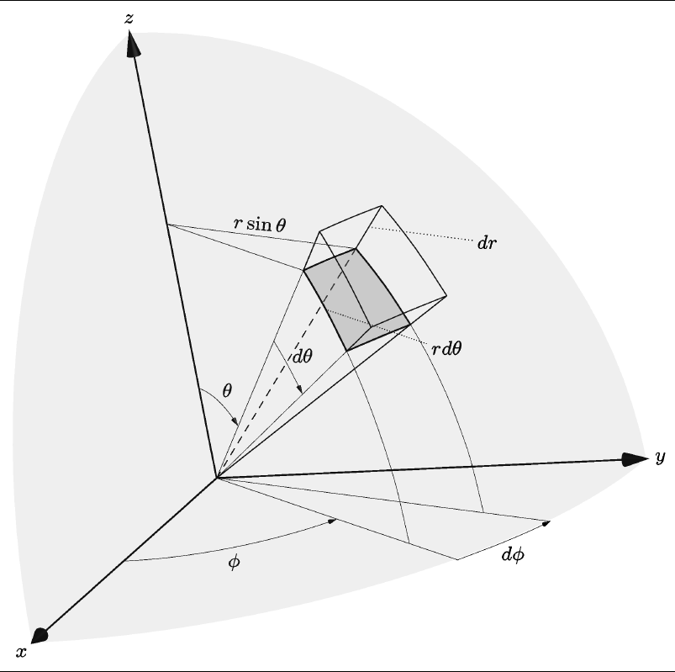
Volume element in spherical coordinates

Slide 43
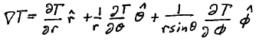
Gradient operator in spherical coordinates
For div, curl, and Laplacian, see front cover

Slide 44
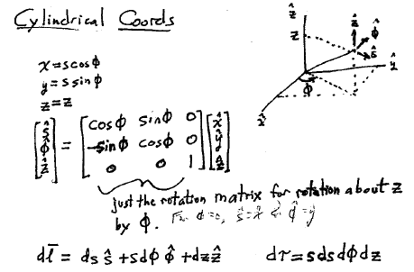

Slide 45
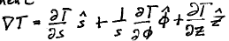
Gradient in cylindrical coordinates
For div, curl, and Laplacian, see front cover

Slide 46
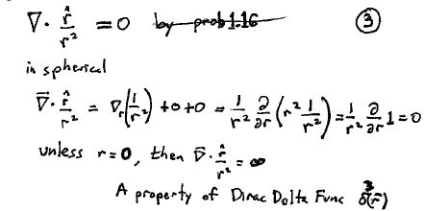

Slide 47
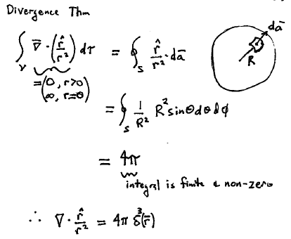

Slide 48
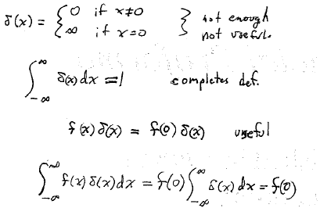
More on the Dirac delta function
Not enough and not useful.
Completes the definition

Slide 49
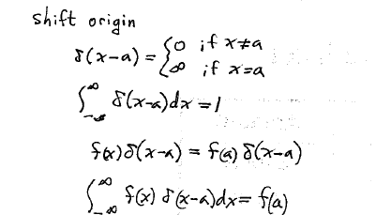
What if we shift the origin of the coordinates?
There are other weird forms of the delta function.
To see what they are, figure out what they do in an integral.

Slide 50
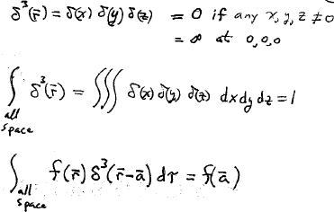
3-D delta function

Slide 51
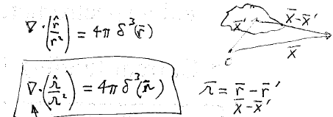
r
r’
r
Derivatives are with respect to x,y,z, not x’,y’,z’

Slide 52
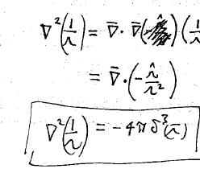
(1/r)

Slide 53
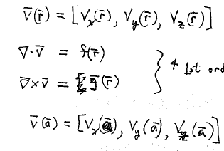
Helmholtz theorem
A vector function is uniquely determined by its div, curl, and boundary conditions
Three unknown functions
Four 1st order partial differential equations
Three boundary conditions

Slide 54
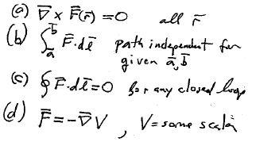
Theorem 1: Irrotational fields

Slide 55
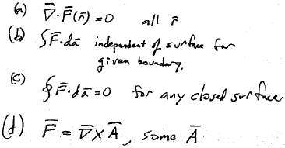
Theorem 2: Solenoidal fields

