Slide 1
E&M I
Griffiths Chapter 2
Electrostatics

Slide 2
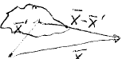
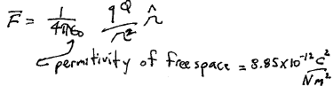
Coulomb’s Law
q
r
r’
Q
r
O

Slide 3
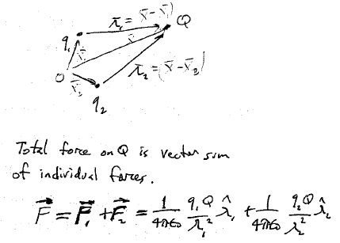
Superposition principle
r1
r
r2
Total force on Q is the vector sum of the individual forces.

Slide 4
Electric field = Force per unit charge: F = Q E
Since, by superposition
Then
Source point
Field point

Slide 5
Continuous charge distribution

Slide 6
Charge might be distributed in 1, 2, or 3 dimensions
For a line of charge
dq = λ dl’
        For a charged surface,
        dq = σ da’
                For a volume charge density
                dq = ρ dτ’
ρ(r’) r dl’
r dl’
^
^
These integrals can be arbitrarily difficult. Need tricks!

Slide 7
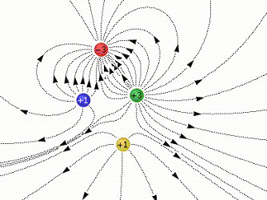
Field lines
Point everywhere in the direction of the local electric field
Originate at positive charge
Terminate at negative charge
Number of field lines is proportional to the charge
Density of field lines is proportional to the electric field magnitude

Slide 8
Flux

Slide 9
Flux through closed surface is proportional to the amount of charge inside
Field lines
Closed surface

Slide 10
Different closed surface
No net flux: All field lines that enter from the left, exit on the right.

Slide 11
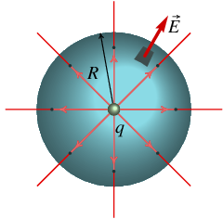
Point charge inside a spherical surface of radius R

Slide 12
Multiple point charges
Gauss’s Law

Slide 13
Divergence theorem
This is a local differential equation that holds at every point in space

Slide 14
A hexagonal array of charge in the xy plane,
Field point at arbitrary position P
Position vector of k-th charge:
r
r - r_{k}
r
r - r_{k}
Note the singularities!

Slide 15
The sum over the y components of this vector will be zero.
What is the electric field if field point P is on the x-axis?
q
Denominator

Slide 16
What does the field tend to at large distances x >> a?

Slide 17
Large distances
At large distances, the charge distribution appears to collapse to a point, so field is that of a point charge.
For higher precision do a Taylor expansion: The Multipole Expansion!

Slide 18
What is the field at the origin, i.e. at the center of this symmetrical charge distribution?
What if we remove one of the charges, how do we find the field at the origin now?

Slide 19
Remove charge 6 from the group. That is the same as adding an equal an opposite charge at that position to “cancel” the original charge.

Slide 20
All space

Slide 21
Derivatives are with respect to components of r, not r’
Gauss’s law in differential form

Slide 22
Electric field of a point charge

Slide 23
Consider any closed path P
Stokes Theorem
Any surface bounded by P
This zero can only hold for any closed path P if everywhere
Pinwheel doesn’t turn

Slide 24
By superposition principle, any arbitrary electric field can be constructed as the sum of the fields of point charges.

Slide 26
We can define a scalar function V that has a unique value at every point, such that
The difference of V at the end points
Then at every point r
Path independence makes V single valued for a given reference point
Some reference point of your choice

Slide 27
The gradient theorem says…
But
The motions caused by electric forces depend on differences in potential at neighboring points, not the value of the potential at a single point.

Slide 28
What is the physical interpretation of electric field?
What is the physical interpretation of electric potential?

Slide 29
Superposition: The potential at a given point is the scalar sum of potentials from individual charges at that point.
gives
It is easier to work with scalar functions.

Slide 30
Gauss’s Law
Laplacian
Poisson’s Equation
Laplace’s Equation

Slide 31
Recipes
To find E
  We need two differential equations
    Div E = ρ/ε₀
    Curl E = 0
  And boundary conditions
To find V
  We need one differential equation (Poisson’s or Laplace’s equation)
  And boundary conditions

Slide 32
Point charge.
The natural reference point is at infinity, where V is set to zero.
Positive charge
Negative charge

Slide 33
If we have a bunch of point charges
If we have a continuous distribution of charge

Slide 34
Our fundamental laws are
  Coulomb’s Law
  Superposition Principle
Their consequences are summarized graphically as

Slide 35
The charge sheet causes a discontinuity in the normal component of the electric field.

Slide 36
A charge sheet causes no discontinuity in the tangential component of electric field.

Slide 37
Combine the two boundary conditions

Slide 38
Follow an infinitesimally short line that crosses a surface, from a to b
As a and b get closer to the surface
(Because fields are finite and so is their discontinuity)
Potential is continuous across a sheet of charge.

Slide 39
Normal derivative of potential at a surface
Discontinuity in normal component of electric field means

Slide 40
Which are continuous across the surface of a conductor?
  Normal component of E.
  Tangential component of E.
  Potential V.

Slide 41
It takes work to move a charge in an external electric field E.
Q
a
A potential difference is the work required to move a unit charge from a to b

Slide 42
What if we bring a charge from infinity to the point r?
We usually set infinity as our reference point with V= 0 there.
Then
is the potential energy of a charge at position r.

Slide 43
What if we assemble a bunch of charges by bringing them in from infinity, one at a time?
The first charge costs nothing.
The second charge costs energy due to the field of the first.
The third charge is moved in the field of the first two.
The total work to assemble three charges is the sum of the three parts, which can be positive or negative.

Slide 44
The work required to assemble any number of charges is
Prevents double counting of the same pairs.
Now we count each pair twice
Potential V(r_{i}) at r_{i} due to all the charges except the i^{th}.

Slide 45
What is the work required to assemble a continuous distribution of charge?
Potential due to all the charge in the distribution including the amount within dτ.
(This will lead to a puzzle!)
We can rewrite this same energy in terms of the electric field using

Slide 46
Integration by parts
Divergence theorem
Far from ρ, these terms go as
This volume must include all the charge.
As we make the volume bigger, the integral increases because E² > 0.
As we enlarge the integration volume, the first integral decreases as 1/r

Slide 47
Enlarge the integration volume to include all space. The surface integral vanishes.
All space
The work required to assemble the charge distribution is stored as potential energy in the resulting electric field.
This is always positive, but that wasn’t obvious from our first expression for W in terms of q and V.
u =
Field energy per unit volume

Slide 48
For point charges
This seems like it could be positive or negative, but it should be the same positive thing as when expressed in terms of E!
A difference is that V(r_{i}) in this discrete sum does not include the contribution from q_{i}.

Slide 49
Suppose we have two charge distributions, each giving rise to its own field at every point.
The electric field obeys the superposition principle, but the energy W does not.

Slide 50
The electrostatic electric field inside a conductor is zero.
  A non-zero field would cause current.
  Then there would be dissipation of energy.
  Then the state of the conductor would not be stationary.
Turn on E₀
This is not a stationary state
When an equilibrium stationary state is established, induced charges screen the interior, where the total field is E₀ + E_{i} = 0.

Slide 51
Any excess charges in a conductor must reside at the surface.
  Otherwise there would be non-zero field inside.
  Charges on the surface are distributed so that E = 0 inside.
Entire conductor is an equipotential
Stationary-state electric-field is perpendicular to the surface just outside.
Otherwise a parallel component would cause a surface current.

Slide 52
A neutral conductor with no extraneous charge plus cavity with a point charge q
There must be an induced charge –q on the inner cavity surface.
There must also be an induced charge +q on the outer surface

Slide 53
The distribution of the charge on the outer surface does not depend on the location of the cavity
If the conductor has spherical shape,
External electric field is
If the cavity is empty, E = 0 inside it:
Inner surface is an equipotential, so line integral of E-field across the cavity has to be zero.

Slide 54
How would we protect an experiment from external electric fields?

Slide 55
Suppose we add some extraneous charge to a conductor (e.g. by rubbing a cat on it.)
All extraneous charge resides on the surface.

Slide 56
The existence of an electric field on the outer surface of a conductor, but not on the inner, creates a force on the surface.
The derivation of this force in chapter 2 is awkward. A simpler proof is based on the Maxwell stress tensor, which we will learn later.
Force per unit area =
This is a outward electrostatic pressure. Doesn’t depend on the sign of the charge.

Slide 57
The magnitude of the electrostatic pressure on a conductor equals the energy density of the field.

Slide 58
Suppose two oppositely charged conductors.
High potential
Low potential

Slide 60
What would we do if the two conductors’ charges were not equal and opposite?
What if they had the same sign?
What if there were three or more conductors?
What if there is only one conductor? Does it have capacitance?

Slide 61
Work is required to add charge onto a capacitor that already has some charge
Additional charge
Potential from the charge that is already there

Slide 62
To find the potential in regions where there is no charge, us Laplace’s equation
Can there be a minimum or maximum of V at any point in the vacuum of space between any configuration of charged conductors?
In other words, can we make a static trap for electrons?

Slide 63
Two constants determined by boundary conditions

