Slide 1
Electricity &Magnetism I
Griffiths Chapter 4

Slide 2
Insulators = Dielectrics
Intrinsic charges are bound and cannot flow.
Extraneous charges can stick but also cannot flow.
Atoms in the dielectric can be polarized.
The atom develops a dipole moment:
Atomic polarizability
*
Units:

Slide 3
Atoms have spherical symmetry
For molecules there are different types of symmetry:
The 32 point-groups. Each is a group of symmetry operations.
The size and direction of an induced molecule depends on its orientation with respect to an external field:
The induced dipole moment of a molecule does not have to be in the same direction as the inducing field.
Polarizability tensor
i^{th} component of the dipole moment depends on all the components of the electric field.

Slide 4
Some molecules (hetero-polar) have a permanent dipole moment, e.g. H₂0, CO, HF
Such molecules experience a torque in an external E-field, which tends to align their dipole moment with the external field.
Put the origin at the center of the dipole

Slide 5
If the field is uniform, the net force on the dipole is zero (though the torque is generally non-zero).
E_{i}
E_{i}
If the field is non-uniform, the force is nonzero.
The change in the field in the direction of the dipole

Slide 6
If we put the origin at some other point, there is a torque about that point due to field non-uniformities

Slide 7
An insulator comprises a collection of polarizable atoms and maybe polar molecules
An external applied electric field induces atomic dipoles and aligns permanent dipoles
Thermal randomization and possible internal fields may oppose the effects of the external field
“Polarization” P of the insulator is defined as dipole moment per unit volume

Slide 8
Potential of a dipole
Potential of a polarized dielectric medium
Dipole moment of a volume element
Integration is with respect to source coordinates so take grad with respect to r’.

Slide 9
Substitute and integrate by parts
Product rule 5
Gauss

Slide 10
These are identified as surface and volume “bound” (intrinsic) charge densities.
See (2.29) and (2.30).

Slide 11
Consider a polarized cylinder
The amount of charge at one end of a dipole
Bound surface charge density of a neutral dielectric

Slide 12
What if we slice the polarized dielectric at an angle?

Slide 14
Total charge =
(intrinsic polarization charge + extraneous charge)
Gauss’s law in differential form
Any and all charge contributes the E-field
Electric displacement or Electric Induction
Gauss’s law in terms of free (extraneous) charge.

Slide 15
Gauss’s law in terms of free (extraneous) charge.
(“Free” charge on a dielectric cannot flow so is not really free.)
This is one scalar equation in 3 unknowns. It’s not enough to determine D.
We can get a second equation from the Curl.
Generally
Zero in electrostatics
But this might not be known

Slide 16
Consider a neutral polarized rod
Electric field lines, sourced by bound charge
Inside
E_{in} depends on L/a
Outside
So D is nonzero everywhere even though there is no free charge.

Slide 17
Boundary conditions

Slide 19
“Linear” dielectrics
Total electric field=the external field that caused the polarization PLUS the field due to the polarization
Electric susceptibility
Permittivity

Slide 20
Relative permittivity
If a homogeneous linear dielectric fills all space
Except for factor ε₀, these are the same differential equations as for E_{vac}. So D = ε E_{vac}
Doesn’t hold if there are inhomogeneities, such as boundaries, where curl ε is nonzero

Slide 21
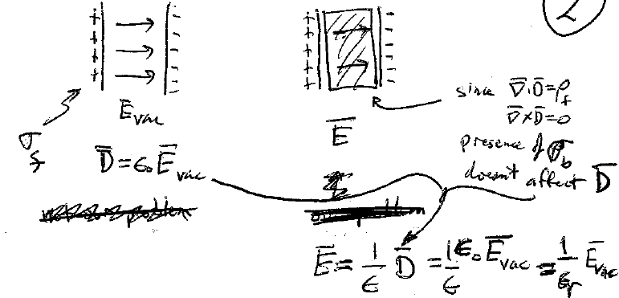
The universe before filling with dielectric
The universe after filling with dielectric
D unaffected by the bound charge due to polarization
Filling the universe with uniform linear dielectric decreases the electric field by factor 1/ε_{r}

Slide 22
Homogeneous linear dielectric
If ρ_{f} = 0 inside the dielectric, and ρ_{b} = 0 because it is homogenous, then ρ_{total} = 0.
inside, i.e. Laplace’s equation holds in homogeneous linear dielectrics, even if they are polarized.

Slide 23
All Chapter 3 tricks for solving Laplace’s equation can be used in homogenous linear dielectrics, except that now the boundary conditions are different.

Slide 24
The potential has no discontinuity at a boundary
Example 4.7: A neutral dielectric sphere placed into a uniform external field
Boundary conditions
0
Original uniform field before the dielectric is inserted

Slide 25
Another boundary condition is that the potential must be finite at the center of the sphere
Solution of Laplace’s equation inside.
Solution of Laplace’s equation outside.
The potential must reduce to uniform-field part at infinity

Slide 26
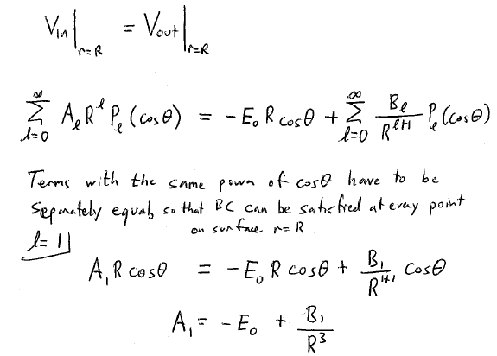
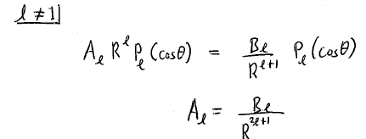
Potential is continuous across surface of sphere

Slide 27
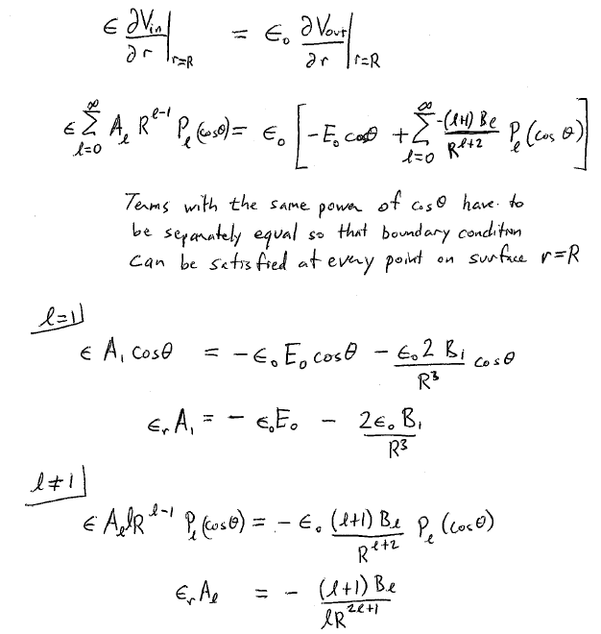
Normal component of D is continuous across boundary

Slide 28
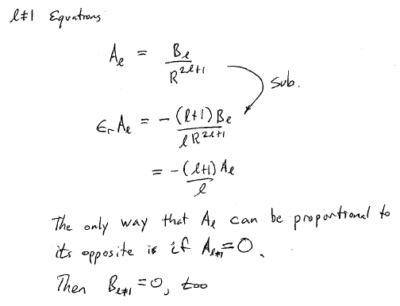

Slide 29
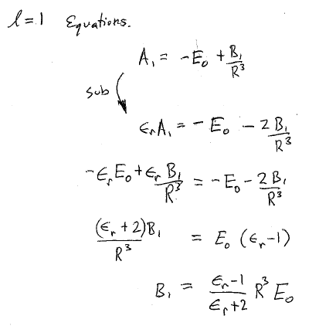
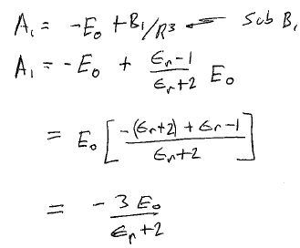

Slide 30
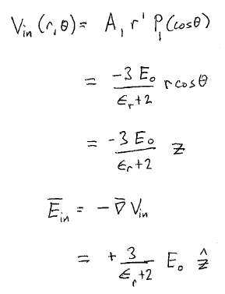

Electric field inside is uniform, is smaller than E₀, and is in the same direction as E₀.

Slide 31
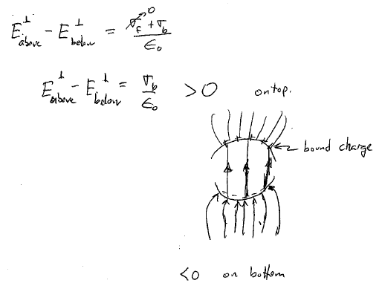
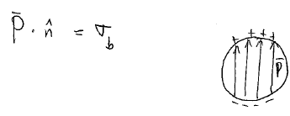

Slide 33
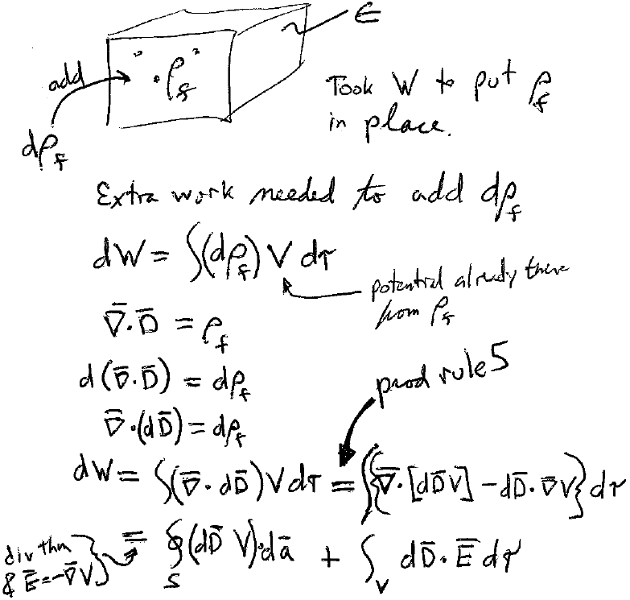

Slide 37
A dielectric slab partly inserted between capacitor plates.
Charge up the capacitor, then disconnect the battery.
That leaves a fixed free charge Q_{f}
Work done to charge the capacitor, which equals the stored potential energy
Pull out the dielectric by a small distance dx. The amount of work done by the external force is

Slide 38
The electrostatic force on the dielectric slab is the opposite of the external force, by Newton’s 3rd law: F = -F_{ext}
The capacitance is the only factor in W that depends on the position of the slab.
W
(w here is the width)

Slide 39
If the battery is not disconnected, then the potential difference V is maintained, and the free charge Q changes when the dielectric is pulled out.
Battery does this amount of work by moving charge to maintain V.
Electrostatic force

