Slide 1
Interactions 3
II.B.
Scattering due to a Coulomb field

Slide 2








































Slide 3































Slide 4
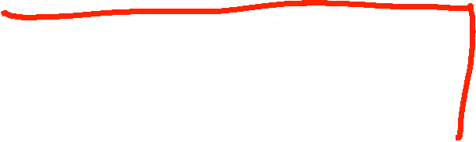






























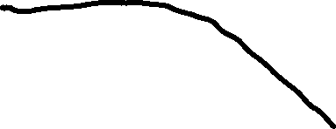














Slide 5






























Slide 6































Slide 7
















































Slide 8















































Slide 9











































Slide 10











































Slide 11

































Slide 12



































Slide 13























Slide 14










































Slide 15

















Slide 16


































