Slide 1
Nuclear Experiences & Opportunities in Nuclear Physics

Slide 3
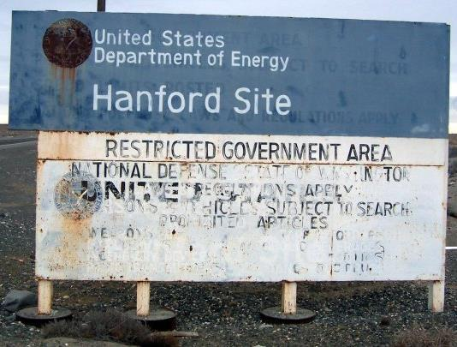

Slide 4
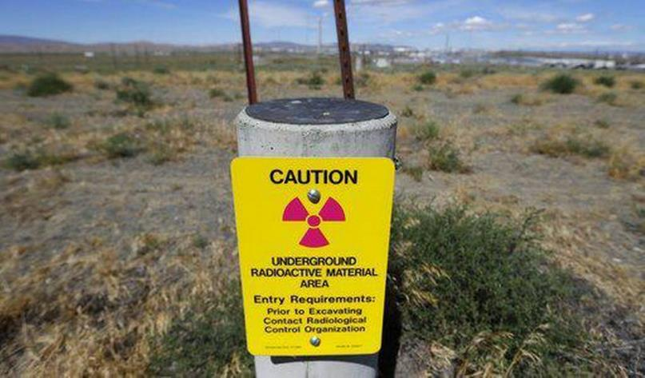

Slide 6
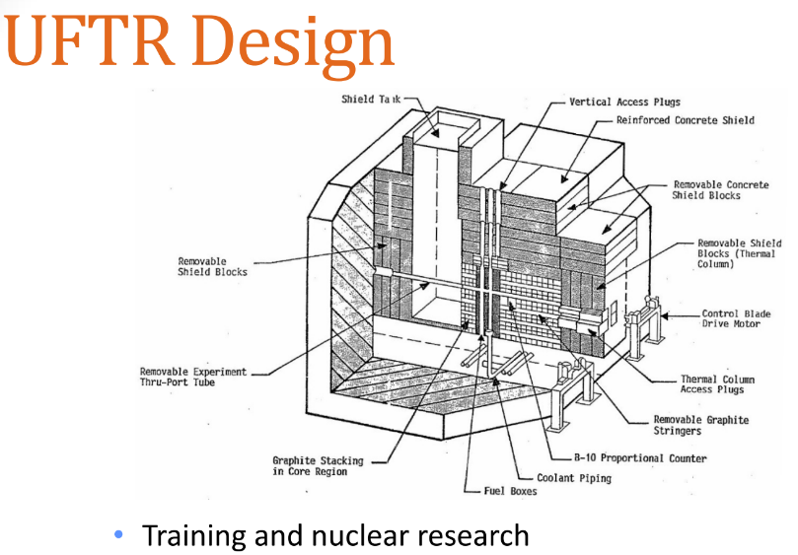





Slide 8
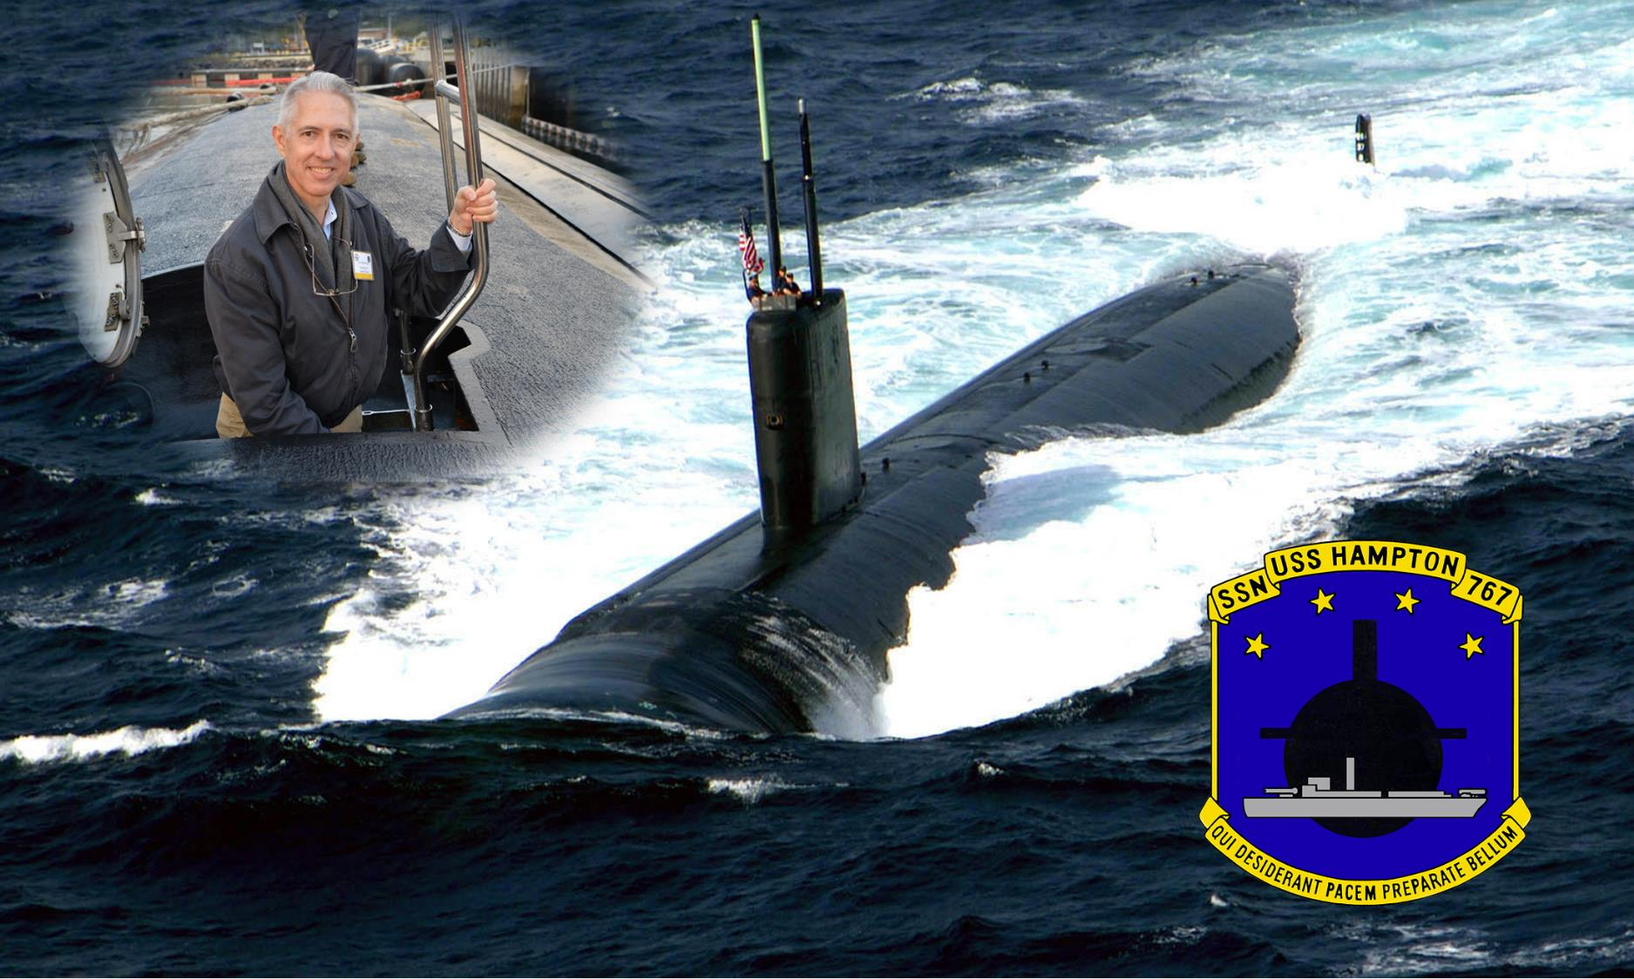

Slide 11
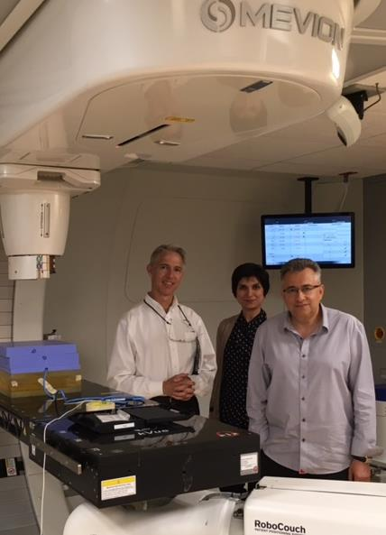
Orlando Health Proton Cyclotron

Slide 12
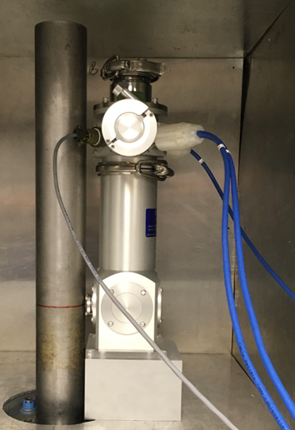
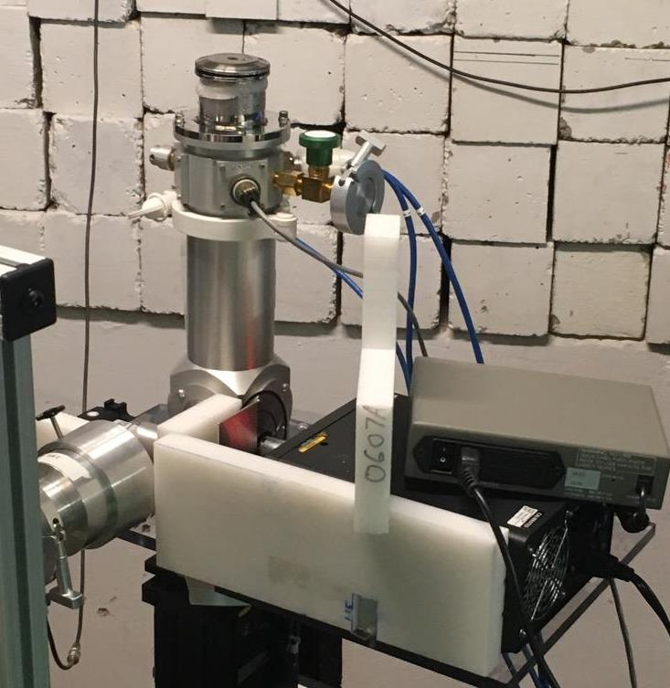
Gamma, Radiation Test Services, Colo Springs
Proton irradiation, Texas A&M cyclotron
⁶⁰Co

Slide 13
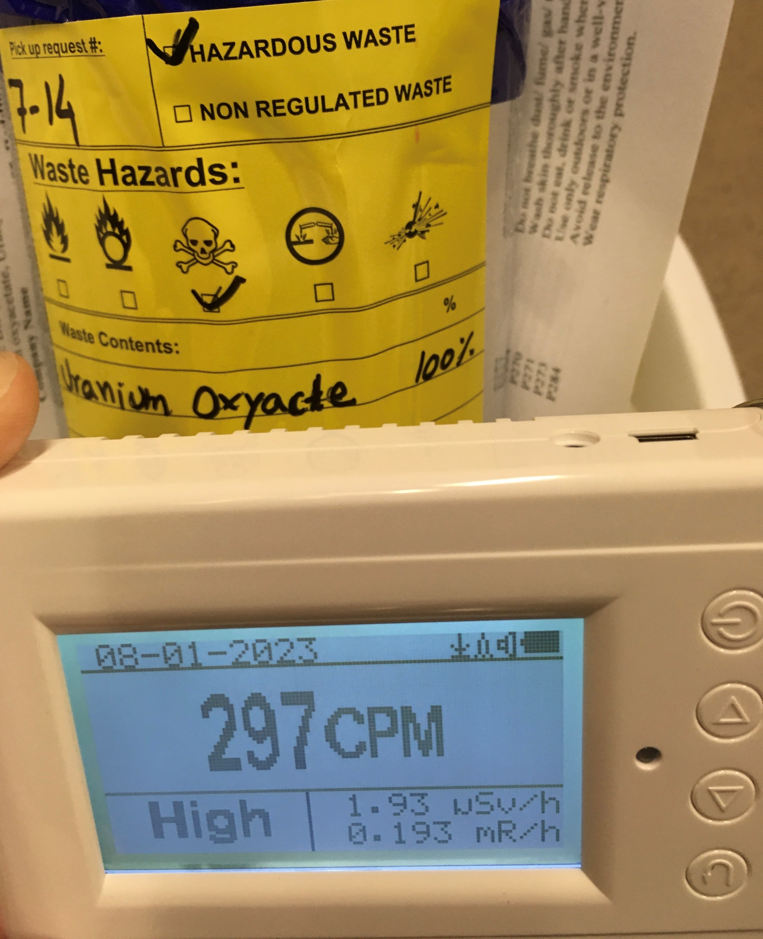
Uranium Oxyacetate
Someone left this in the chemical cabinet of our cleanroom. It’s used is as a negative stain for electron microscopy.
It is acutely toxic and radioactive.
Counts outside the metal can means they are gammas.
Activity reduces to background (20 cpm) a couple feet from the can.

Slide 14
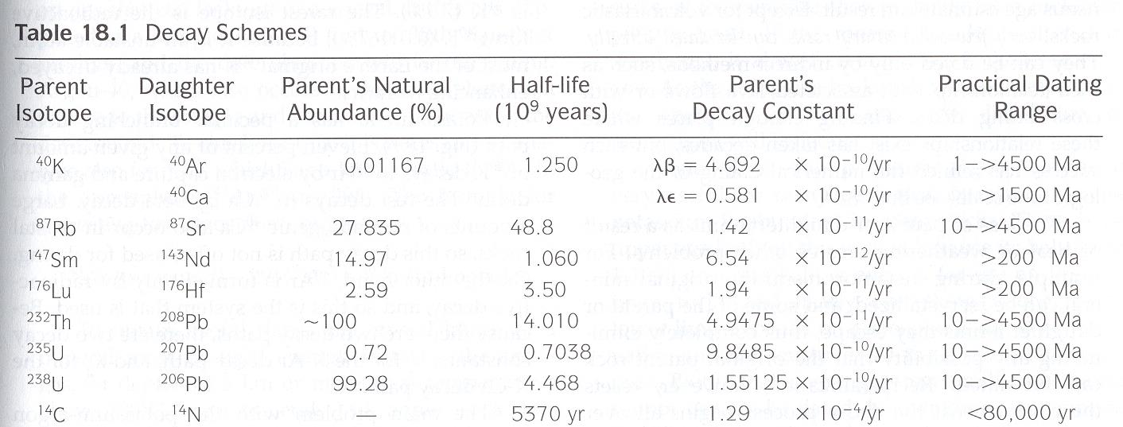
Geochronology Prof. Joe Donahue used gamma spectroscopy for dating horizons in sediment cores from the past couple of centuries. The material producing the gamma emission is sediment particles, mostly clay minerals. The gamma emitters of interest are natural lead-210 and fallout cesium-137, mostly radionuclides that have been adsorbed onto the particles during the transport and deposition process. The gamma spectrometer system was made by Amtek (former Ortec), in Oak Ridge. The detector is a Profile-S Series Coaxial P-type HPGe low-background gamma ray detector, 58 mm dia x 25 mm L (relative efficiency 15%; resolution <650 ev FWHM @ 122 kev). The spectrometer is a DSPEC-LF-POSGE Digital Gamma Ray spec with HV supply and MAESTRO Software.

Slide 15
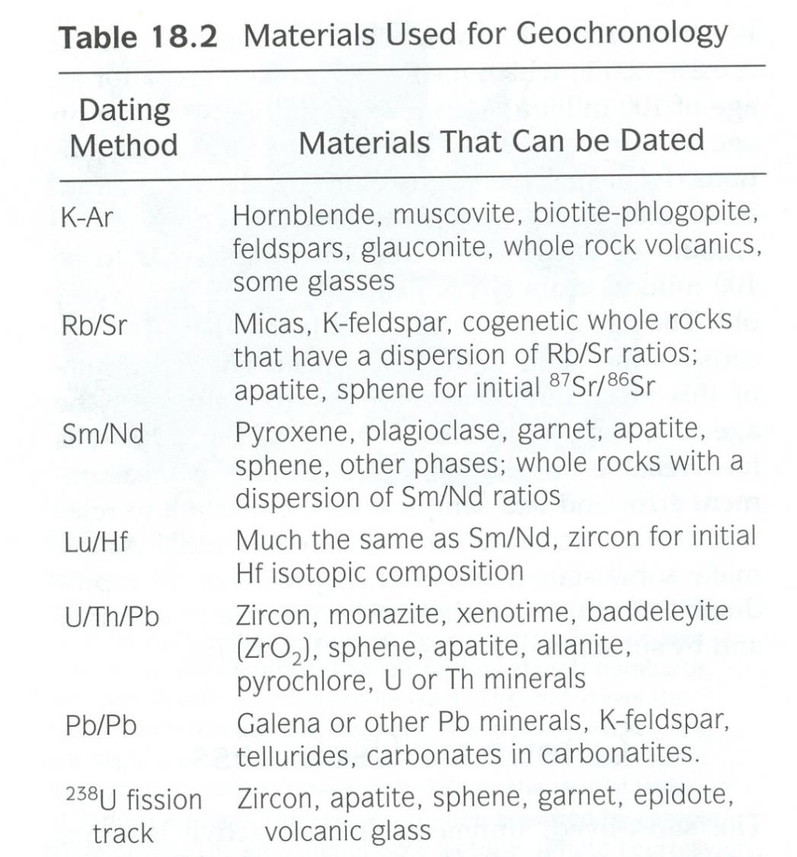
Most of the commonly dated minerals and rocks are igneous or metamorphic

Slide 16
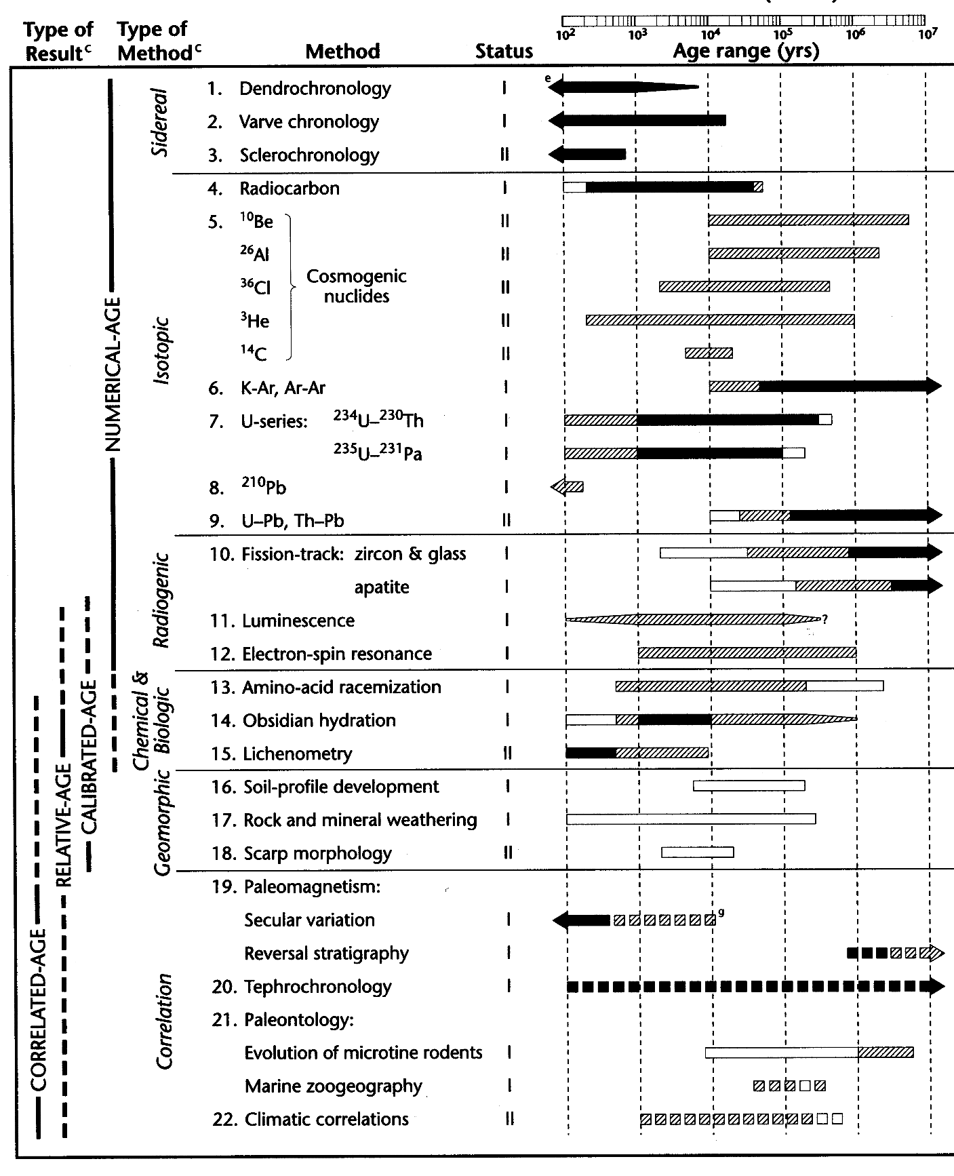
U-Series Dating

Slide 17
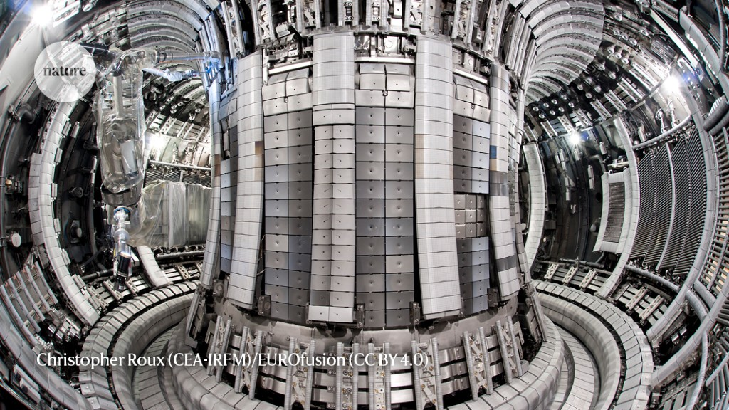
Nature NEWS
09 February 2022
Nuclear-fusion reactor smashes energy record

Slide 18
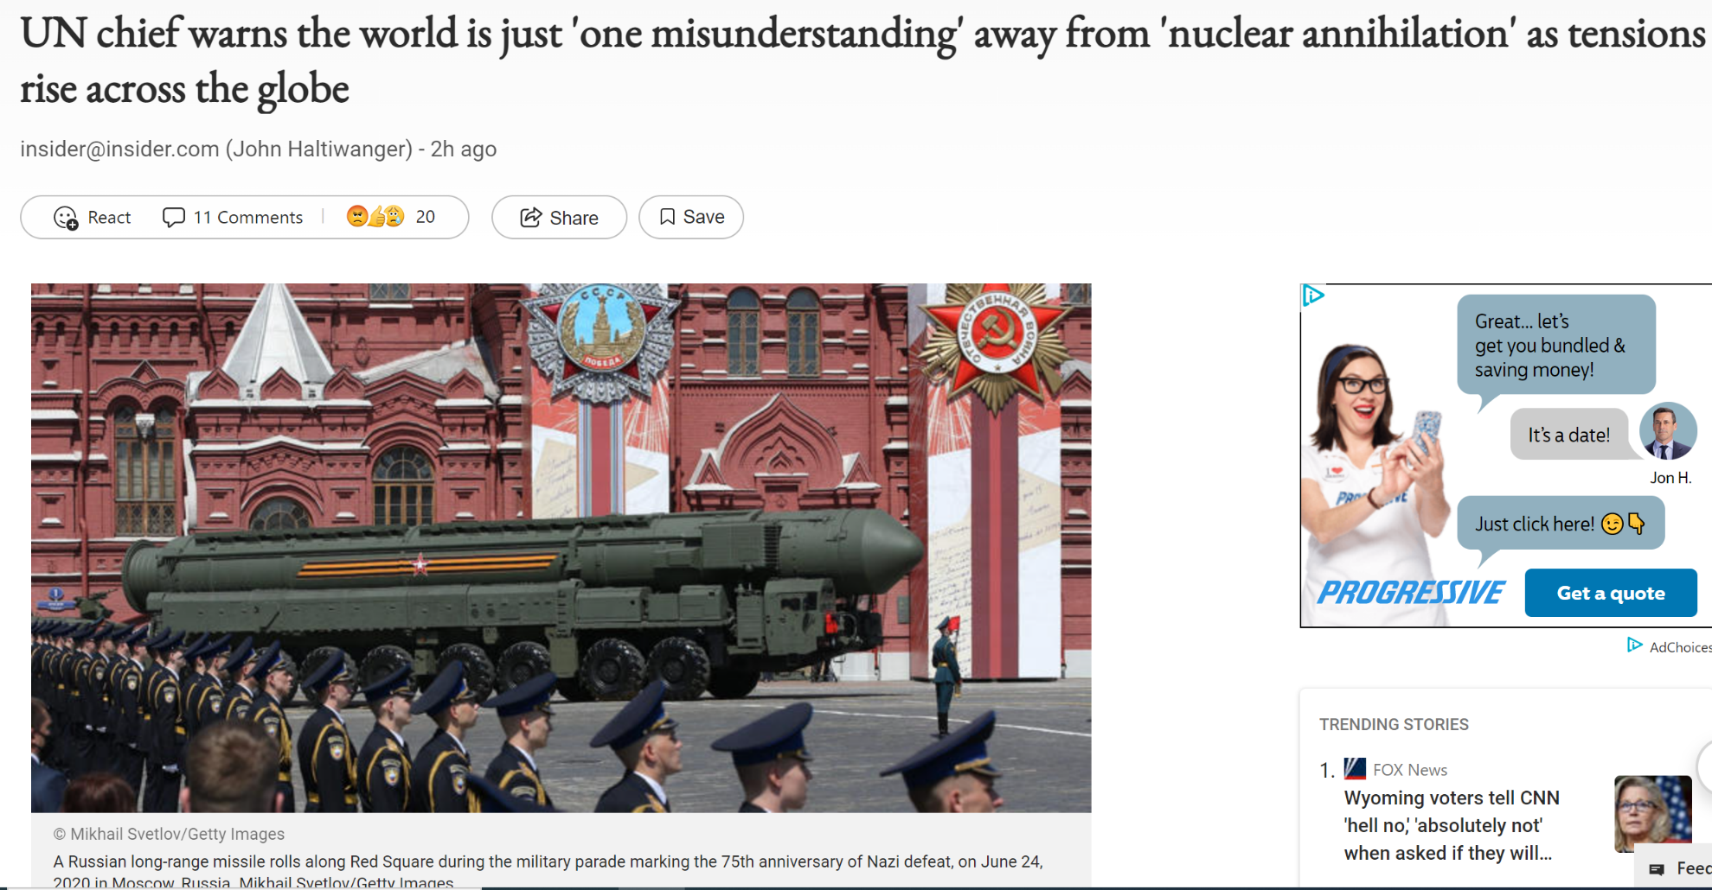
If it happens, who will know what to do?

Slide 19
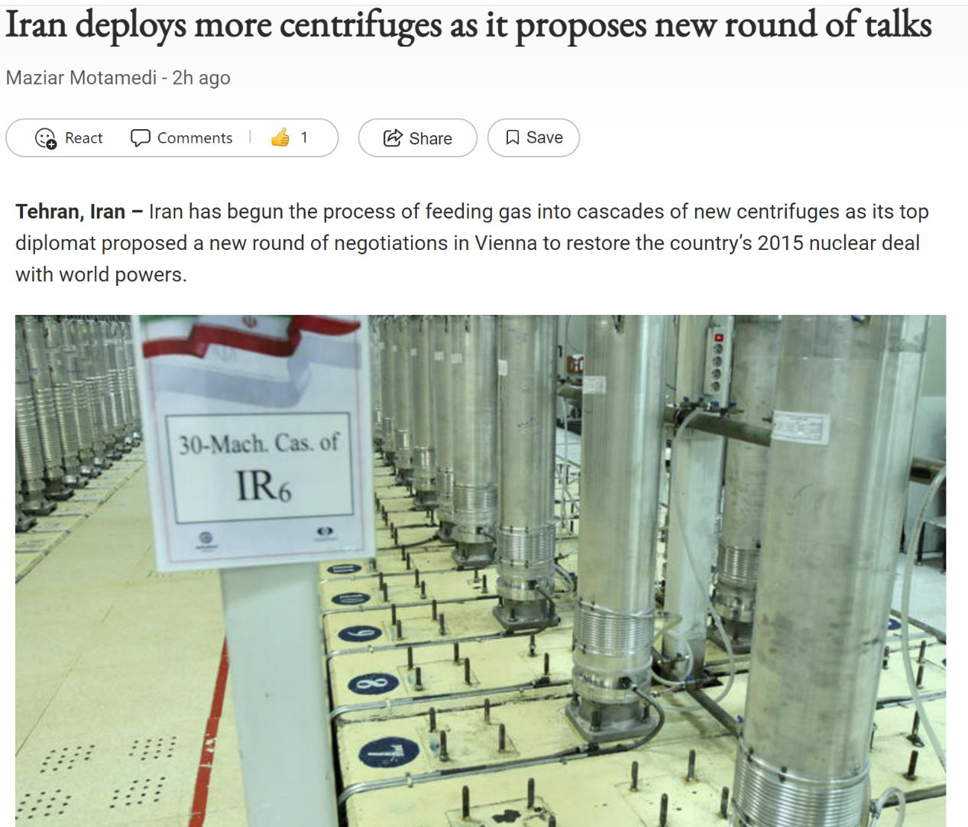
Do you know what these do?

Slide 20
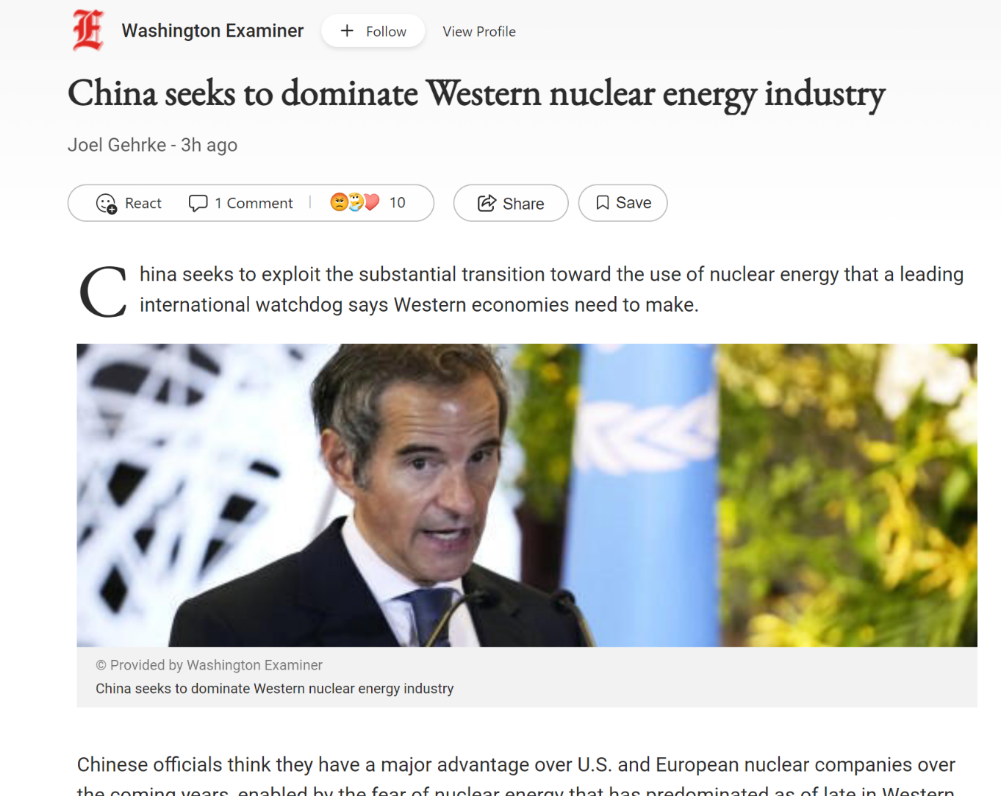
Uh Oh!
WHO in the USA is going to do this?

Slide 21
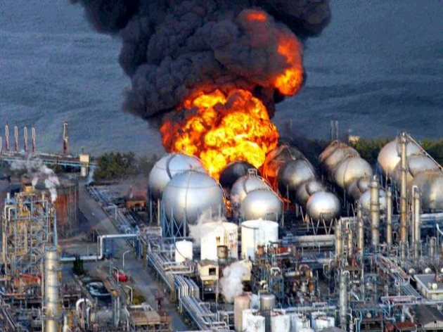
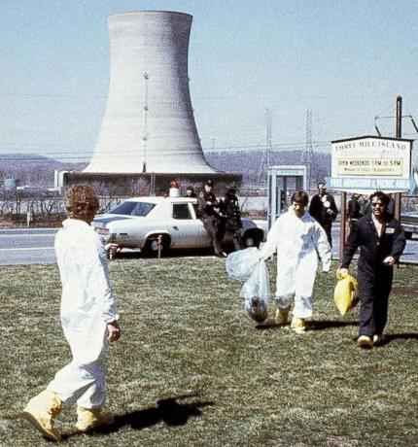
Fukushima. Three Mile Island.
When this happens, who ya gonna call?

Slide 22
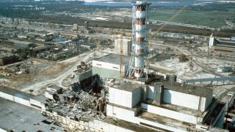
Chernobyl! Yet, nuclear power is not going anywhere.

Slide 23
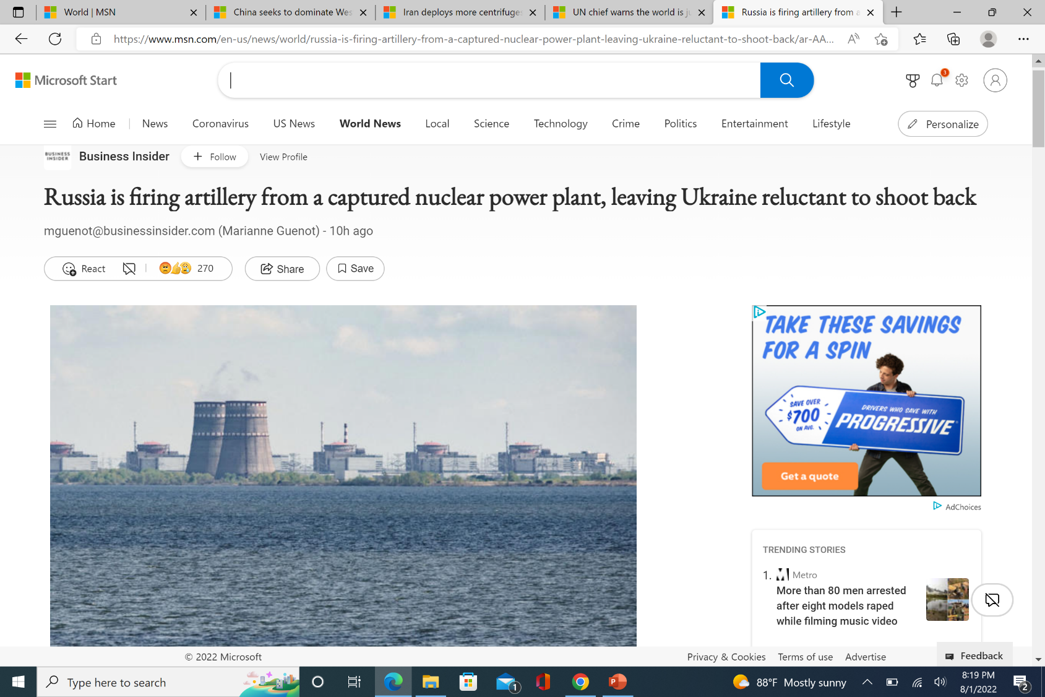

Slide 24
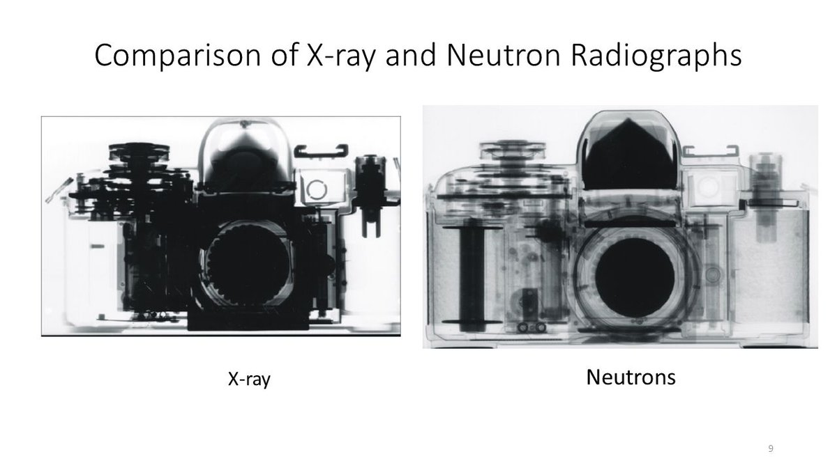
Blocked by heavy elements (metal, bone)
Blocked by light elements (plastic)
How do you get a beam of neutrons? Ask a physicist!

Slide 25
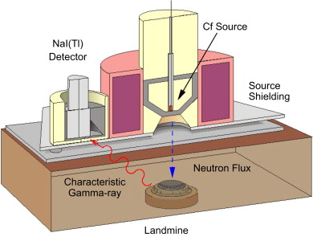

Why is the gamma characteristic of explosives and not of water or dirt or plants?

Slide 26
There are jobs in Nuclear Physics.
Nuclear Physics and Nuclear Techniques are core knowledge.
Who has taught “Classical” Nuclear Physics (not particles, strings, or cosmology) at UCF in the last 32 years?
NOBODY

