Slide 1
Chapter 1. The principle of relativity
Section 1. Velocity of propagation of interaction

Slide 2
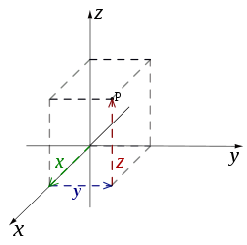

1. To describe processes, we need coordinates and clocks. These define a “system of reference.”

Slide 3
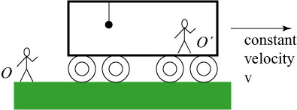


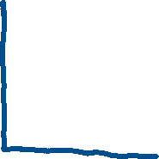


2. If a free body (F_{ext} = 0) moves at constant velocity v in a particular reference system K, then K is an inertial reference system.
K
V

Slide 4
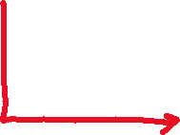


3. If a reference system K’ moves uniformly relative to an inertial reference system K, then K’ is inertial, too.
K’
K
V

Slide 5
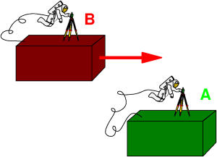





4. Principle of relativity: All laws of nature are identical in all inertial reference systems (experiment!). The equations expressing laws are invariant (same form) under transformation of coordinates and time.

Slide 6
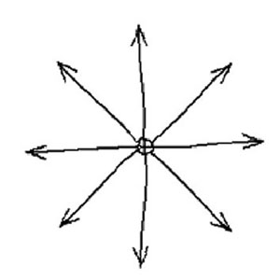







5. Newtonian Mechanics: Interactions are described by potential energy. This assumes instantaneous propagation.
If the source of an electric force moves, a test charge feels it with no delay
Original
force
vector
New
Force vector

Slide 7
Experiment: There always is a delay between when one body changes and the effect of that change on a second body. Velocity of propagation of interactions is the distance between two bodies divided by the delay time before an effect due to the interaction occurs.

Slide 8
7. Velocity of propagation of interactions is finite.
If finite, it must have a maximum value.
A consequence is that motion of particles cannot exceed this maximum.
8. The velocity of propagation of interactions is called the “signal velocity.” When a first particle changes, it sends a signal to a second particle “informing” it of the change.

Slide 9
Signal velocity must be the same in all inertial reference systems by principle of relativity. Equations of physics only have the same form in different reference systems if the signal velocity has the same value.
Signal velocity is a universal constant: c = 2.998 x 10¹⁰ cm/s.
Same as velocity of light in vacuum.
The value of c is so much larger than ordinary velocities of material particles, that classical mechanics is well described by c = infinity.
Explains why assumption of instantaneous interactions works for classical mechanics

Slide 10
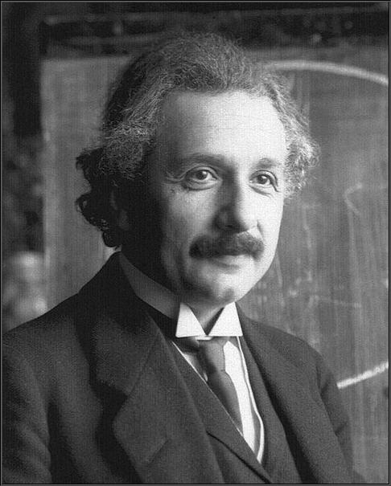
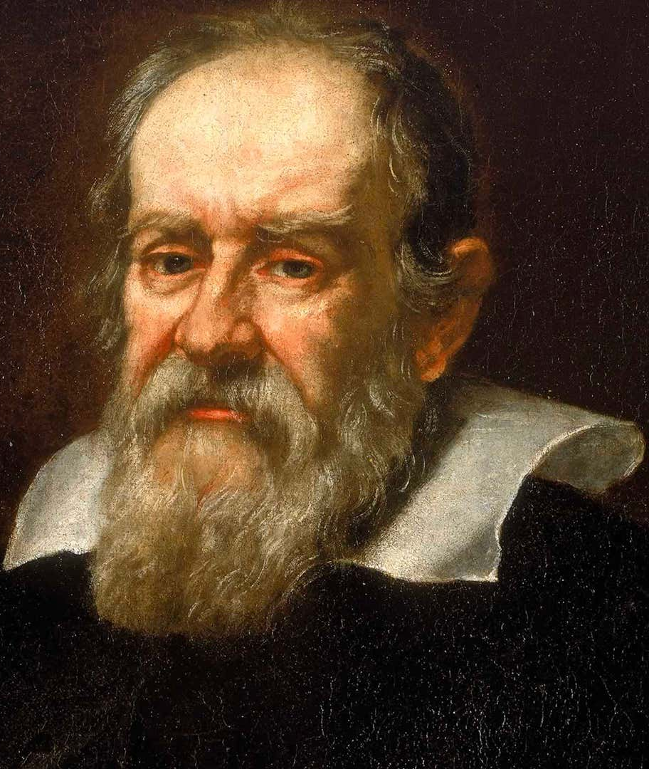

11. Principle of relativity + finite signal velocity = Principle of relativity of Einstein (1905). Gives relativistic mechanics, which has different formulas than classical mechanics.
Contrasts with principal of relativity of Galileo, based on instantaneous interactions

Slide 11
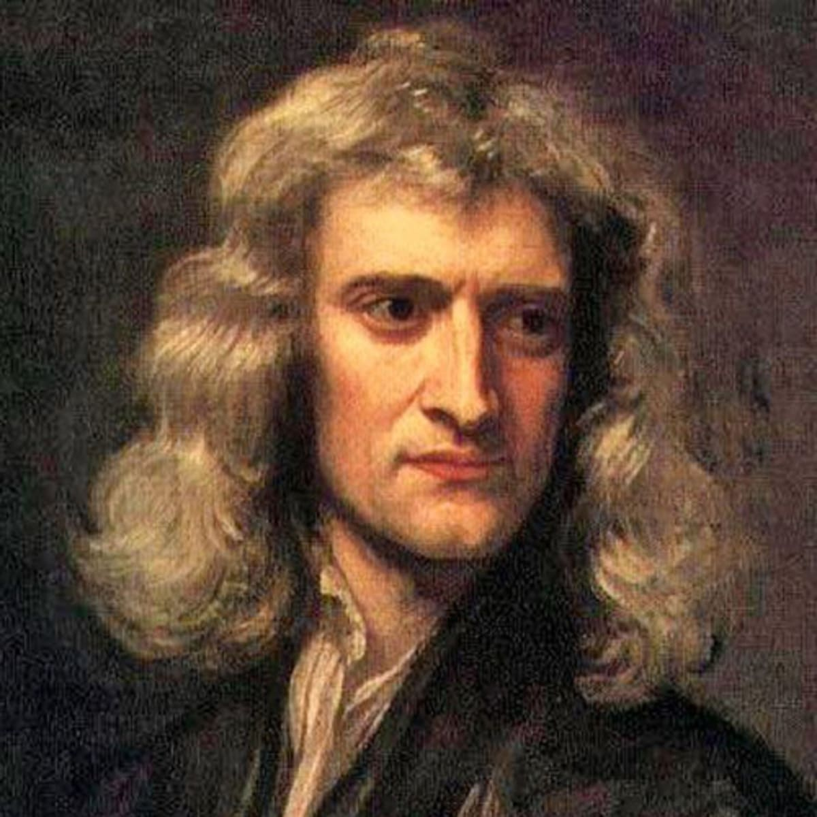

12. The formulas that describe Relativistic Mechanics must revert to the formulas of classical Newtonian mechanics if c is replaced in them by infinity.

Slide 12
13. Distance is already relative in classical mechanics. Spatial relations depend on reference system. Two non-simultaneous events can occur at the same place or at different places depending on the system.
K’
K
V

Slide 13
14. Time is absolute in classical mechanics.
The interval of time between two events is the same in all systems.
If two events are simultaneous for one observer, they are simultaneous for all observers.

Slide 14
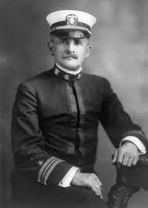
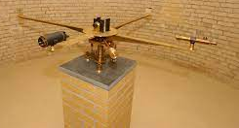
15. Absolute time contradicts Einstein relativity principle.
Velocity of composite motion would be the vector sum of individual velocities.
If applied to propagation of interactions, the signal velocity would depend on the reference system.
This is confirmed by Michelson experiment: No dependence of light velocity on direction of earth’s motion.
1881

Slide 15
16. Time cannot be absolute in relativisitic mechanics.
Events simultaneous in one system K’ will not be in a different system K.
Separation in time between two events depends on the reference frame, which must be specified.
K’
K
V

Slide 16
17. Two inertial reference systems, K’ moves relative to K along X (X’).
Two signals start from A simultaneously.
Both signals travel at c.
They reach points B and C, equidistant from A, simultaneously in K’.
Z’
Z
V
B A C
K’
X’
K
X
Y
Y’

Slide 17
18. The two events, which are simultaneous in K’, are not simultaneous in K.
In K, both signals also travel at c.
But B moves towards source while C moves away.
Signal arrives at B earlier than at C in K system.
Z’
Z
V
B A C
K’
X’
K
X
Y
Y’

Slide 18
Notions of space and time derived from daily experiences are only approximations.
The resulting approximate formulas are accurate only because ordinary velocities are so much smaller than the velocity of light.
Formulas that are accurate for higher velocities found outside ordinary experience are very different.

