Slide 1
Four-potential of a field
LL2 Section 16

Slide 2
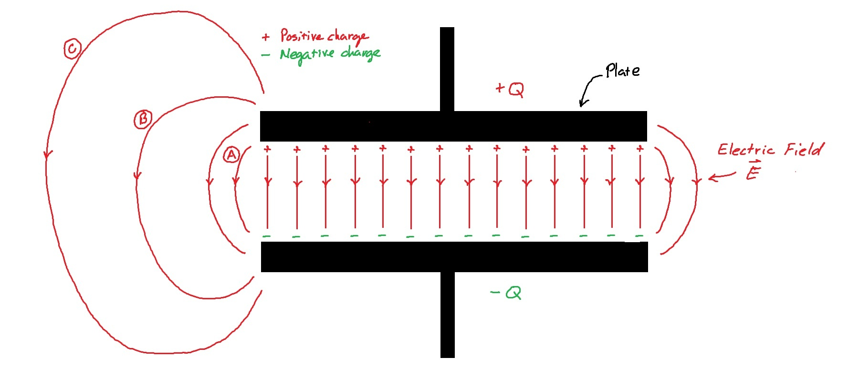
1. For a given field, the action is the sum of two terms
S = S_{m} + S_{mf}
  Free-particle term
  Particle-field interaction term
S_{mf} is determined by properties of the particle and properties of the field.

Slide 3
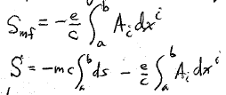
2. By experiment:
  The important property of the particle is its charge e.
  Properties of the field are determined by a 4-vector.
The 4-potential of the field is denoted by A_{i}.
Components of A_{i} are functions of coordinates and time.
The action S must be a scalar.
The action must be an integral along the world line of the particle from event “a” to event “b”.

Slide 4
3. Action function of a charge in a given electromagnetic field is
We will find the Lagrangian from it, and then the generalized momentum of the particle, and the Hamiltonian.
We will apply Hamilton’s principle to this function to obtain the equation of motion in section 17.

Slide 5
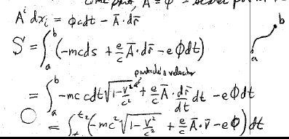
4. The components of the four potential
A^{i} = (φ, A)
  Time part A⁰ = φ = “scalar potential”
  Space part A = 3D “vector potential”
Particle’s velocity
t₁

Slide 6
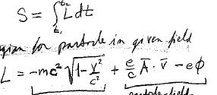
Since
The Lagrangian for a particle in given fields is
Term for interaction of particle with given fields.
Free particle term (8.2)

Slide 7
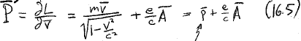
5. Generalized momentum
Ordinary relativistic moment of the particle.

Slide 9
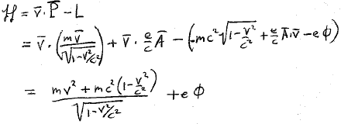

6. Hamiltonian of charges in given fields
Must be expressed in terms of p, not v, to be a proper Hamiltonian
.
Then A will appear.
Total energy ε₀ of a free particle, kinetic + rest energy, in absence of field.

Slide 10
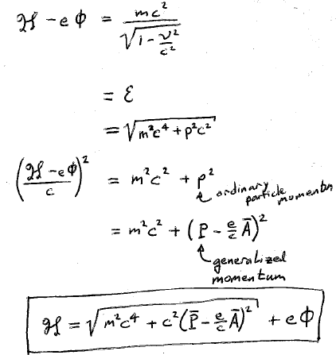
Hamiltonians must be functions of p, not v.
Ordinary particle momentum
Generalized momentum

Slide 11
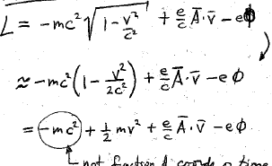
7. Classical Lagrangian for non-relativistic motion of a charge in given fields
Low velocities
Binomial expansion
Constant terms in a Lagrangian do not affect the equations of motion.
Rest energy is unimportant in classical limit.

Slide 12
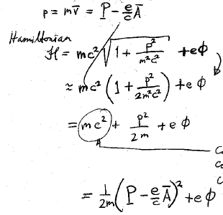
Classical Hamiltonian for non-relativistic motion of a charge in given fields.
Ordinary particle momentum
Hamiltonian
Binomial expansion
Constants don’t affect Hamilton’s equations of motion

Slide 13
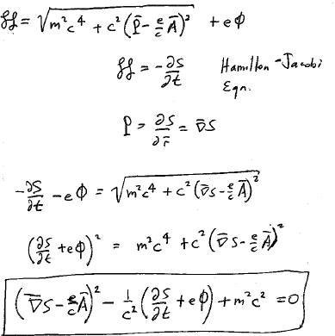
Hamilton-Jacobi Equation
8. Hamilton-Jacobi equation for particle in given fields.
Will be used in Chapter on geometrical optics.

