Slide 1
Equations of motion of a charge in a field
Section 17

Slide 2












1. A charge in a field
The field acts on a charge e
The charge e acts on the field
But if e is small, we can neglect the 2nd effect
Then the field is independent of position and velocity of e.

Slide 3




What is the equation of motion of a small charge in given electromagnetic fields.
Hamilton’s principal: This condition for a minimum determines the Lagrange equation of motion.
r and v are the usual coordinates and velocity of the particle,
But is not the usual particle momentum.
It is the generalized momentum.
There is an extra term due to the A.v in L.

Slide 4
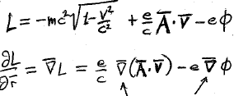


3. Besides the generalized momentum, we need the gradient of L in the equation of motion
This gradient acts on the r dependence of A and φ.
(v is considered an independent variable.)
We need a particular vector identity for the first term

Slide 5
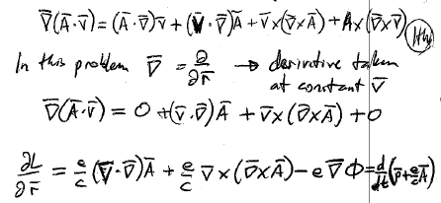






















In this problem
The derivatives are taken at constant v.
Equation of motion for particle in given fields

Slide 6
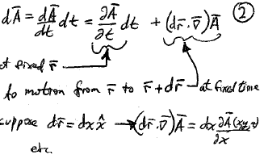



Equation of motion has the total time derivative of A.
The total differential of A is found using the chain rule.
Change of A at fixed r.
Change of A due to motion
from r to r + dr at fixed time.
For example, suppose

Slide 7
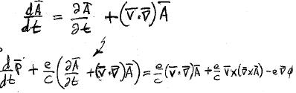
















Divide dA by dt
Sub into the equation of motion:
These two terms cancel.
Equation of motion of charge in given field

Slide 8













4. Equation of motion of charge in given field F = dp/dt
Independent of v.
Proportional and perpendicular to v.
5. Electric field.
6. Magnetic field.
7. E is a polar vector; B is an axial vector (Doesn’t change sign under inversion.)

Slide 9









8. Equation of motion of a charge in a given electromagnetic field is

Slide 10
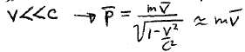

9. Classical Lorentz force law
Low velocities

Slide 11
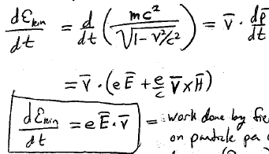







10. Rate of change of (kinetic + rest energy) =dε_{kin}/dt
HW
11. Rate of change of the kinetic energy is the work done by the field on the particle per unit time. During dt, the particle moves dr, and the work done on the particle is eE.dr
12. The magnetic field does no work on the charge since the magnetic part of the force is perpendicular to dr

Slide 12


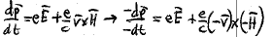




13. Equations of mechanics are invariant with respect to a change in the singe of the time. Time reversal symmetry. If a given trajectory of a particle is a solutions to the equation of motion, the reverse trajectory is also a solution.
14. Relativistic equations of motion in E-M field are unchanged by the transform

Slide 13
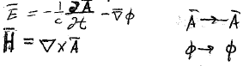


15. The effect of the time-reversal transform on the potentials is

Slide 14

16. If a certain motion is possible in an EM field, the reversed motion is possible in an EM field having H reversed.
Motion in a magnetic field.
H
F
F
X H
Reversed motion with reversed magnetic field
H
F
If you don’t reverse the H-field, the motion is not the reverse.

