Slide 1
Gauge Invariance
Section 18

Slide 2
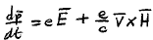
1. For given fields, are the potentials unique?
The field is characterized by its effect on a charge.
Equation of motion involves E and H.
Equation of motion does not involve A and φ.
Therefore, two fields are physically identical if they have the same E and H, even if φ and A are different.

Slide 3



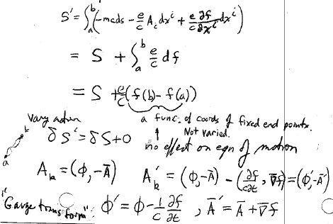












Given A^{k} = (φ,A), E and H are uniquely determined, but given E and H,
A^{k} =(φ,A) is not uniquely determined.
We can add to each component of A_{k}, where f = f(x,y,z,t) is an arbritary function.
Then the transformed 4-potential is
A new term appears in the transformed action:
b
a
This difference is between functions evaluated at fixed end points. End points are not varied when applying Hamilton’s principle to find the equation of motion. No effect on the equation of motion.

Slide 4
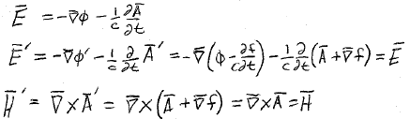




3. The Gauge Transform does not change the fields. Therefore the potentials are not unique.
A is determined only to within the grad of an arbitrary function.
φ is determined only to within the time derivative of the same function.

Slide 5
Trivial case
  Can add arbitrary constant vector to A.
  Can add arbitrary constant to φ.
Because fields E and H involve only derivatives of these potentials.

Slide 6
5. Gauge Invariance
Physical quantities must be invariant under gauge transform.
Equations of physics must be similarly invariant.

Slide 7
6. We may choose f(x,y,z,t) arbitrarily to simplify problems.
It is always possible to choose f so that φ = 0.
It is not generally possible to make A zero, since it is composed of three quantities.

