Slide 1
Constant Electromagnetic Field
Section 19

Slide 2
1. Constant fields are independent of time
If E and H are independent of time, φ and A can be chosen time independent, too.
(But they don’t have to be: We can get constant fields from time dependent potentials by Gauge Transform).
If we choose potentials to be time independent, then
E is determined only by φ, and H by A.

Slide 3
2. If potentials are chosen as constant, the only gauge transformation we can make to φ that doesn’t change E or H is addition of a constant.
The constant cannot depend on t or r.
An extra condition is usually imposed, e.g. φ = 0 at infinity.
Then φ is determined uniquely.

Slide 4
3. We can add an arbitrary constant to A without changing E or H, but we can also add grad(f), where function f(x,y,z) is arbitrary but doesn’t depend on t.
A is not unique even for constant fields.

Slide 5
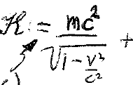
4. If fields are constant, the Lagrangian for a charge in the fields does not depend explicitly on time.
The energy is conserved and equals the Hamiltonian.

Slide 6
5. The constant field adds energy eφ to the particle.
eφ is the “potential” energy of a charge in the field.
The energy does not depend on A, so H does no work on the charge.
Only E changes the energy of a particle.

Slide 7
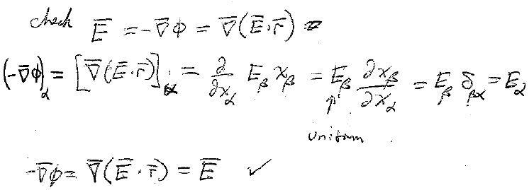
6. Uniform constant fields are the same at all points in space, no r dependence
A uniform constant electric field has scalar potential

Slide 8
A is not unique
Two examples that both give uniform H:
A₁ = (1/2) H x r
A₂ = [-H y, 0, 0]
These two choices differ by grad(f), where f = -xyH/2

Slide 9
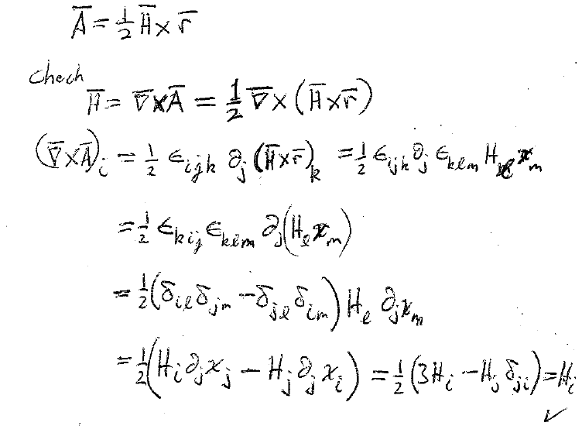
7. A uniform constant magnetic field has a vector potential that is not unique. One possibility is
Let’s see if it works

Slide 10
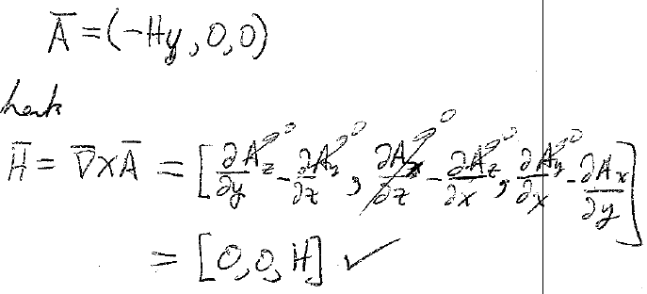
Another possible choice of vector potential for uniform constant magnetic field is
(We chose the z-axis parallel to the H field.)
Now let’s check this one

Slide 11
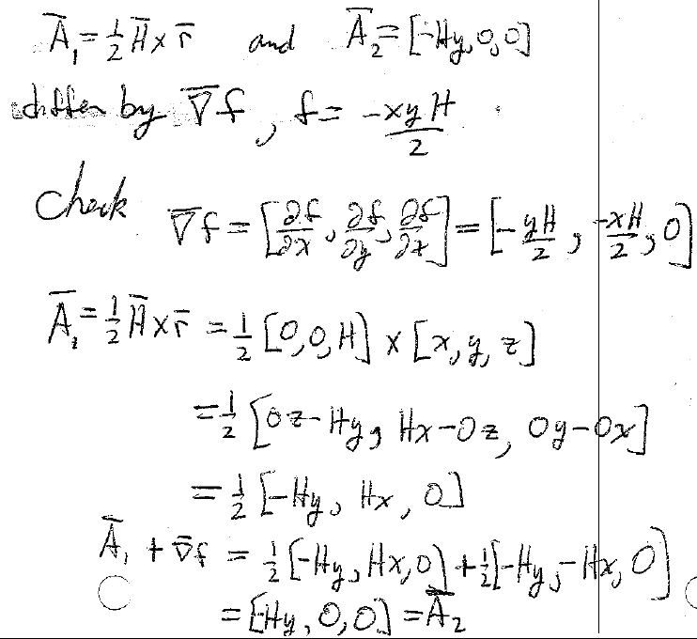
Were two of the possible choices for the vector potential of a uniform constant field
They differed by
Let’s check the difference

