Slide 1
Intervals
LL2 section 2

Slide 2
1. An “EVENT” occurring in a material particle is defined by 3 spatial coordinates of the particle and the time of the occurrence.
The time of occurrence of an event is different in different inertial reference systems, and is not absolute.
To describe an event, the frame of reference must be specified.

Slide 3
2. Events are “WORLD POINTS” in fictitious 4-dimensional space with x,y,z,t axes.
4-space is the set of all world points described by 3 space coordinates and time.
Every particle has a “world line”.
Uniform rectilinear motion has a straight world line.
t
x

Slide 4
3. Invariance of velocity of light can be expressed mathematically in terms of coordinates and times of events as observed in different reference frames.
Consider two reference frames
Z’
Z
V
K’
X’
K
X
Y
Y’

Slide 5
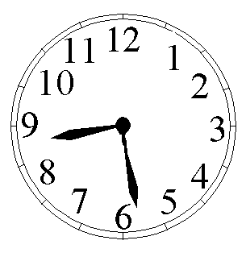

4. Consider two events
As described by an observer in system K
  Event #1: light pulse emitted from (x₁, y₁, z₁) at t₁
  Event #2: light pulse arrives at (x₂,y₂,z₂) at t₂
Z’
Z
V
t
t’
K’
X’
K
X
Y
Y’

Slide 6
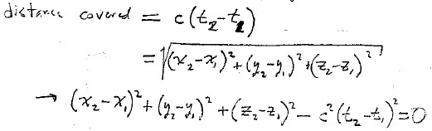
Distance covered

Slide 7
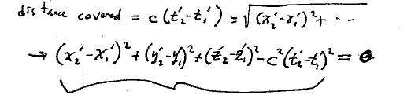

5. The coordinates of the same two events according to an observer in K’ are x₁’, y₁’,z₁’,t₁’ and x₂’, y₂’, z₂’, t₂’.
The propagation speed is the same = c.
Z’
Z
V
t
t’
K’
X’
K
X
Y
Y’
Distance covered in K’
-s’₁₂²

Slide 8
6. Definition of the “interval”
S₁₂ = [c²(t₂-t₁)² – (x₂-x₁)² – (y₂-y₁)² – (z₂-z₁)²]^{1/2}
For coordinates of any two events recorded by an observer in K.

Slide 9
7. The invariance of the propagation velocity means that,

Slide 10

8. Infinitesimal interval (squared):
Means the two events are infinitely close to each other in space and time

Slide 11
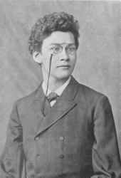
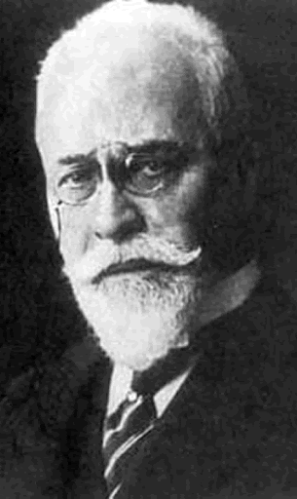
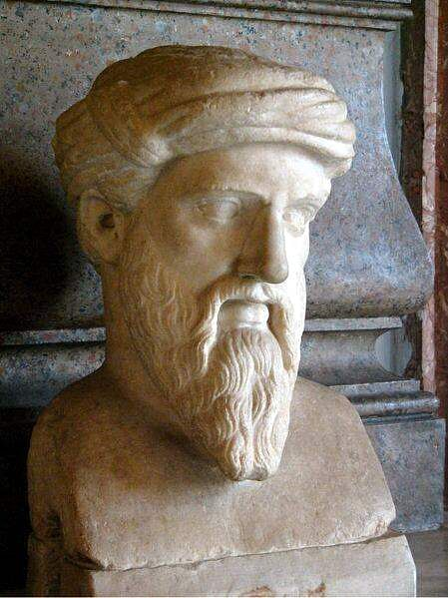
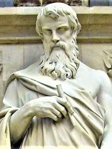
Interval is the “distance” between two points in a fictitious 4D space with axes x, y, z, t.
Fundamental difference with Pythagorean formula from ordinary geometry: Squares of coordinate differences are summed with different signs.
Pseudo-Euclidean, or Minkowski Space.
Pythagoras
Euclid

Slide 12

10. Theorem: The interval between two events is the same in all inertial reference frames.
Even when the interval is non-zero
For any pair of events
This is the mathematical expression of the constancy of c.

Slide 13
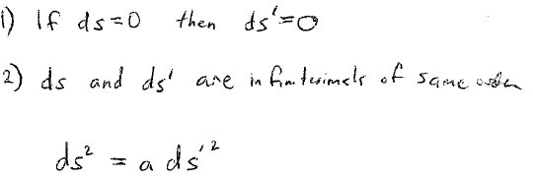
Proof
Since
and
Then
By (2), a cannot depend on dx, dy, dz, dt
a cannot depend on x, y, z, t, or different points in space at different times would not be equivalent, which violates the homogeneity of space and time.
a cannot depend on the direction of V, since that would violate the isotropy of space.
So a = a(V) depends on V, at most.

Slide 14
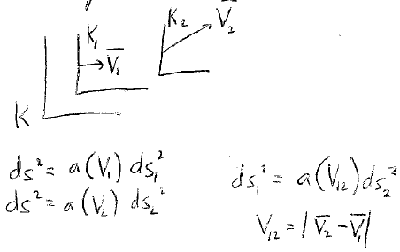
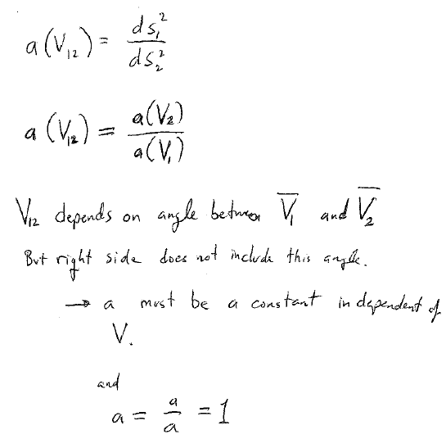
11. Consider 3 reference frames

Slide 15
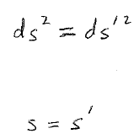
V₁₂ depends on the angle between V₁ and V₂,
But the right side does not include this angle.
a must be a constant, independent of V
And a = a/a = 1.
12. The interval between two events is the same in all inertial systems of reference. It is invariant under transformation from one inertial system to any other.
For infinitesimal intervals
For finite intervals

Slide 16
Consider two events with coordinates x₁y₁z₁t₁ and x₂y₂z₂t₂ in reference system K.
Is there another reference system K’ where the two events are at the same place, i.e. have the same space coordinates?

Slide 17
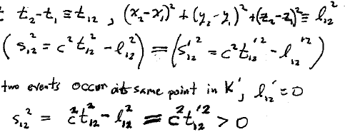
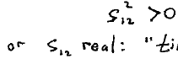
14. Let
then
If two events occur at the same point in K’, then l₁₂’ = 0
The condition for two events to occur at the same point in some reference frame is
“time-like” interval

Slide 18
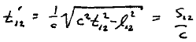
If the interval between two events is time-like, there is a system where they occur at the same place.
The elapsed time between those events in that system is
real
The distance that the body moves between events is l₁₂ < c t₁₂

Slide 19

If events occur in the same body (e.g. heart beats), then the interval is always time-like.
The distance the body moves between events l₁₂ < c t₁₂, because the body cannot move faster than c.
Events: right foot touches ground
l₁₂

Slide 20

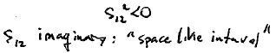

17. Consider two events with coordinates x₁y₁z₁t₁ and x₂y₂z₂t₂ in reference system K.
Is there another reference system K’ where the two events occur at the same time, t₁’ = t₂’?
If two events occur at the same time in K’, then t₁₂’ = 0, and
The condition for two events to occur at the same time in some reference frame is
“Space-like” interval

Slide 21

18. For space like intervals, a reference frame exists where the two events are simultaneous.
Distance between points where events occur at the same time:

Slide 22
19. Because of the invariance of the interval, time-like intervals can never be transformed to space-like and vice versa.
The character of the interval is independent of the reference frame.

Slide 23
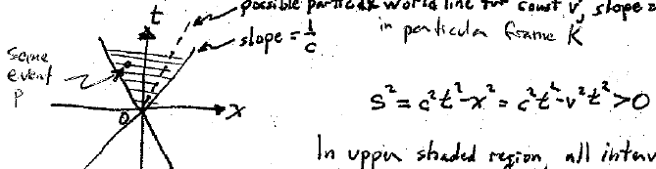
20. Light cone
Possible particle world line for constant v in particular frame K,
Slope = 1/v
Slope = 1/c
Some event P
In upper shaded region, all intervals are time-like
Since t > 0, all events occur “after” the origin.
(The Origin is the “event” that defines x = y = z = t = 0.
P occurs after O

Slide 24
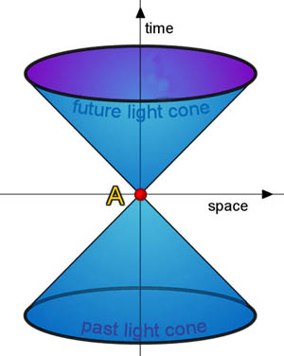
Impossible to find any frame where two events separated by a time-like interval are simultaneous.
Can’t find any frame where event occurs with t < 0.
Can’t make P occur simultaneously or before O
Opposite lower region defines absolute past relative to O.

Slide 25
21. In the regions to the right and left, intervals are space like.
In no reference frame can two events with space-like interval occur in the same place.
Such events are absolutely remote relative to O.
But such events can occur before, after, or simultaneously depending on the frame.
Absolutely separated
Absolutely separated

Slide 26
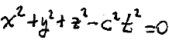
22. 4D “light-cone” surface defined by
The absolute past and future are the interior regions.
23. Only events related by time-like intervals can be related causally
Intervals for real objects are always time-like.

