Slide 1
Motion in a constant uniform electric field
Section 20

Slide 2
Then, the motion of e is confined to the XY plane.
Choose coordinates so that X is parallel to E.
Choose inertial reference frame so that there is no motion of charge e along Z.
Y
E
e
X

Slide 3
To obtain the trajectory…
1. Obtain equation of motion in terms of relativistic momentum.

Slide 4
2. Integrate to obtain momentum vs. time.

Slide 5
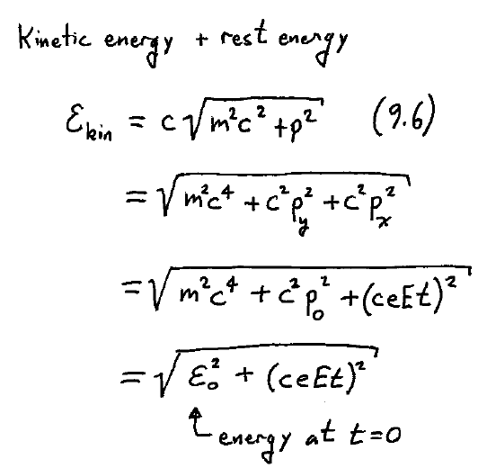
3. Obtain the kinetic energy ε_{kin} as function of time

Slide 6
4. Use equations of relativistic dynamics to obtain differential equation for velocity.
Components of velocity

Slide 7
5. Integrate to obtain coordinates as function of time
Parametric equation x vs. t
Parametric equation y vs t.

Slide 8
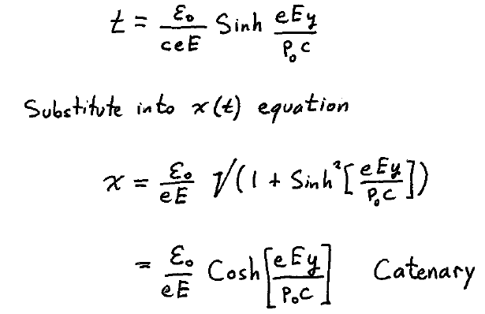
6. Eliminate t to obtain the trajectory: x vs. y
First express t in terms of y
Then substitute into x(t) equation

Slide 9
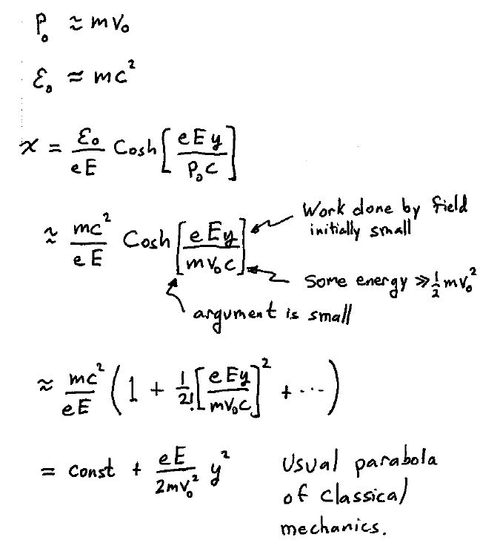
v<<c

Slide 10
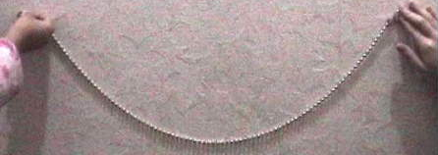
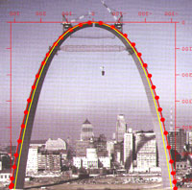
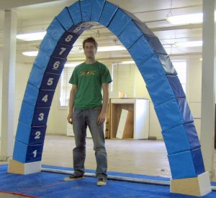
Trajectory is a Catenary

