Slide 1
Motion in a constant uniform magnetic field
Section 21

Slide 2


We want to know the trajectory.
Obtain equation of motion for relativistic momentum

Slide 3
How much work does a magnetic field do on a charged particle?
By how much does a magnetic field change the kinetic energy of a charged particle?

Slide 4


2. Use equations of relativistic dynamics to obtain differential equation for velocity.
Take the time derivative of both sides.
Here we used that ε is constant, since the H-field does no work on the particle.

Slide 5

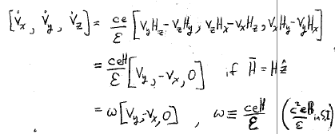


Slide 6


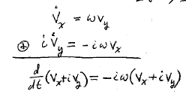


This is the differential equation for v that we want.

Slide 7
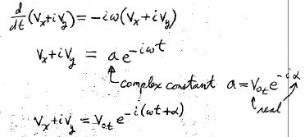


















3. Integrate to obtain velocity vs. time.
Complex constant
real

Slide 8

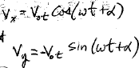





















Real part
Imaginary part
v_{ot} and α are determined by the initial conditions.
α = the initial phase.
= constant

Slide 9
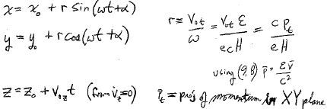


4. Integrate again to obtain coordinates vs. time.
p_{t} = projection of the momentum in the XY plane.

Slide 10
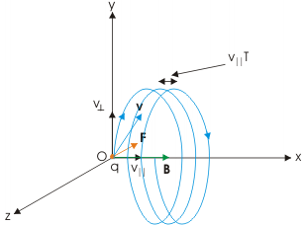





Trajectory is helix with constant speed along z. Angular rotation frequency = ω.

Slide 11
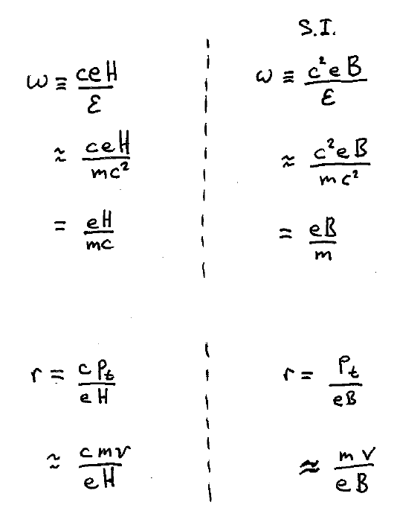
Low velocity v <<c

Slide 12
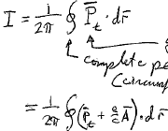


For an H-field that is uniform on the scale of the particle orbit, the change in magnitude and direction is “Adiabatic”.
Orbit changes only slightly during one period.
Adiabatic invariant (Mechanics)
Projection of the generalized momentum in the plane perpendicular to H.
Integrate over the complete period of motion (circumference of a circle.)

Slide 13
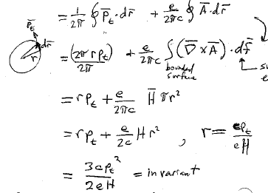





Stokes.
Bounded surface
Surface area element
Invariant
p_{t} varies as √H when H varies

Slide 14
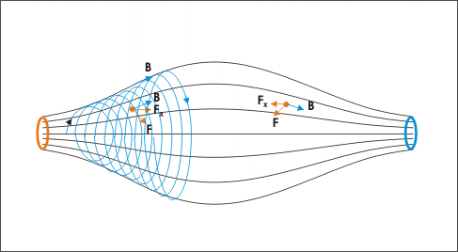
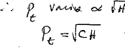




If H magnitude varies slowly in space…
Weaker H
Stronger H
As electron moves through changing field,
H appears to be changing temporally in magnitude, while remaining spatially uniform to the charge.

Slide 15
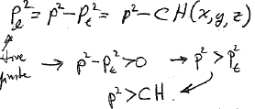






Energy (and p²) remain constant, since H does no work. (ε² = m²c⁴+ p²c²).
The longitudinal component of p ≡ p_{l}, p² = p_{l}² + p_{t}².
Positive definite
Penetration into regions with p² < CH is impossible.

Slide 16
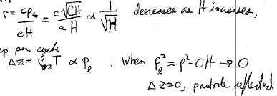





(21.6)
Radius of helix decreases
as H increases.
Step per cycle
Particle is then reflected

Slide 17




Inhomogeneity of H causers a drift of the guiding center transverse to H.

Slide 18
Magnetic bottle

Slide 19
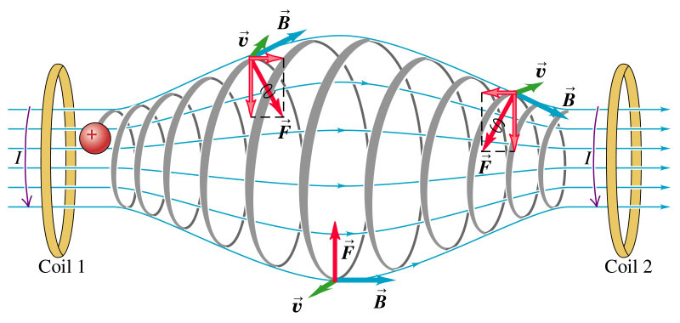
Magnetic bottle
The radius of the helix decreases as H increases.
The longitudinal step per cycle decreases as H increases.
Eventually, the particle is reflected.

Slide 20
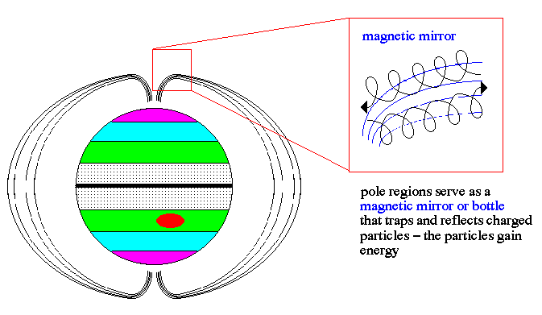


Naturally occurring magnetic bottle

