Slide 1
Charge in a constant uniform electric & magnetic field
Section 22

Slide 2
We consider non-relativistic motion only.
(Why? Because otherwise it’s too hard?
Or is there a reason that this is all that matters?)
Then, p = mv
Choose Z || H
Choose X &Y so that H & E lie in the YZ plane
Z
H
E
Y
X

Slide 5
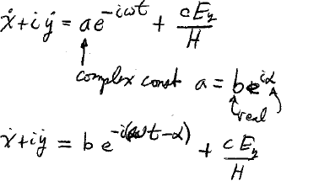


Complete solution
Complex constant
Real
Now shift the origin of time by α/ω to eliminate constant phase.

Slide 6
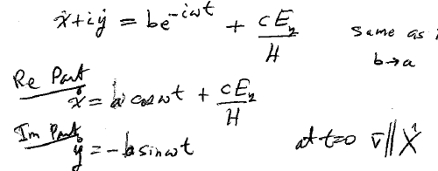



Same as if α = 0. Then b = a.
At t = 0,
Velocity components are periodic functions of time.

Slide 7
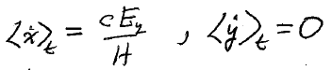


Time-averaged values
Average X velocity is constant: the drift velocity
Perpendicular to both E & H
Z
H
E
Y
v_{D}
X

Slide 8
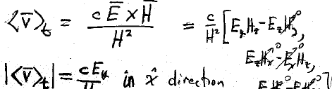



















Drift velocity
H

Slide 9
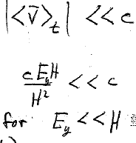


All derivations in this section assume v << c.
But both fields can be large.
In SI units E_{y} << c B = c μ₀ H.

Slide 10
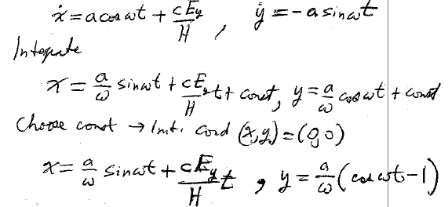







Trajectory
The velocity equations were
Integrate
The constant is determined by the initial conditions.

Slide 11
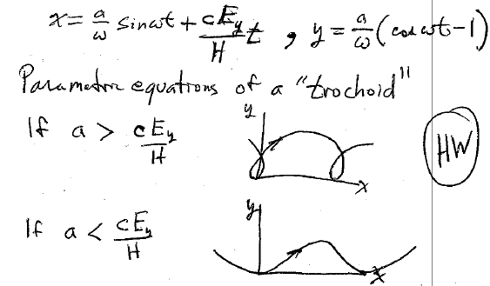










Slide 12
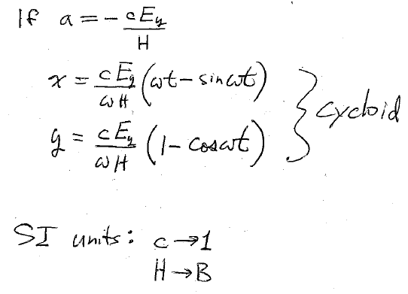







Slide 13
Trajectory
(ignoring constant acceleration along z due to Ez)
Z
B
E
Y
X

