Slide 1
Electromagnetic field tensor
Section 23

Slide 2
We seek the equation of motion in 4D for a particle in a given field
In section 17, we got the 3D equation of motion from Lagrange equations
Lagrange equations come from minimizing the action between fixed end points in space.

Slide 3
Same approach, but in 4D
Again write down the action for particle in given field.
Don’t separate space and time parts of the particle-field interaction term.
Now vary the action between fixed end points in 4-space (fixed events) to zero.
This leads to the 4D equation of motion

Slide 4
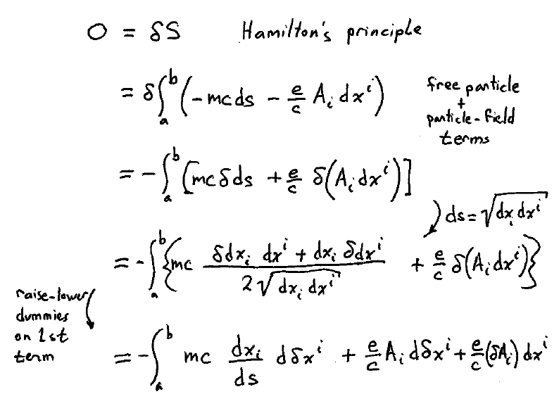

Slide 5
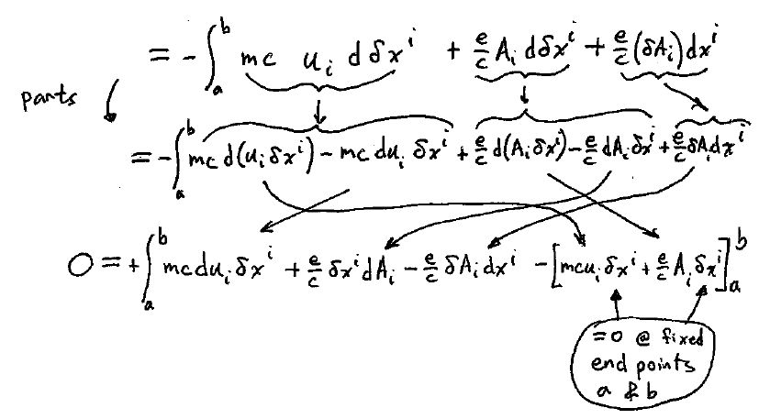

Slide 6
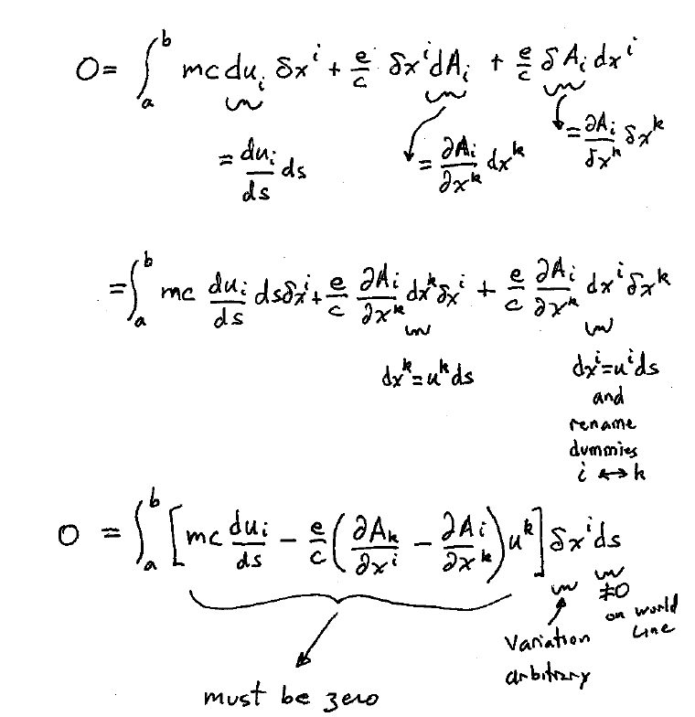
-
-

Slide 7
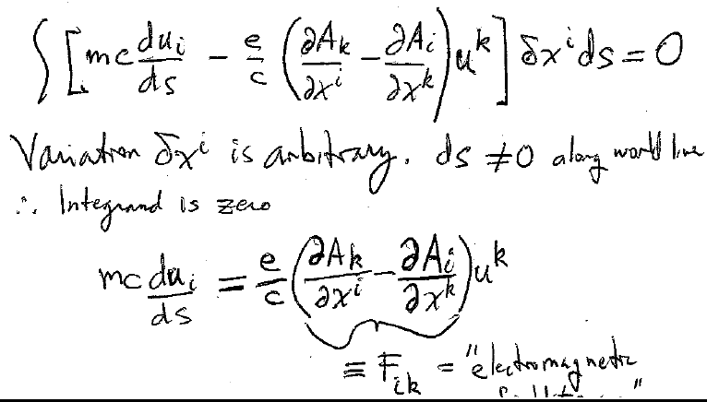
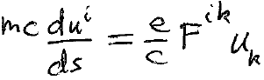

Equation of motion for charge in given fields
Electromagnetic field tensor

Slide 8
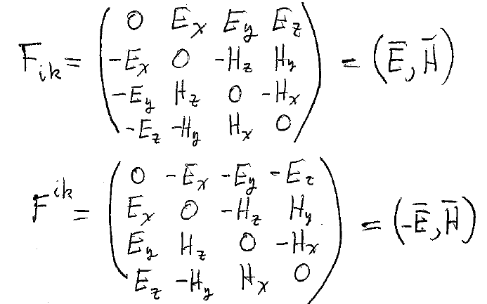





To find F_{ik}, substitute A_{i} = (φ, -A) into the definition of F_{ik}, and use definitions of E and H.

Slide 9

Equation of motion
Time component:
Space components:
These two equations are relativistically correct.
They are not independent.
Since u^{i} w_{i} = 0
This means that one of the 4 equations of motion can be written in terms of the other 3.

Slide 10
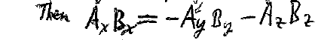







3D example. Suppose A is given and A.B = 0.
Given
B_{x} is not independent of B_{y} and B_{z}.

Slide 11
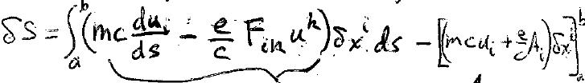











To find the generalized momentum, or the Hamiltonian, or to use the Hamilton-Jacobi equation, we need the action as a function of all 4 coordinates: S(ct, x, y, z)
An intermediate step in the derivation of the Equation of Motion was…
If we allow only allowed trajectories, i.e. those that satisfy the equation of motion, then this term is zero.
Now we allow the end point to vary, so this term is now not zero.

Slide 12
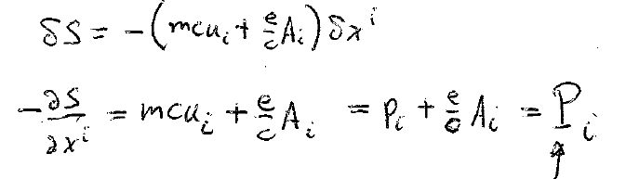



Generalized momentum 4-vector for the particle.

Slide 13
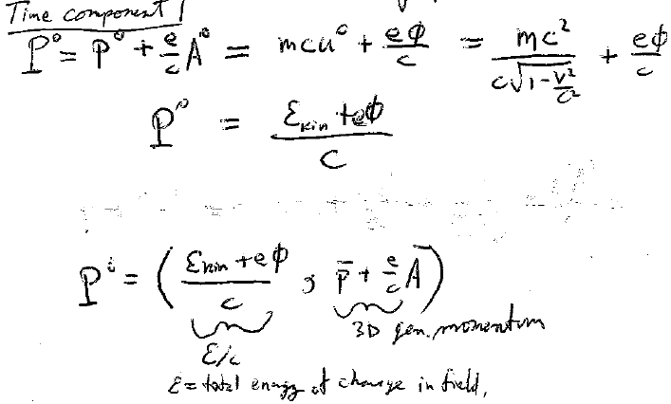





The time component of the generalized 4 momentum is the total energy of the charge in the field / c.
3D generalized momentum
Total energy of a charge in a field.

Slide 14
The components of electric and magnetic field are the components of
Two four vectors
An antisymmetric four-tensor of rank 2
A symmetric four-tensor of rank 3
1
2
3

