Slide 1
Lorentz transform of the field
Section 24

Slide 2




The four-potential A^{i} = (φ, A) transforms like any four vector according to Eq. (6.1).

Slide 3
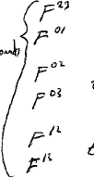
The electromagnetic field tensor F^{ik} transforms like any antisymmetric rank 2 tensor, according to section 6 problem 2.
The six non-zero components are the components of E and H.
Unchanged
Transform like x⁰
Transform like x¹

Slide 4
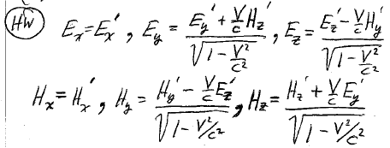




E and H fields transform into superpositions of each other
HW

Slide 5
Electric and magnetic fields are relative
The same physical fields have different component values in different reference frames.
E or H can be zero in one frame and non-zero in another.

Slide 6
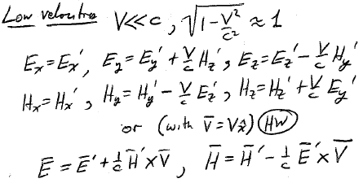




Transformation formulas in the low velocity limit.
To get formulas for the inverse transformation, change the sign of V and shift the primes.

Slide 7
If in some system one of the fields is zero, we get special relationships between E and H
If H’ = 0 in K’ system, H = (1/c) V x E
If E’ = 0 in K’ system, E = -(1/c) V x H
In either case E and H are perpendicular

Slide 8


For example, if H’ = 0 in the K’ system (Homework),
Homework:
Note that H in the K system is perpendicular to E.

Slide 9
If E,H are perpendicular in some system K…
Y
Y’
V
and E > H
  There exists a system K’ where H’ =0
  and V = cH/E
but if E < H,
  There exists a system K’ where E’ =0
  and V = cE/H
In each case, the V for that K’ system is perpendicular to both E and H
H
X’
X
E
E’
Z
Z’

Slide 10
To make the magnetic field vanish by transforming to another inertial reference frame, which condition does not apply?
E and H must be perpendicular in some frame
E<H
The V in the transformation must be perpendicular to both fields.
1
2
3

