Slide 1
The first pair of Maxwell’s equations
Section 26

Slide 2
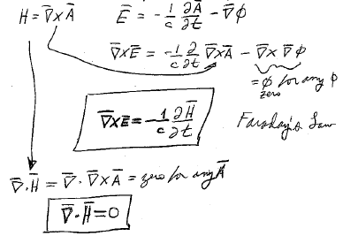

Zero for any φ
Zero for any A

Slide 3
These are equations for E and H alone
They do not involve terms for the sources of E and H.
  We have considered how particles interact with given fields
  But not yet how fields arise from given particle motions.

Slide 4
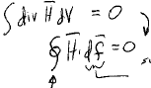











Integral forms of Maxwell’s first two equations.
Gauss’s Theorem
Surface area element
Integral is over the entire closed surface surrounding the volume.
Flux of magnetic field through the surface
Thus, the flux of magnetic field through any closed surface is zero.

Slide 5

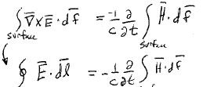



















Any surface
Same surface
Same surface
Closed contour of surface
Circulation of E around a closed contour
(“electromotive force”)
= time rate of change of magnetic flux through any surface that spans the contour.

Slide 6
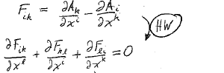
4-D form of first two Maxwell’s equations
The electromagnetic field tensor was defined as
Tensor of rank 3 (HW)
Antisymmetric in all 3 indices (HW)
If any two indices are the same, the component is zero (HW).
Represents 4 equations (HW):

Slide 7
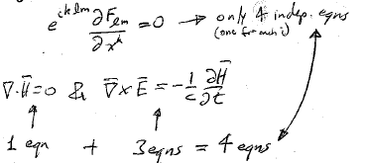


The 4D form of the first two Maxwell’s equations can be written in terms of the 4-vector that is dual to the antisymmetric 4-tensor of rank 3.
This represents 4 independent equations, one for each value of the free index i.
Four equations for the 6 components of E and H.

Slide 8
Which statement is not true?
The first two of Maxwell’s give relationships between the time and space dependences of the components of electric and magnetic fields.
They tell how to determine E and H from given charges and currents.
With only four equations for the six field components, they do not uniquely specify the fields.
1
2
3

