Slide 1
Action function of the electromagnetic field
Section 27

Slide 2
The system considered includes electromagnetic fields and particles
The action S = S_{f} + S_{m} + S_{mf}
The first term depends on the properties of the field
The second term depends on the properties of free particles
The third term depends on interaction between particles and fields

Slide 3
The free particle part of the action is the sum of integrals of ds along world line of each particle
Section 8.
Integrate along the world line of particle a.

Slide 4
The interaction term
Section 16
Potential of the field at the space-time position of e_{a}.
Integrate along the world-line of particle a

Slide 5
The last part of the action to find is the part that describes the field
This is needed to find the equations of motion for the field, which are Maxwell’s 3rd and 4th equations

Slide 6
The field equations must be linear differential equations
Superposition principle
The field at a point due to a number of charges is the vector sum of the fields of individual charges at that point
Each solution of the field equations (TBD) gives a field that can exist in Nature
Any superposition of such fields can also exist in Nature
Such superpositions must also satisfy the field equations
Therefore, the field equations must be linear in the fields

Slide 7
The equations of motion for the field must be linear differential equations.
They are found using Hamilton’s principle.

Slide 8
We get linear differential equations for the fields if the argument of the action integral is quadratic in the fields.
Quadratic function of the fields
Linear function of the fields
Linear function of the fields
The variation is arbitrary
Must vanish, and this condition gives the equation of motion for the fields

Slide 9
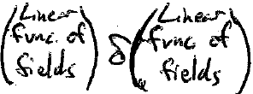

Slide 10
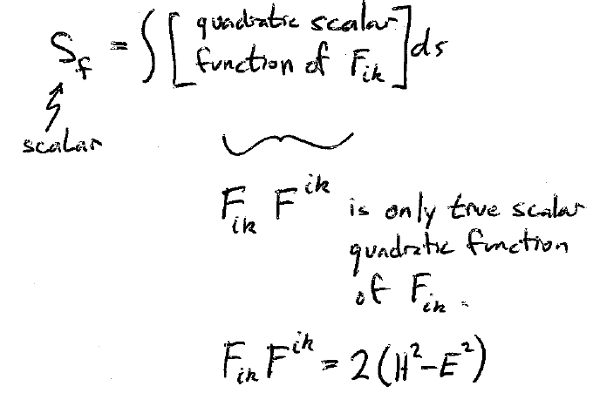
The electromagnetic field tensor contains all the components of the fields.
scalar quadratic function of F_{ik}
A scalar.
is the only true scalar quadratic function of F_{ik}.
This was one of the invariants of the field.

Slide 11
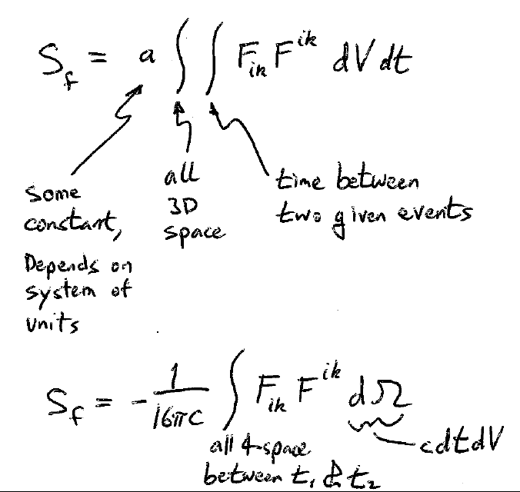
All 3D space
Integrate over time between two given events.
Some constant that depends on the system of units.
Gaussian
units
All 4-space between t1 and t2.

Slide 13
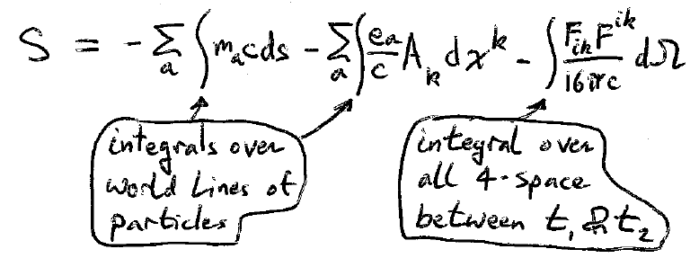
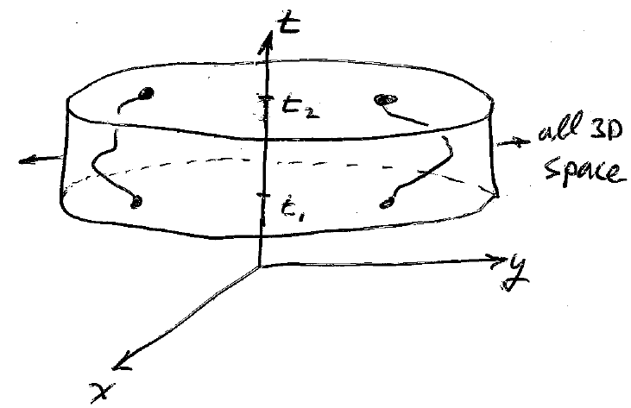
Action for particles and fields

