Slide 1
Four dimensional current vector
Section 28

Slide 2



For convenience, we often consider a distribution of point charges to be a continuous distribution of charge.
Define charge density ρ, so that ρ dV = the amount of charge within dV.
Charge density is a function of position and time: ρ = ρ(r,t)
= the amount of charge in the volume of integration
= the sum of all the point charges in that volume

Slide 3

Actually
Charge on particles is invariant under Lorentz transform, but ρ is not invariant due to length contraction. However, length contraction divides out in ρ dV, which is invariant.
Invariant scalar
Four-vector
Four-vector
A scalar, see (6.13) and footnote.
Is a four vector

Slide 4
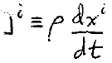
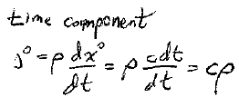
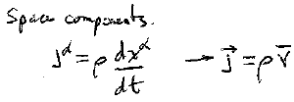




The sources of the field are charges and currents
Both are conveniently combined into a single 4 vector
Then we know immediately how charges and currents transform.
Current four vector

Slide 5


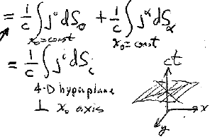







All of the charge in the entire universe =
All of space at a given time.
x₀ = const
The extra term is just zero, since…
Length elements in hyperplane x⁰ = constant are
dx^{i} = [0 dx 0 0]
dx’^{i} = [0 0 dy 0]
dx”^{i} = [0 0 0 dz].
Hyperplane perpendicular to x₀ axis.
dS¹ = dS⁰²³
Similarly
dS² = dS³ = 0, so j^{α}dS_{α} = 0 on hyperplane x⁰ = const.

Slide 6
Sum of charges whose world lines pass through arbitrary hypersurface of integration.

Slide 7

The action includes the free particle term, the particle-field interaction term, and the field term
Second term:
Integral along world line or charge element de = ρ dV
Sum over all charges
World line of charge a
Integral over whole volume

Slide 8

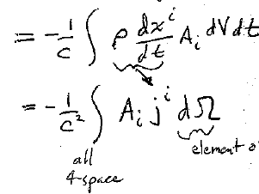
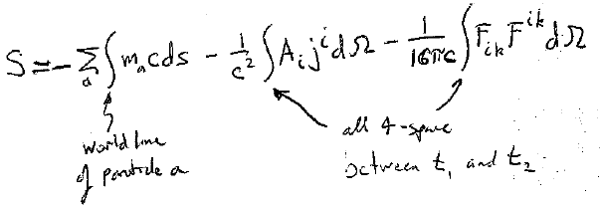





Converts world-line path integral into time integral
Element of volume in 4-space
All of four-space between t₁ and t₂
World line of particle a

