Slide 1
The equation of continuity
Section 29

Slide 2
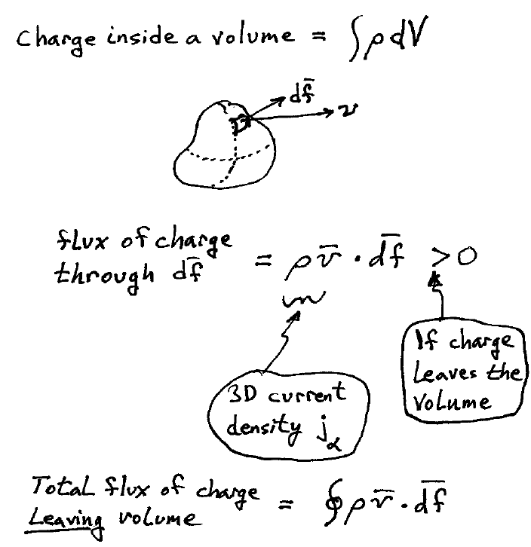

Slide 3
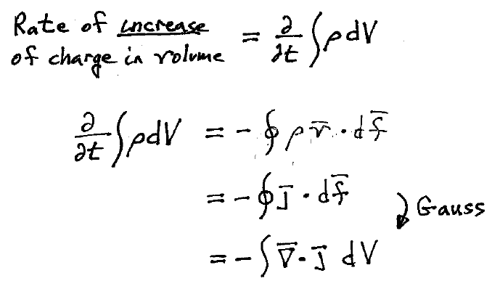
= flux of charge entering the volume through the surface by Charge conservation

Slide 4
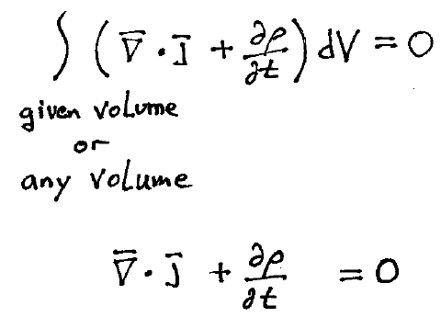
Continuity Equation

Slide 5
Continuity equation holds for point charges
The coordinates of a charge change due to its motion.
Since ρ is a function of r – r₀.
Velocity is independent of the field point coordinate r

Slide 6
4D Continuity Equation (HW)

Slide 7
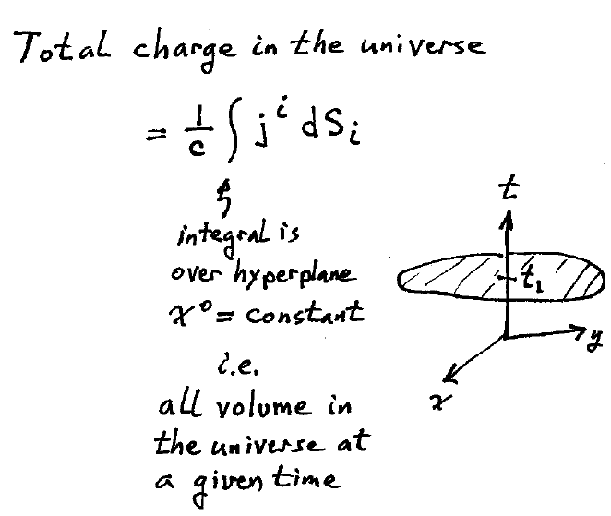

Slide 8
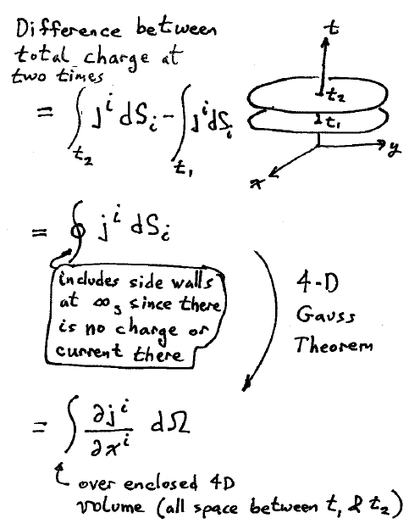

Slide 9
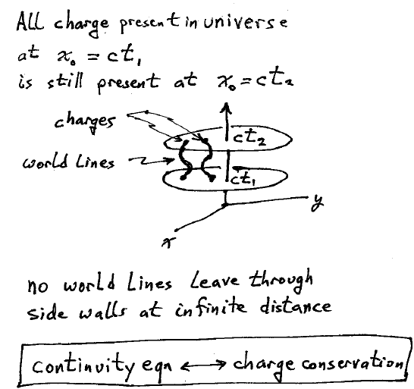

Slide 10
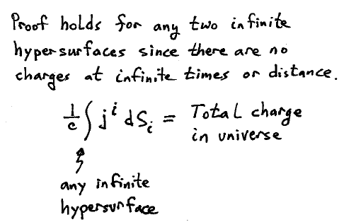

Slide 11
