Slide 1
Proper Time
LL 2 Section 3

Slide 2
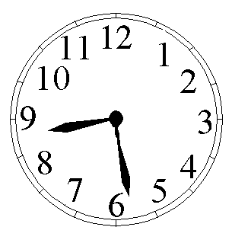
1. Some clocks are moving in arbitrary manner in our inertial reference frame.
v(t)
Y
Question: Is the frame attached to this clock an inertial frame?
X
Our frame, our clock.

Slide 3
Does a lab on the Earth constitute an inertial frame?
What about the Earth as a whole?
Does the solar system as a whole constitute an inertial frame?
How about the galaxy?

Slide 4
Over short enough times, arbitrary motion can be considered uniform motion.
At each moment, we can rigidly link a coordinate system with the clocks to make a set of different inertial reference systems
Y’
Y
v, dr
K’
t’
X’
K
X
t

Slide 5
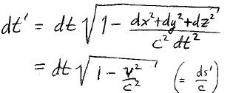




2. In the K’ system linked to the moving clock, dx’ = dy’ = dz’ = 0.
Invariance of intervals
ds² = ds’²
c²dt² - dx² - dy² - dz² = c² dt’ ² - 0
Integrate to get a finite time interval
v is nearly constant during infinitesimal dt,
but over whole motion from t₁ to t₂, v does not have to be constant

Slide 6


3. The time on a clock moving with an object is the “proper time” for that object.
t₂’ - t₁’ = proper time between two events for an object at rest in K’, as measured on moving clock, while
= the time between the same two events measured in the rest system K
<

Slide 7
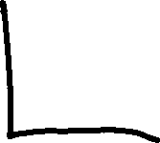


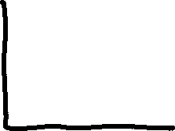






4. Moving object’s proper time is always less than the corresponding time in the rest system.
Moving clocks go more slowly.
Time interval observed in rest system is dilated relative to proper time.
These conclusions do not assume uniform rectilinear motion of moving clocks.
They do assume rest frame is inertial.

Slide 8












5. For uniform rectilinear motion of clock in K’ relative to K, both frames are inertial.
From point of view of observer in K, K’ clock lags.
From point of view of observer in K’, K clock lags.
Is that a contradiction?
Y’
Y
V
K’
t’
X’
K
X
t

Slide 9
No contradiction. To compare clock rates in two reference systems, we need several clocks in one frame, but only one clock in the other frame.
Process is not symmetric
Clock that appears to lag is always the one being compared to the many.
Because time is not absolute, the many clocks are not synchronized.
Y
Y’
V
K’
t’
X’
K
X
t

Slide 10





6. Consider a clock that describes a closed path
Moving clock appears to lag relative to clock in K
Converse reasoning is now impossible, because clock in closed trajectory is not in uniform rectilinear motion, so its reference system is not inertial.
Y’
Y
K’
t’
X’
t
K
X
7. Argument that leads to result that clock at rest (inertial frame) lags from point of view of moving clock (non-inertial frame) is not valid here, since laws of physics are different in two frames.

Slide 11
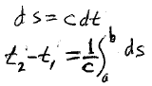

8. Consider two events for an object stationary in the K system.
Integral is over the world line of the clock
= the time between events measured on the clock in K

Slide 12













Clock at rest follows a straight world line parallel to the t axis.
For the clock at rest in K
t
b
a
x
For the clock following the closed trajectory
Thus interval between given world points (a,b) always has its maximum value if the connecting world line is straight.
Consequence of 4-space being non-Euclidean.
(For Euclidean 3-space minimum distance between two points is for straight line.)
curve
straight

