Slide 1
The second pair of Maxwell equations
Section 30

Slide 2
Principle of least action
For given fields, we varied the particle trajectory between fixed end points to find the equations of motion of a charge.
Now, for given motion of charges, we vary the potentials to find the field equations.

Slide 3
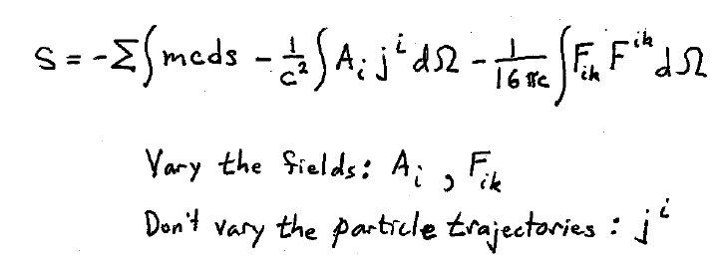
Action

Slide 4
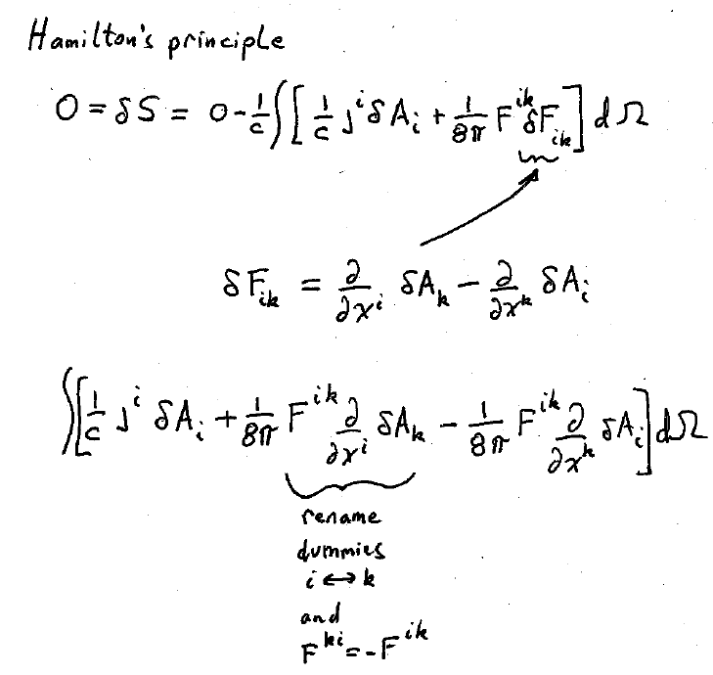

Slide 5
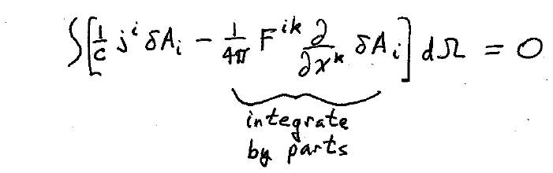

Slide 6
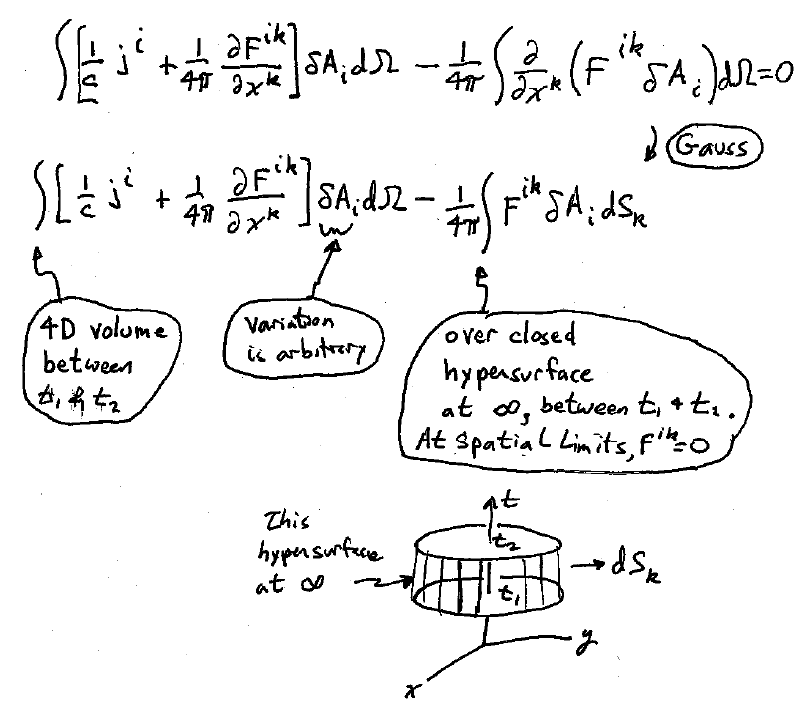
On end hyperplanes at t₁ & t₂, variation of potentials is zero

Slide 7
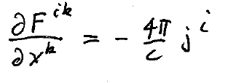
Second pair of Maxwell’s equations in 4D

Slide 8
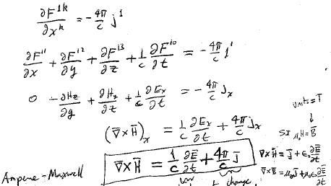
Space components
Units = Tesla
Ampere-Maxwell Equation
Charge current
Displacement current

Slide 9
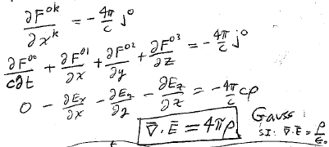
Time component

Slide 10
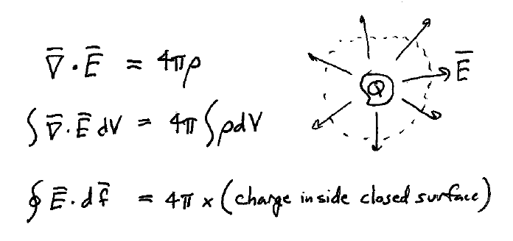

Slide 11
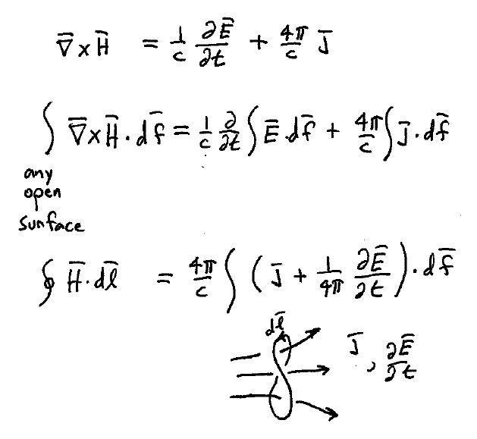

Slide 12
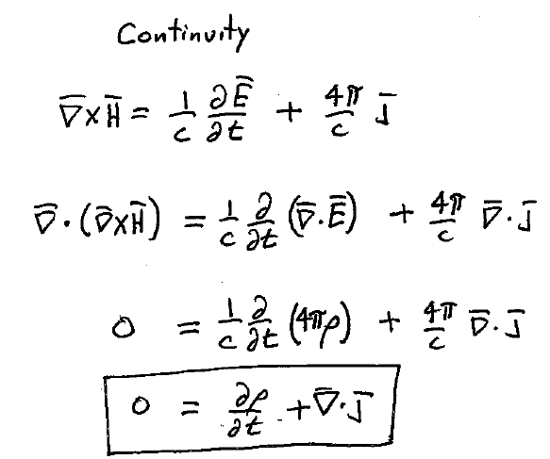

Slide 13
