Slide 1
Energy-momentum tensor
Section 32

Slide 2
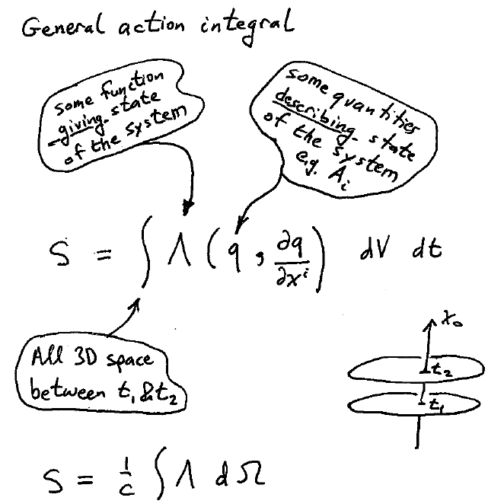

Slide 3
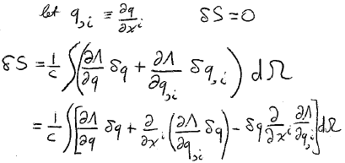
The principle of least action gives the field equations
Parts

Slide 4
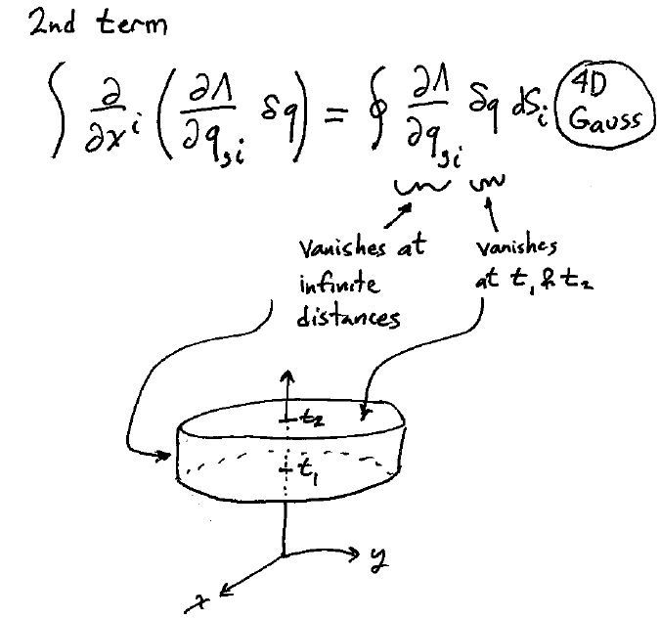
dΩ

Slide 5
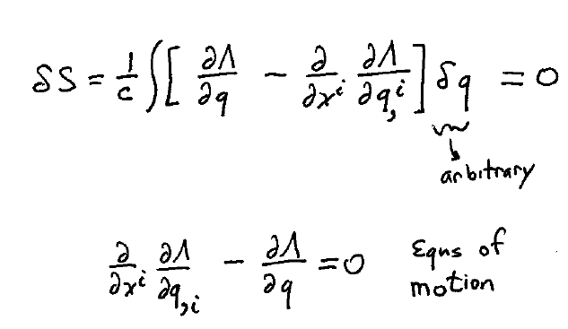

Slide 6
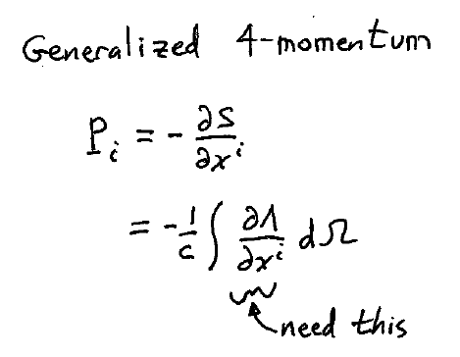

Slide 7
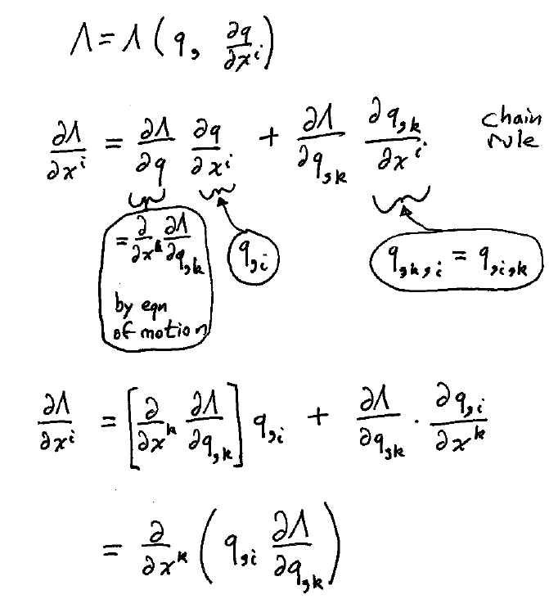

Slide 8
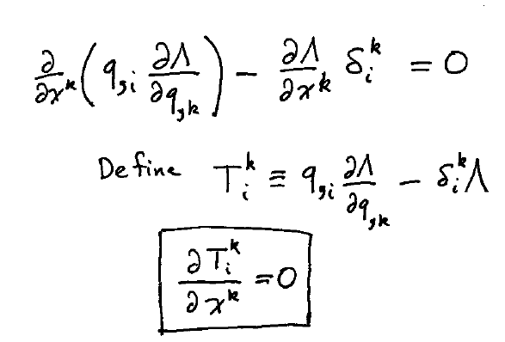

Slide 9
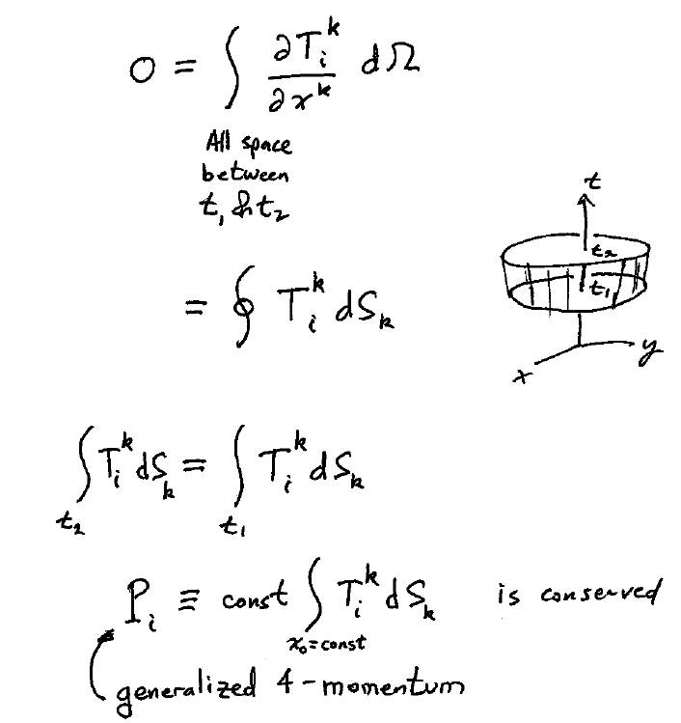

Slide 10
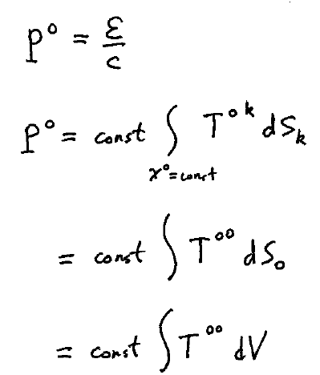
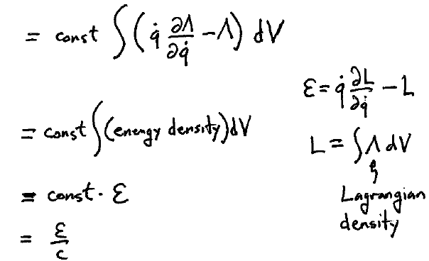

Slide 11
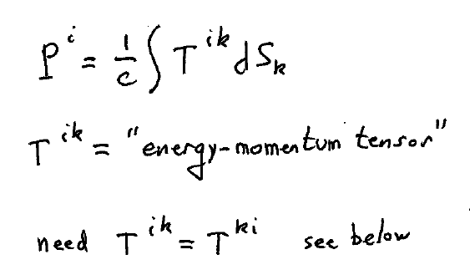

Slide 12
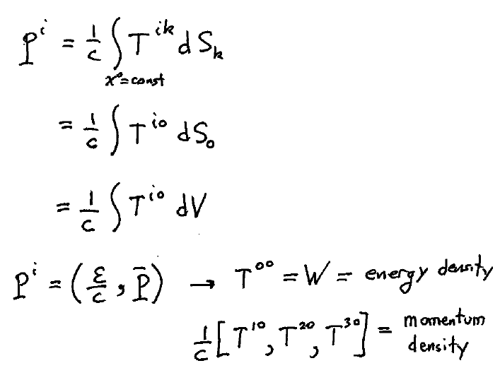

Slide 13
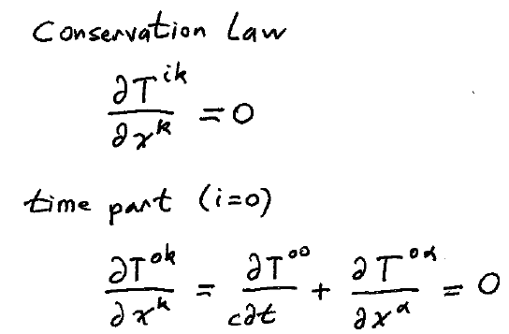
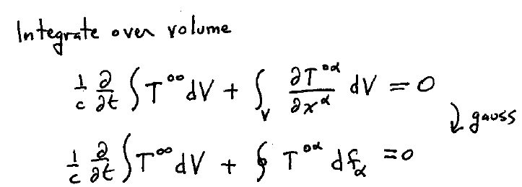

Slide 14
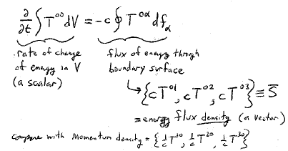
Rate of change of energy in V (a scalar)
Flux of energy through the boundary surface
= energy flux density (a vector)
Compare with momentum density =
Energy flux density S = c² * momentum density

Slide 15
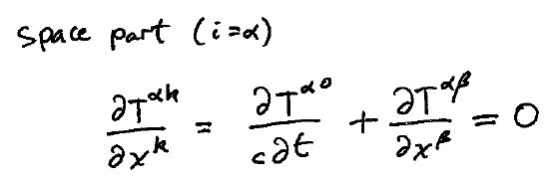

Slide 16
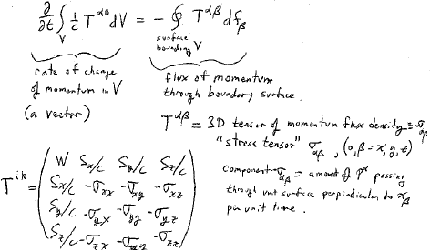
Integrate the space part over volume V
Rate of change of momentum in V (a vector)
Flux of momentum through the boundary surface
3D tensor of momentum flux density ≡ -σ_{αβ}
σ_{αβ} = “Stress tensor”, (α,β = x,y,z)
The component -σ_{αβ} = the amount of p^{α} passing through unit surface perpendicular to x_{β} per unit time

Slide 17
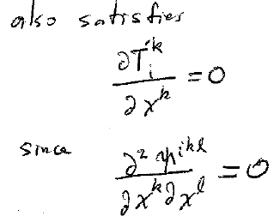
This definition is not unique.
Any other tensor
, where Ψ^{ikl} = -Ψ^{ilk}
Also satisfies
Since

Slide 18
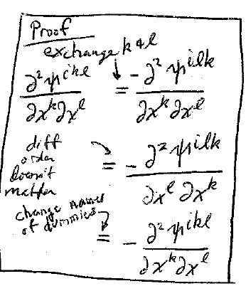

Slide 19
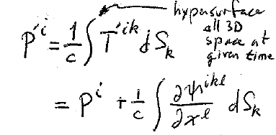
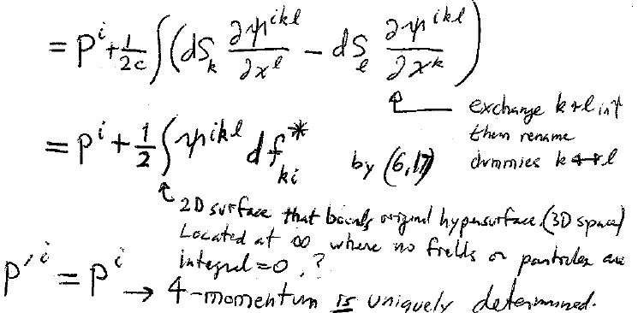
Total four-momentum
hypersurface=all 3D space at a given time
Exchange k & l in Ψ. Then rename dummies k ↔ l
By (6.17)
2D surface that bounds the original hypersurface (3D space) located at where no fields or particles are present. Hence, the integral is zero.
Four-momentum is uniquely determined.

Slide 20
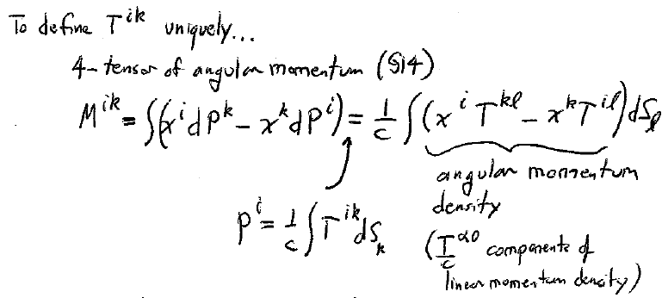
To define T^{ik} uniquely, consider the four-tensor of angular momentum (section 14).
Angular momentum density
(T^{α0}/c are components of linear momentum density)

Slide 21
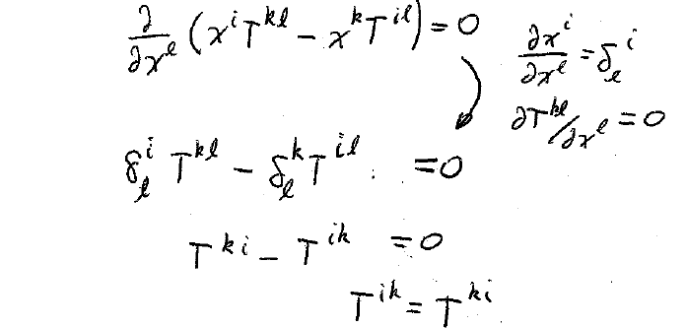
Conservation of angular momentum
Energy-momentum tensor must be symmetric

Slide 22
But
is generally not symmetric
We can make it symmetric by the transformation
with
This defines T^{ik} uniquely.

