Slide 1
Energy-momentum tensor of the electromagnetic field
Section 33

Slide 2

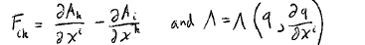
No charges for now, just fields
E-M field tensor
Action
Lagrangian density
So the q are the components of the four potential A_{k}

Slide 3
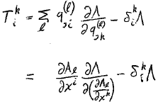
Energy momentum tensor with several quantities q^{(l)} ,which are the components of A_{k}, namely A_{l}.)
Sum over l
Strange derivative of Λ.
Find it next.

Slide 4
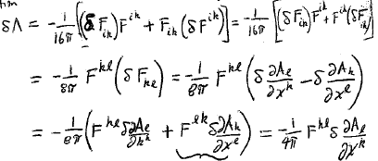
Raise and lower dummies
Vary the Lagrangian density
Rename dummies
l k
Swap indices on antisymmetric tensor

Slide 5
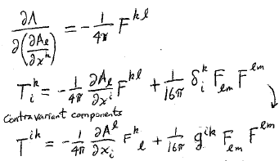
So weird derivative is
Substitute into the energy momentum tensor for the electromagnetic fields
Unit 4-tensor turns into metric tensor when one index is raised.
Contravariant components

Slide 6
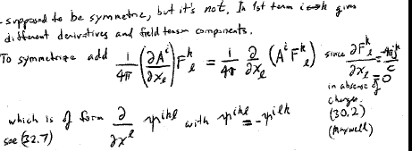
Energy momentum tensor is supposed to be symmetric, but it is not.
In first term, I k gives different derivatives and field components
To symmetrize add
Which is of the form
since
= 0
in vacuum

Slide 7
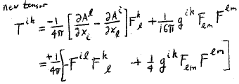
The new energy momentum tensor that we get is
New term
This is symmetric

Slide 8
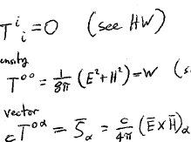
Trace
(HW)
Energy density
(HW)
Poynting vector
(HW)
Maxwell Stress Tensor σ_{αβ}

Slide 9

T^{ik} is diagonal if E||H, or E = 0, or H = 0 (HW)
For the field direction along the x-axis
T^{ik} can always be diagonalized, unless both invariants of the field vanish.

Slide 10
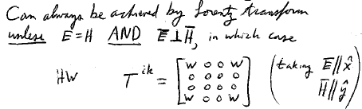
If both invariants vanish,
E = H AND

Slide 11
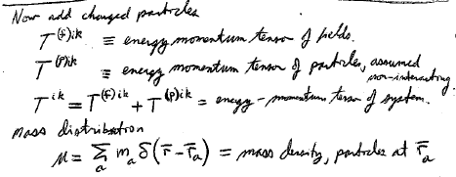
Now add charged particles, which may interact with the field, but not directly with each other (no action at a distance).
Energy momentum tensor of the fields
Energy momentum tensor of the non-interacting particles
Energy momentum tensor of the system

Slide 12
Mass density of particles
Momentum density of particles
Four-momentum:
Four-momentum density

Slide 13
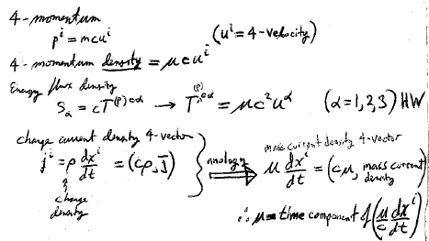
Energy flux density of particles
T^{(p)0α}

Slide 14
Mass current density of particles
Charge current
density 4-vector
Charge
density
Mass current
density 4-vector
Mass current
density

Slide 15
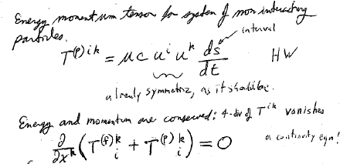
Energy momentum tensor for system of non-interacting particles
interval
Already symmetric

Slide 16
Conservation of energy and momentum means mathematically that the 4-divergence of the energy-momentum tensor vanishes.
This is a continuity equation for T^{ik}

Slide 17
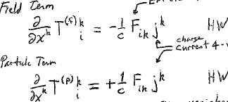
Proof
EM field tensor
Charge current
4-vector (ρc, j)
Sum vanishes

Slide 18
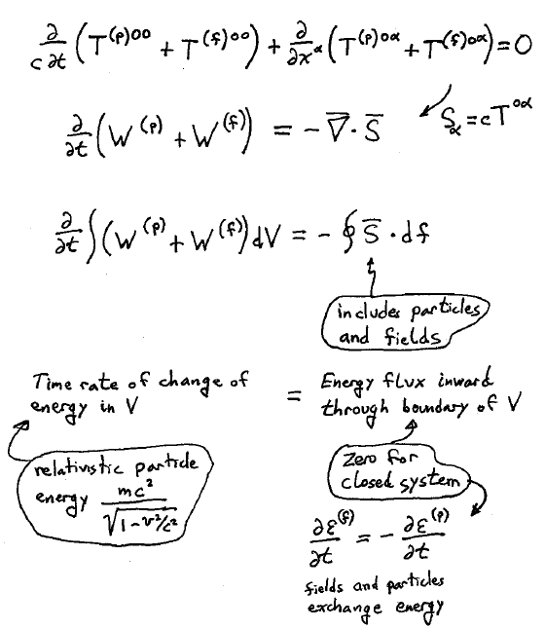
Time part of conservation equation, i = 0

Slide 19
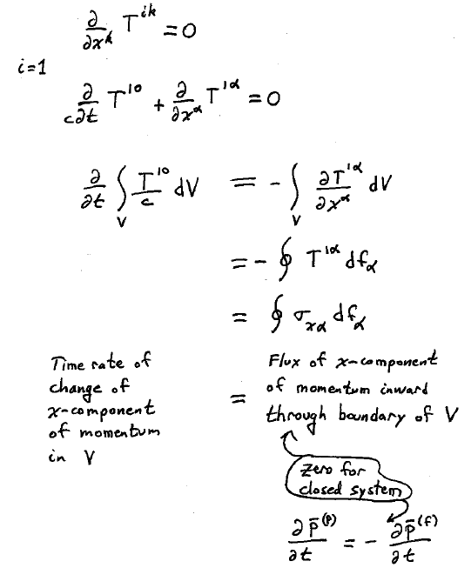
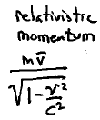
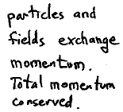
Space part of conservation equation, e.g. i = 1

