Slide 1
Coulomb’s Law
Section 36

Slide 2
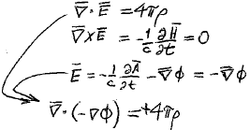

Electrostatic field
Poisson’s equation

Slide 3

In vacuum, ρ = 0.
Then Poisson’s equation becomes Laplace’s equation

Slide 4
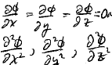


Theorem: Scalar potential cannot have an extremum in vacuum.
Proof: Suppose φ has an extreme value somewhere
Then
0 at that point
AND
All have the same sign
But that violates

Slide 5
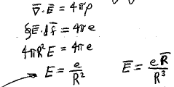
Point charge.
Field is spherically symmetric.
No φ or θ dependence.
E is oriented along a radius vector from the point charge.
E = E(R) is a function only of the distance R from the charge.
Coulomb’s law
Inversely proportional to the square of the distance from the charge.

Slide 6

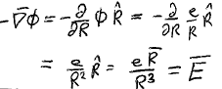
Potential of a point charge
Since

Slide 7
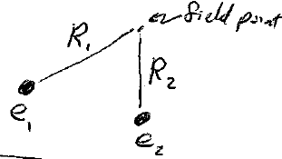

System of charges
Superposition principle:
E-field at a field point is the vector sum of the fields form all charges
Potential at field point is sum of potentials from all charges

Slide 8
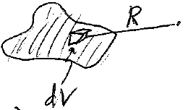

Continuous charge distribution
Field point
ρ = charge density

Slide 9



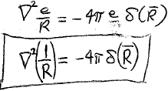
Point charge
Poisson’s equation

