Slide 1
Electrostatic energy of charges
LL2 Section 37

Slide 2

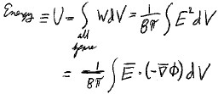
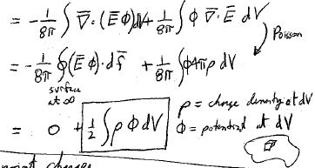


Energy density =
E = field of static charges
Energy
All space
Gauss’s law
Poisson’s equation
ρ = charge density at dV
= potential at dV

Slide 3


System of point charges
Potential at location of e_{a} due to all the charges

Slide 4


Single point charge has infinite self energy
Potential due to itself at charge’s location R = 0
Implies infinite rest mass for point charge ε = mc².
Validity of classical electrodynamics breaks down at small distances.
Set
Classical radius of an electron = 2.8 x 10⁻¹⁵ m ~ nuclear dimensions

Slide 5
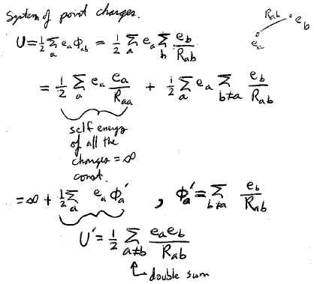
System of point charges
Self energy of all the charges is infinite, but at least it is constant.
Double sum

Slide 6
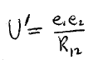
Interaction energy of two charges

