Slide 1
Field of uniformly moving charge
LL2 Section 38

Slide 2

Origins are the same at t = 0.
Coordinates of the charge e
K: (Vt, 0, 0)
K’: (0, 0, 0)

Slide 3



4-potential in K’, the rest frame of e.
A^{i} = (φ’, A’)
= Distance from charge to field point according to an observer in K’

Slide 4
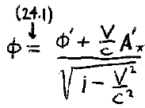
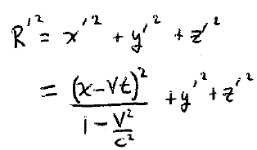
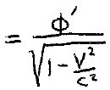
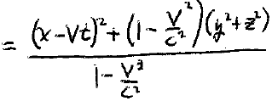

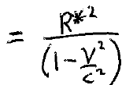
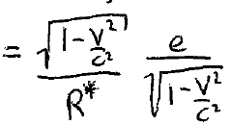
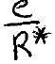

Scalar potential of moving charge in lab frame K
We need to express φ in terms of K-system (lab) coordinates.
φ =

Slide 5
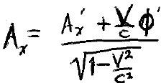





Vector potential of moving charge in lab frame K

Slide 6



In K’ frame, there is only the static electric field of a point charge.
Position of the field with respect to the charge according to an observer in K’.

Slide 7
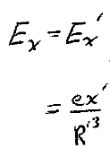
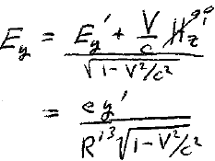
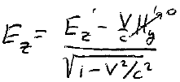


Electric fields of moving charge as measured in the lab
(24.2)
=
Substitute transformations
for x’, y’, z’, and R’ (HW)
R is distance from moving e to fixed P according to K

Slide 8
R is distance from moving e to fixed P according to K

Slide 9
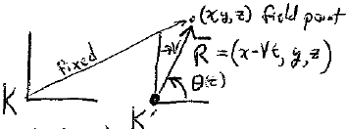



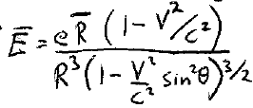

Lab coordinates and angle of fixed field point relative to the moving charge
Field point
Position of field point with respect to charge according to observer in K
Angle according to observer in K
=

Slide 10

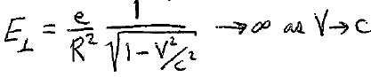
Electric field in lab from moving charge
Smallest value at θ = 0 and π,
i.e. parallel to the direction of motion
Largest value at θ = π/2
i.e. perpendicular to V

Slide 11

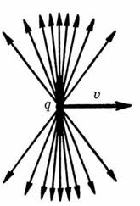
For V c, the electric field is compressed to a narrow range about θ = π/2 with
HW

Slide 12


H-field in K system found by (24.5): H = (1/c) V x E
(H’= 0 in K’)
For V << c, electric field is not deformed
But we still get a magnetic field due to the current of the moving charge

