Slide 1
Motion in the Coulomb field
LL2 section 39

Slide 2
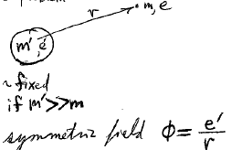
The non-relativistic situation is Kepler’s problem.
What is the relativistic situation?
The larger mass is approximately fixed if m’ >> m
The centrally symmetric field is

Slide 3
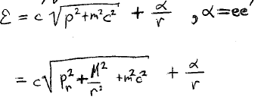
The total energy (relativistic kinetic and potential) is
M is the constant angular momentum

Slide 4
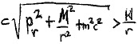
Can the particle fall to the center?
  Not if e & e’ have the same sign (replusive Coulomb force).
  Not if e & e’ have opposite sign (attractive Coulomb force)
  AND Mc > |α| (lots of angular momentum).
In the second case, we always have
|α|
and ε →∞ as r → 0.
But ε needs to be constant,
So particle cannot fall into the center for this case.

Slide 5
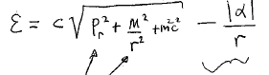
If Mc < |α|, then as r → 0
These go to +∞
and this one goes to -∞
in such a way that ε can remain finite.
The particle can fall to the center for the Coulomb field if the particle is relativistic.

Slide 6
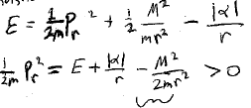
In non-relativistic case, the total energy is
So this inequality must hold.
This term is positive definite.
But this negative term wins as r → 0.
Thus, r cannot go to zero in non-relativistic case (for Coulomb field) unless M = 0.

Slide 7
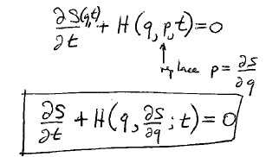
Hamilton-Jacobi equation
(a differential equation satisfied by the action.)
replace

Slide 8
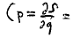
Separation of variables is possible for all cyclic variables, and even for some that are not-cyclic.
Constant for cyclic coordinates
The HJ method is the most powerful way to find equations of motion.

Slide 9
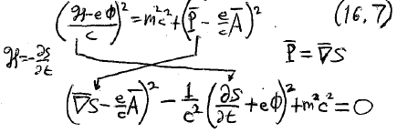
Particle in an electromagnetic field

Slide 10
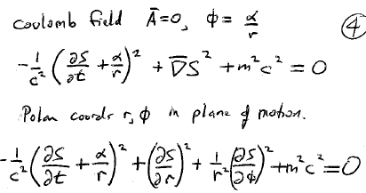
Coulomb field
Polar coordinates r, φ in the plane of motion.
0

Slide 11
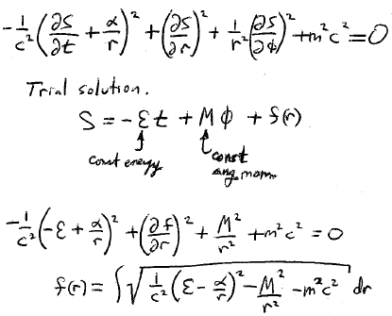
Trial solution
Constant angular momentum
Constant energy

Slide 12
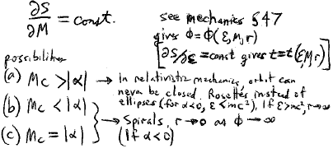
The trajectory is determined by the condition
See Mechanics volume 1, section 47
Constant, gives φ = φ(ε, M, r)
Three possibilities
In relativistic mechanics the orbit is never closed.
For α < 0, ε < mc², we get rosettes instead of ellipses.
For ε > mc², r →∞.
Spirals, r →∞ as φ→∞
(if α < 0, i.e. attractive Coulomb field)

