Slide 1
The Lorentz Transformation
Section 4

Slide 2


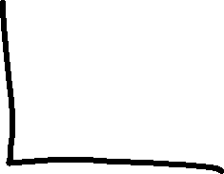
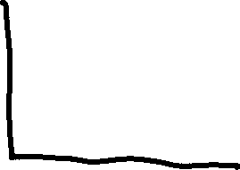


1. Every event has 4 coordinates, whose values depend on the reference frame.
x, y, z, t in the K system
x’, y’, z’, t’ in the K’ system
What are the formulas that transform from one set to the other?
Event

Slide 3

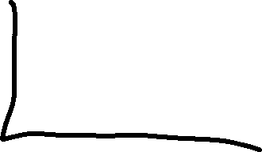
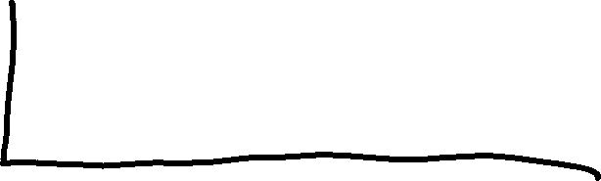




2. Gallileo transform, based on t = t’, origins coincide at t = 0.
Event
Does not leave the interval invariant!

Slide 4
3. The correct and unique transformation is found from the requirement that it must leave interval s between two events (world points in 4 space) unchanged.

Slide 5












4. A rotation in 4-D x,y,z,ct coordinate system is a transformation that leaves the interval unchanged.
Just as in 3D, a rotation of the coordinates leaves the length of a vector unchanged.
The representation of the vector changes, but not its length.

Slide 6








5. In 3D we can resolve any rotation into a sequence of rotations in 3 planes.
In 4D, every rotation can be resolved into a sequence of rotations in six planes:
  xy, yz, zx, (The usual 3D rotations)
  tx, ty, tz. (Three new planes)

Slide 7



6. Consider a rotation in the tx plane
y,z, coordinates don’t change.
Transform must leave (ct)² – x² unchanged
That is the square of interval from origin in tx plane to point (ct,x)
Formula for a rotation in the x-t plane that leaves c²t²-x₂ unchanged is
ct
x
Ψ = “angle” of rotation (or boost parameter, or rapidity)
This the correct transformation because it conserves the interval
Hyperbolic functions appear instead of trig functions because 4-space is pseudo-Euclidean

Slide 8




7. If two frames move relative to each other along their mutual x axes…
…then only x and t are subject to transformation.
We already have the transformation formula, but we don’t know how Ψ depends on V.

Slide 9
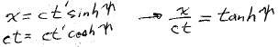
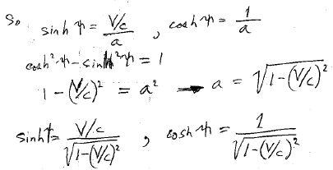




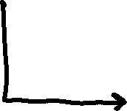




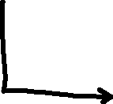

8. Apply the formula to the motion of the origin of K’ (the point x’ = 0).
That gives the coordinates in K of the K’ origin:
Since x/t = V,
tanh Ψ = V/c.

Slide 10

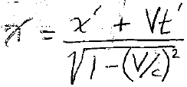
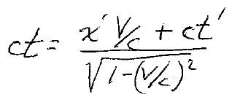
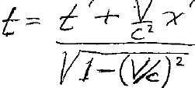







Formula for rotation in x-t plane
becomes
Lorentz transformation

Slide 11











9. Inverse formulae: V -V & swap primes

Slide 12

10. Limit c →∞ gives Galileo transform with absolute time.

Slide 13
11. For V > c, coordinates and time are imaginary.
Denominators go to zero if V = c.

Slide 14





12. Small velocities, V<<c
Gallilean transform for x
But non-absolute time

Slide 15
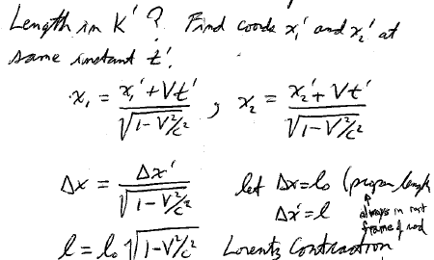





13. Suppose a rod is at rest in frame K and parallel to X-axis.
The length in K is Δx = (x₂ – x₁) = proper length of rod.
What is the length of the same rod in K’?
First find the coordinates x₁’ and x₂’ at the same instant t’.
Coordinates of the ends of the rod.
Let proper length Δx = l₀.
(Proper length is always measured in the rest frame of the object.)
14. LORENTZ CONTRACTION. If rod is moving, it will appear shorter to an observer at rest.

Slide 16



16. Since Δy and Δz don’t change, volume transforms according to
Proper volume

Slide 17

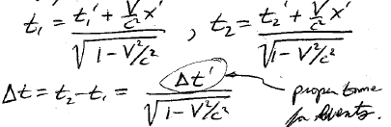






17. On a clock at rest in K’, two events at the same location x’, y’, z’ are separated by a time interval Δt’ = t₂’ – t₁’
What is the time interval between the same two events in the K system?
Proper time interval for the events
Time dilation

Slide 18









The Galilean transform is commutative.
The combined result of two successive tranforms V₁ and V₂ does not depend on the order.
Lorentz transforms do not commute, unless V₁ || V₂.
Rotations about different axes depend on the order.

