Slide 1
Dipole Moment
Section 40

Slide 2
If the field point is very far from the charge distribution
To zeroth order, it looks like a point charge.
The next order is a correction.

Slide 3
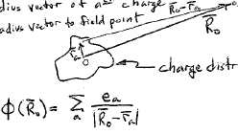
Field point
r_{a} = position of the a^{th} charge
R₀ = position of the field point
Some distribution of charge
If r_{a} << R₀ for all charges e_{a} in the distribution, then expand potential φ in powers of the small quantities r_{a}/R₀.

Slide 4
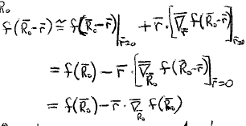
Taylor’s theorem

Slide 5
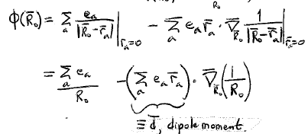
Dipole moment

Slide 6

Continuous charge distribution
Generally depends on the choice of origin

Slide 7


Theorem: d is independent of the choice of origin if the sum of all the charges is zero, e.g. a molecule.
New origin
Old origin
r_{a}’ = r_{a} - a
0
-

Slide 8
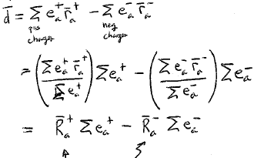
Divide system into positive and negative charges.
Position vectors of positive and negative charge centers (like center of mass).

Slide 9
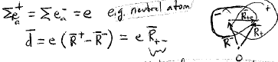
For example a neutral atom
If
Vector from negative center to positive center

Slide 10
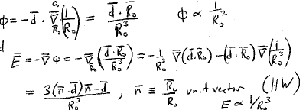
For a neutral system, total charge = 0
Electric field
Unit vector

Slide 11

Alternate expression for dipole field (HW)

Slide 12






E has axial symmetry about d.
Spherical coordinates
Typo in book

