Slide 1
Multipole Moments
Section 41

Slide 2
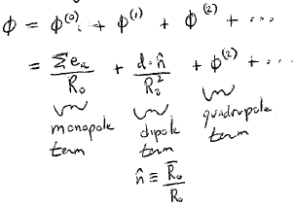
Expand potential φ in powers of 1/R₀.

Slide 3
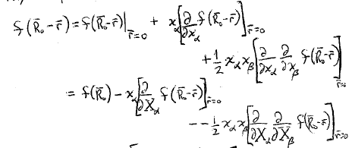
The exact potential is
Taylor expansion

Slide 4
Quadrupole potential
r = 0
We can set r = 0 before taking the derivative

Slide 5
The quadrupole potential has two factors
The factor Σ_{a}x_{α}x_{β} is a symmetric tensor.
It is given by the coordinates of all of the charges.
A symmetric tensor has 6 independent quantities.
The rest of φ⁽²⁾ depends only on the field point R₀.
ARE THERE REALLY 6?

Slide 6
How many independent quantities does a rank-two 3D tensor have?

Slide 7
6.
Are all six independent of each other?
How many quantities describe the monopole?
How many quantities describe the dipole?
How many quantities should describe the quadrupole? 6?

Slide 8
The potential of a point charge satisfies Laplace’s equation
and
so
We can add this zero to φ⁽²⁾ without changing it.
And we can multiply it first by and then add it.

Slide 9
The factor that characterizes the charge distribution is now a different symmetric tensor:

Slide 10
The advantage of the new tensor is that it has zero trace.
Trace
is an equation that allows one of the 6 quantities to be expressed as a combination of the other 5.
Therefore D_{αβ} has only 5 independent quantities.

Slide 11
Depends on 5 quantities that characterize the charge distribution.
Unit vector in the direction of the field point.

Slide 12
Every 3-D symmetric tensor can be diagonalized by finding principal axes.
Since D_{αα} = 0, only two principle axes are independent.

Slide 13
Suppose charges are symmetric about z
Then z is a principle axis.
Other two axes lie in the x-y plane.
Their location is arbitrary.
D_{xx} = D_{yy} = -D_{zz}/2
Let D_{zz} be defined as “D”.
Now we can express φ⁽²⁾ as product of D and P₂(cosθ), a Legendre polynomial.

Slide 14
Legendre Polynomial

Slide 15
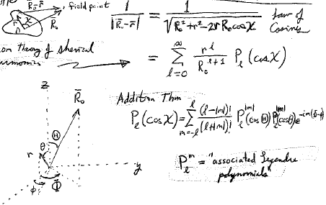
Field point
Law of cosines
From theory of spherical harmonics
Addition theorem
-im(Φ−φ)
Associated Legendre polynomials
x

Slide 16
Spherical functions
Note typos in book

Slide 17
2^{l}-pole moment in spherical coordinates
2l + 1 independent quantities
Characterizes the charge distribution
__________
Monopole
Dipole
Quadrupole

Slide 18
Note typo in the book
Relations between Cartesian and spherical expressions for dipole and quadrupole moments

