Slide 1
System of charges in an external field
LL2 Section 42

Slide 2
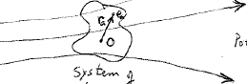
External E-field, whose potential is φ(r)
A system of charges

Slide 3
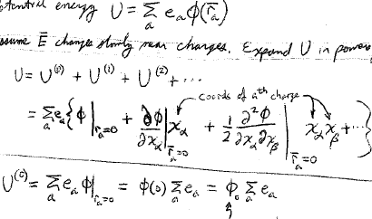
The potential energy of the charges in the external field is
Assume E changes slowly near the charges. Expand U in powers of r_{a}.
Value of the potential at the origin.
Zeroth approximation assumes all charges are located at the origin.

Slide 4
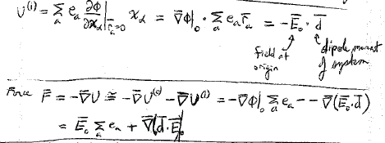
Field at the origin
Dipole moment of the system of charges
Force =
This is the net force on the charge distribution as a whole.
Determined by how the potential and field change near the origin.

Slide 5



If the system is electrically neutral
Then,
HW
For there to be a force on a neutral system, there must be a dipole moment, and the electric field must be non-uniform
Torque

Slide 6
An electric field is applied to a neutral molecule. If it experiences a force and accelerates, what two things must be true?

Slide 7
Neutral molecule must have a dipole moment and the electric field must be non-uniform.
For a neutral molecule to experience a torque in an external electric field, do we still need a dipole moment and field non-uniformity?

Slide 8
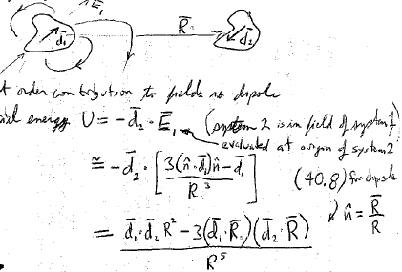
Suppose we have two systems of charges, each with zero total charge. There separation R is large compared to their dimensions.
The lowest non-zero contribution to their fields is the dipole term.
Potential energy
(system 2 is in the field from system 1)
Evaluated at the origin of system 2
(40.8) for dipole

Slide 9
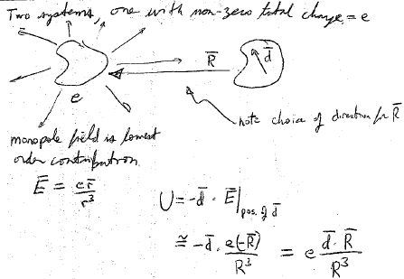
Two systems of charges, one with non-zero total charge e, well separated
Note the choice of direction for R
The monopole filed is the lowest order contribution

Slide 10
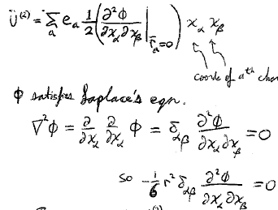
Coordinates of the a^{th} charge
satisfies Laplace’s equation
So we also have
We can add this zero to U⁽²⁾ without changing it.

Slide 11
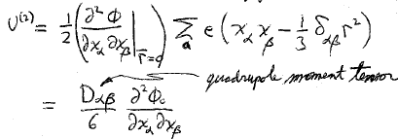
Quadrupole moment tensor

Slide 12
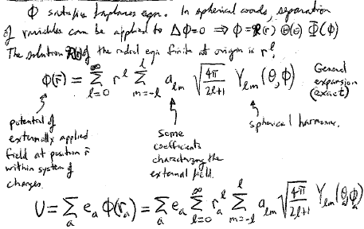
satisfies Laplace’s equation. In spherical coordinates, sepatarion of variables can be applied
The solution R(r) to the radial equation that is finite at the origin is r^{l}.
General solution (exact)
Potential of the externally applied field at the position r within the system of charges.
Spherical harmonics
Some coefficients characterizing the external field

Slide 13
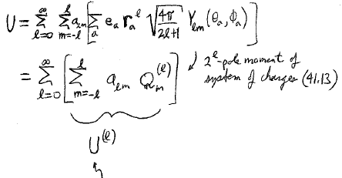
2^{l}-pole moment of the system of charges (41.13)
l^{th} order term in the expansion of U in powers of r_{a}.

