Slide 1
Constant magnetic field
LL2 section 43

Slide 2
Electrons in atoms and circuits all perform finite motion.
This creates magnetic fields that are constant when averaged over time.

Slide 3
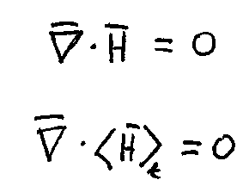

Slide 4
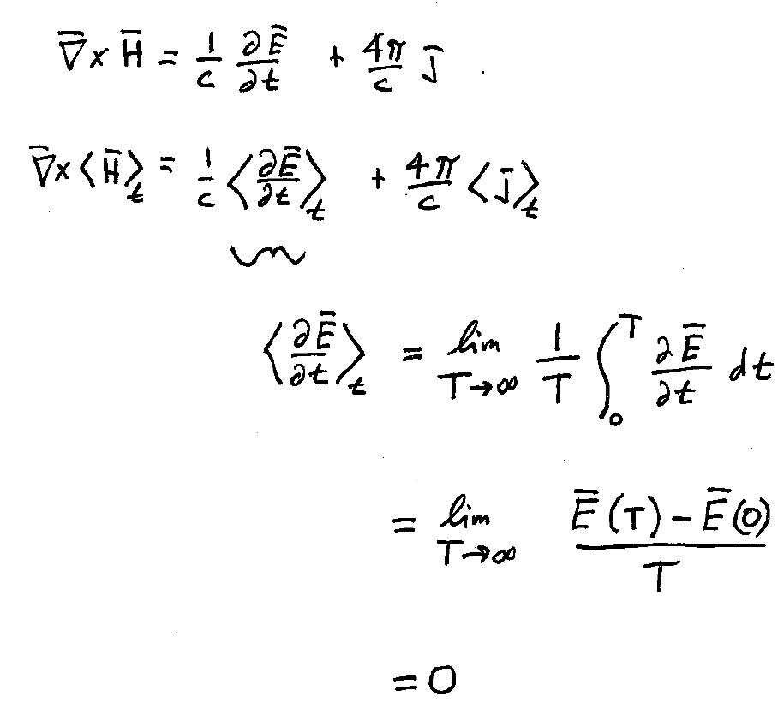
Displacement currents do not contribute to constant H-fields
Since E(t) varies over a finite range at any point r

Slide 5
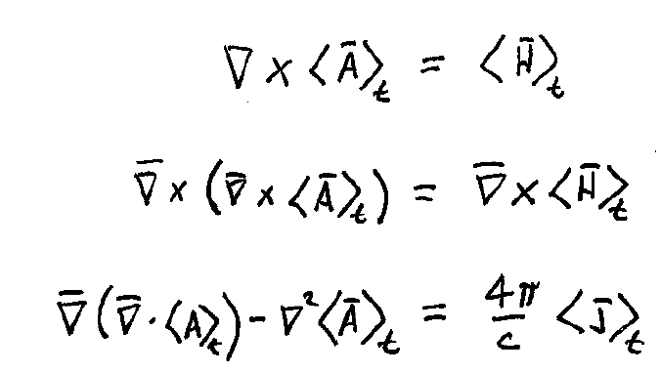
Time-averaged vector potential
Choose Coulomb Gauge: div A = 0

Slide 6
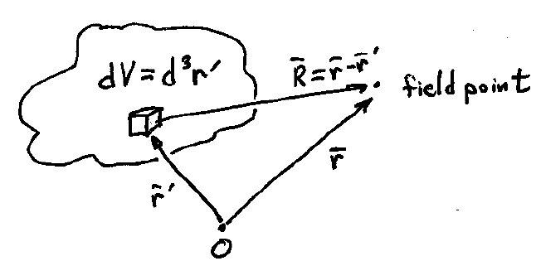
Poisson Equation
Coulomb’s law
Analogy

Slide 7
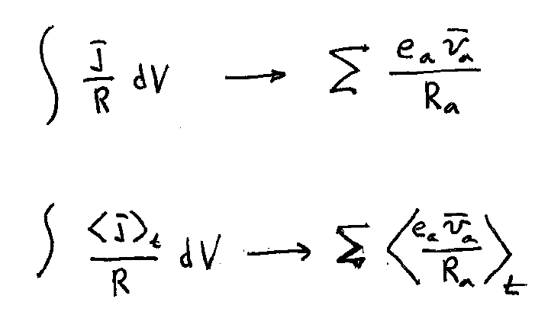
Transition from continuous current density to discrete particles
R is time independent integration variable
R_{a} is time dependent distance in the sum

Slide 8
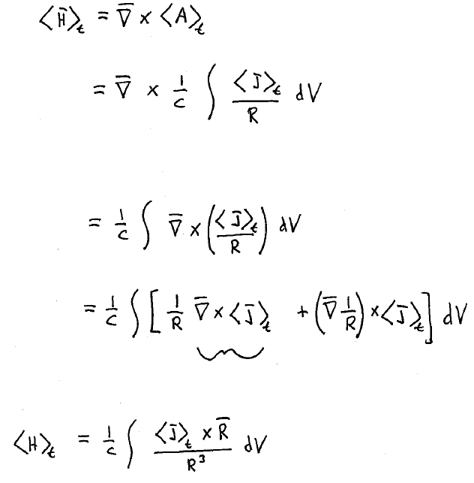
Curl is with respect to field point coordinates r
Source point coordinates r’ integrate out
= 0, since j is a function of r’, not r
Biot-Savart Law

