Slide 1
Magnetic moments
LL2 Section 44

Slide 2
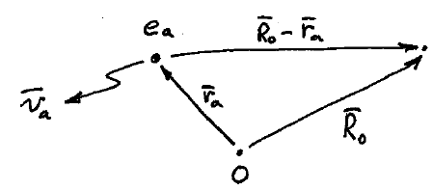

System of charges in stationary motion
Field point
(far from charges)

Slide 3
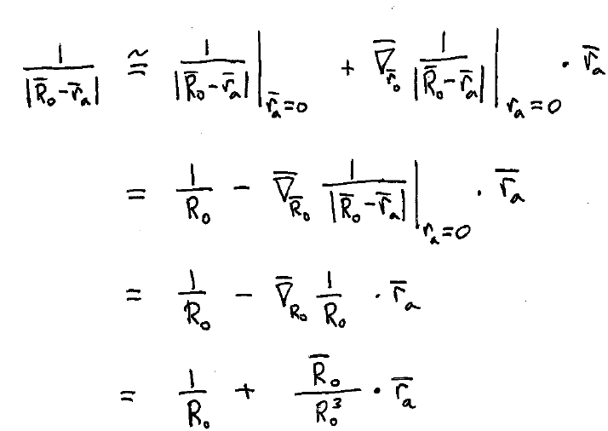

Slide 4
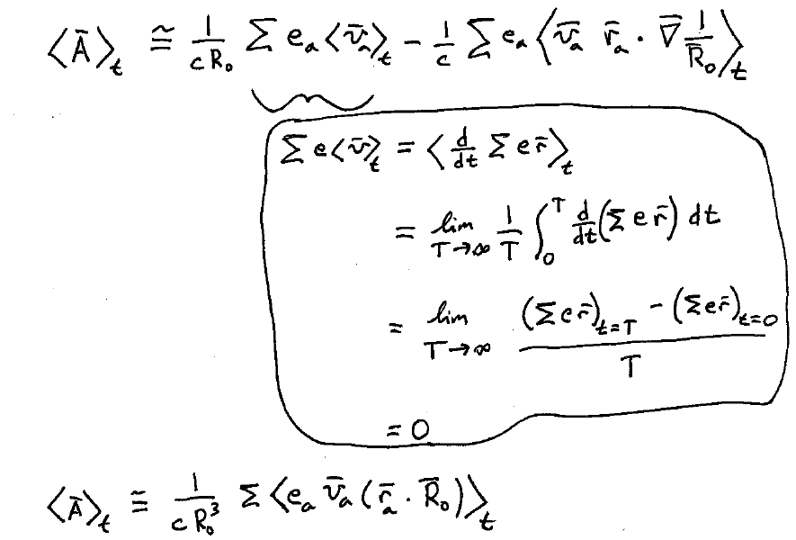

Slide 5
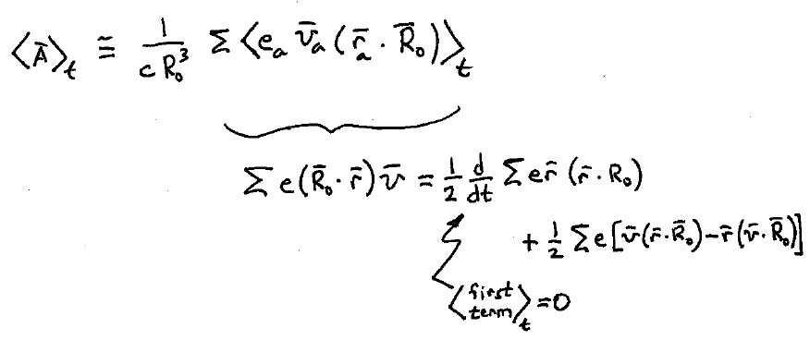

Slide 6
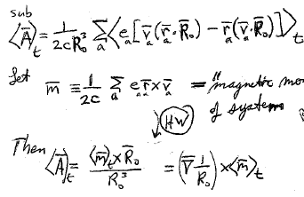
“Magnetic moment” of the system of charges.

Slide 7
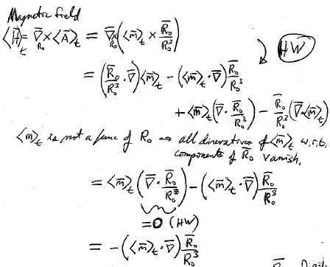


<m>_{t} is not a function of R₀, so all derivatives of it with respect to components of R₀ vanish.
Dipole field

Slide 8
