Slide 1
Larmor’s Theorem
LL2 Section 45

Slide 2




System of charges, finite motion, external constant H-field
Time average force
Time average of time derivative of quantity with finite variations

Slide 3










Time averaged torque
Time average of time derivative of quantity with finite variations

Slide 4


Compare with electric dipole

Slide 5




Lagrangian for charge in a given electro-magnetic field
If no external electric field.
Free particle term
Lagrangian for system of charges in an external constant uniform H-field
Extra term due to external H-field,
For closed system

Slide 6

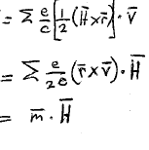

(19.4) for uniform H-field
Compare

Slide 7
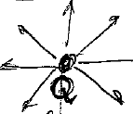



Centrally symmetric electric field.
System of charges, finite motion, v<<c, e.g. electrons of atom
No magnetic field.
Transform to rotating reference frame
Ω
-Ω x r
r
Velocity in lab frame
Velocity in rotating frame
Suppose v’ = 0,
Then v = -Ω x r

Slide 8


Lagrangian of system of charges in lab frame
L = Σ ½ mv’² - U
U is a function of the distances from the e_{a} to Q and of the distances between the e_{a}.
This function is unchanged by the transform to the rotating frame.
Lagrangian of system of charges in rotating frame and without an applied magnetic field

Slide 9

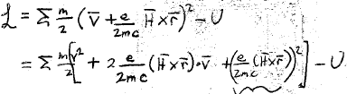
Assume e/m is the same for all particles, e.g. electrons of an atom.
And choose
Neglect for small H

Slide 10
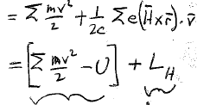
- U
Same as the Lagrangian for chargres in an external constant uniform H-field, but it appears just because of a particular choice of Ω.
Lagrangian for closed system when v<<c

Slide 11
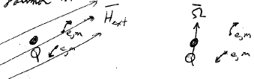
System of charges, Non-relativistic, Same e/m, Finite motion, Central E-field
Larmor Theorem:
System of identical chargres in a weak applied magnetic field H and centrally symmetric E-field, Coordinates not rotating
Same system without an H-field, but now coordinates rotating at Ω = eH/2mc
= “Larmor frequency”
These two problems have the same Lagrangian, and hence the same equations of motion.

Slide 12
For sufficiently weak H, Ω = eH/2mc is much smaller than the frequencies of finite motion for the charges.
Then, average quantities describing the system over times t << 2π/Ω = Larmor period
Averaged quantities will vary slowly with time at frequency Ω.

Slide 13






Time averaged angular momentum <M>_{t}
torque
If e/m is the same for all particles,
m = eM/2mc (44.5)
Larmor precession:
<M> and <m> rotate around H
Without changing |M|

