Slide 1
The wave equation
LL2 Section 46

Slide 2
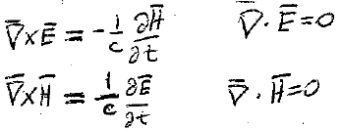
1. Electromagnetic field in vacuum is determined by Maxwell’s equations with ρ = 0 and j = 0.
These have non-zero solutions.
Thus, electromagnetic fields can exist without charges.
2. Electromagnetic fields in vacuum in the absence of charges are electromagnetic waves.

Slide 3
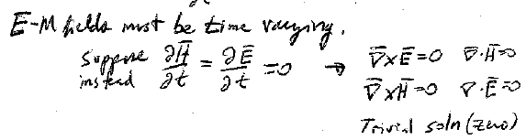

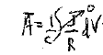












3. Such electromagnetic fields must be time-varying
Suppose instead
Then
These constant-field equations, without charge or current, have only a trivial solution
4. What are the potentials for the actual time-dependent fields?

Slide 4



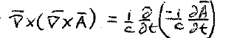






5. The potentials φ and A are not unique. They are subject to auxiliary conditions.
First condition: φ = 0. This choice is always possible, see section 19.

Slide 5




6. A is still not unique
The gauge transform
, where f is time independent (so that φ doesn’t change), does not change E or H.
Second condition (Coulomb Gauge): div A = 0.
Shows that div A is a function only of coordinates.
Thus, we can always make div A = 0 by transform
where df/dt = 0.
d’Alembert equation
Wave equation

Slide 6
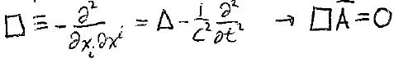








7.
d’Alembert equation
Wave equation
d’Alembertian operator
8. E and H obey the same equation
(Apply operators curl or d/dt to the equation for A.)

Slide 7
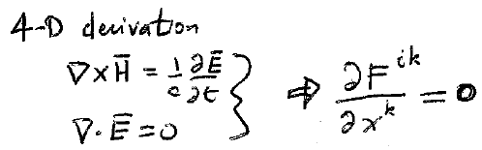
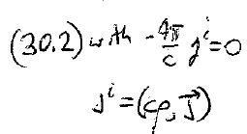
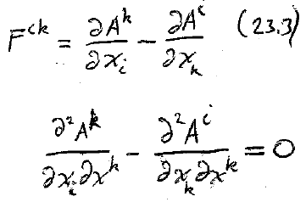





9. 4D derivation

Slide 8
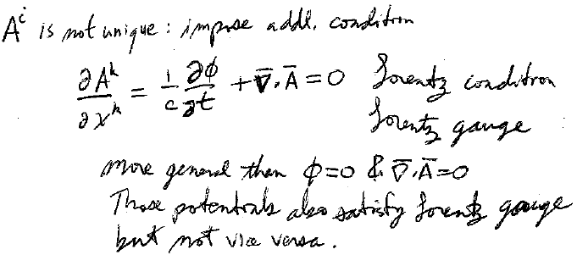

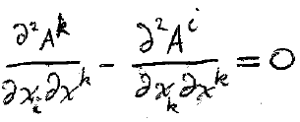
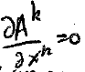
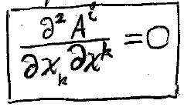
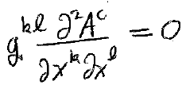












10. A^{i} is not unique. Impose an additional condition.
Lorentz condition
Lorentz gauge
4D divergence: Makes a 4-scalar, which is relativistically invariant
Lorentz gauge is more general than Coulomb gauge:
Potentials that satisfy Coulomb gauge also satisfy Lorentz gauge,
But not vice versa.
Coulomb gauge is valid only in one reference frame.
Sub Lorentz condition into 4D wave equation

Slide 9
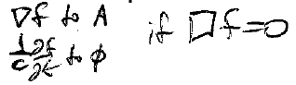



11. Potentials that satisfy the Lorentz condition in one frame, do so in every other frame.
4D divergence: Makes a 4-scalar, which is relativistically invariant
Lorentz gauge is more general than Coulomb gauge:
Potentials that satisfy Coulomb gauge also satisfy Lorentz gauge,
But not vice versa.
Potentials that satisfy the Coulomb gauge in one reference frame generally do not if the reference frame is changed.
Lorentz condition still does not define (φ , A) uniquely.
We can add

