Slide 1
Plane waves
LL2 Section 47

Slide 2
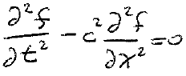

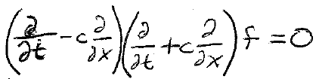
If fields depend only on one coordinate, say x, and time,
Then the wave equation becomes

Slide 3
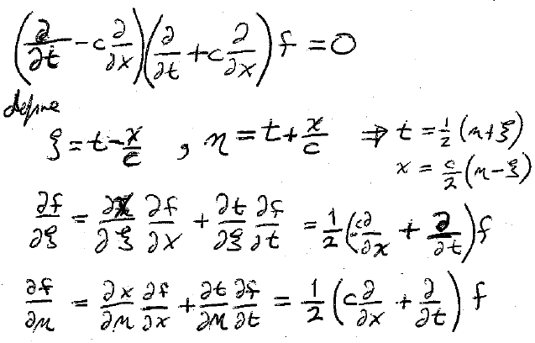
Define

Slide 4
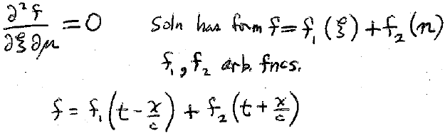
Wave equation
Solution has form
Arbitrary functions

Slide 5

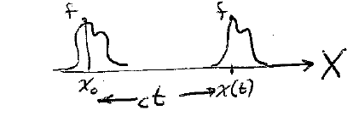
Suppose f₂ = 0.
In each plane x = constant,
the field changes with time.
At each moment t,
the field varies with position.
Field has same values for x,t satisfying
(t – x/c) = constant,
x = const + c t.
values of EM field propagate in x direction at speed c.

Slide 6
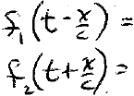
A wave moving toward positive x.
A wave moving toward negative x.

Slide 7

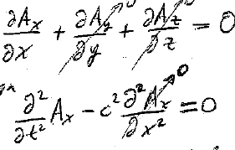


Choose Coulomb gauge:
Then
Since A = A(x,t)
Wave equation
Non-zero A_{x} implies a constant longitudinal field,
But fields must vary with time.
Therefore, A_{x} = 0.
A can be chosen perpendicular to propagation direction.

Slide 8



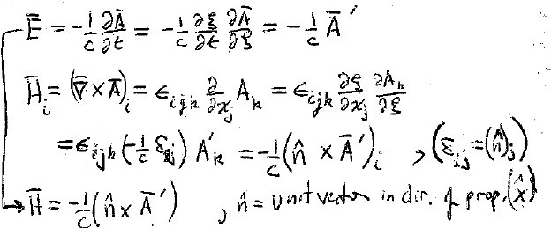
Wave moving in +X direction
n is a unit vector in the direction of propagation.

Slide 9


E, H, and n are mutually perpendicular: “transverse” wave.
E = H (Gaussian units).

Slide 10










Energy flux in plane wave
S = (c/4π) E² n = (c/4π) H² n

Slide 11








Energy density
Energy flux density = S = c W n
Momentum density (p79 & (32.15)
Relation between energy W and momentum W/c is the same as for a particle moving at c, Eq. (9.9)

Slide 12

Momentum flux
Maxwell stress tensor
Homework: For propagation in X direction, only –σ_{xx} = W is nonzero.
(Momentum has only an x component and it flows only in the x-direction.)

Slide 13
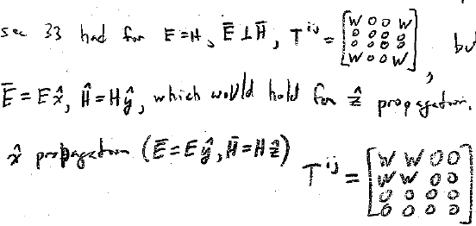
From section 33, we had for E = H &
But this was for
which would hold for Z propagation.
For X propagation
And –σ_{xx} = W.

Slide 14
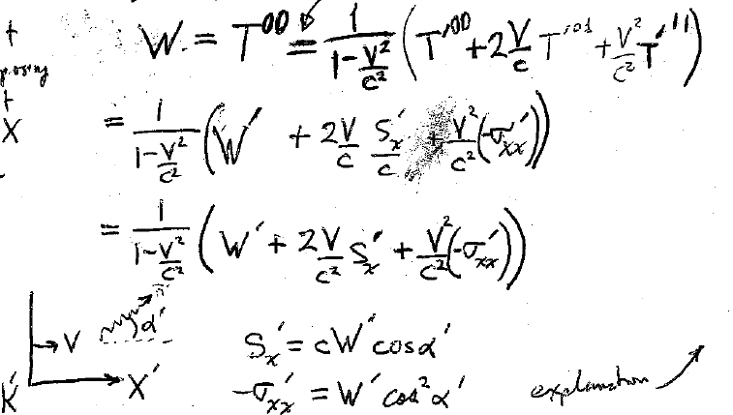
Transformation of energy density W when changing to a different inertial frame.
Sec 6, Problem 1
We don’t suppose that n || X here.
Explanation

Slide 15
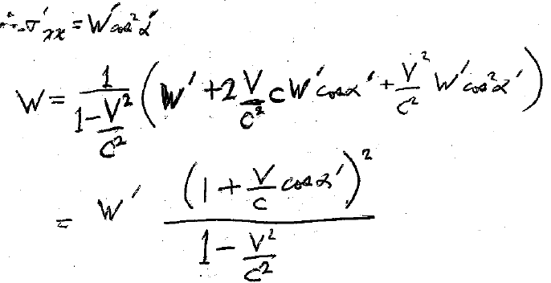
X’ component of momentum is proportional to Cos α’.
X’ flux of momentum is proportional to Cos α’.
Therefore the flux of the X’ component of momentum in the X’ direction is proportional to Cos² α’.
The flux of n’ component of momentum in the n’ direction = W’.

Slide 16
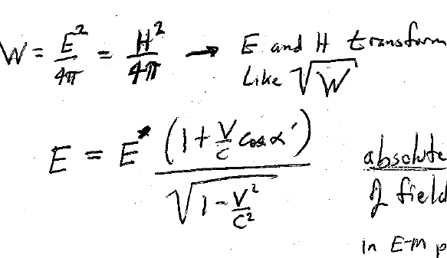
E and H transform like Sqrt[W].
Absolute value of the field magnitude in the electromagnetic plane wave.

