Slide 1
Monochromatic plane waves
LL2 section 48

Slide 2
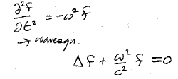
Plane waves are monochromatic when f (= A, E, and H) depends on time according to cos(ωt + α), ω = cyclic frequency
This differential equation gives the spatial distribution of the plane wave

Slide 3
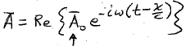
Plane wave propagating in positive X direction: f = f (t-x/c)
Monochromatic plane wave is a simple periodic function of t-x/c
Complex vector amplitude.
A is a superposition of cos and sin
E and H have analogous forms with same frequency ω

Slide 4
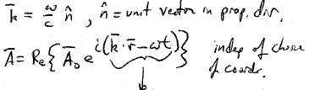
Wavelength:
= 2 π c /ω
= period of variation of field with x at fixed t
Wavevector
“phase” of wave

Slide 5
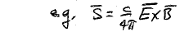
Linear operations
  Omit “Re” and operate with complex fields
Non-linear operations
  Take Real part first !!!!!

Slide 6
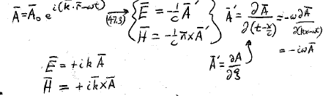

Slide 7






Direction of the field (polarization)
Complex vector
Also complex
Let
Half the phase of E₀²
Still complex, but b² = |E₀²| is real
b₁ and b₂ are perpendicular

Slide 8

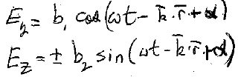
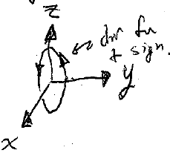

“+” if b₂ is along +Z
Equation of an ellipse
“elliptical” polarization

Slide 9
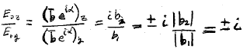
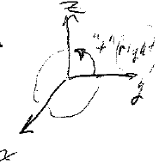
If b₁² = b₂²,
then the ellipse is a circle,
and |E| = constant.
“Circular polarization.”
Choice of y, z axes is now arbirtrary.
“+” gives “right”

Slide 10
If b₁ or b₂ = 0,
then ellipse is a line.
“Linear polarization”
“plane polarized”
Any elliptical polarization is a superposition of plane polarized waves.

Slide 11
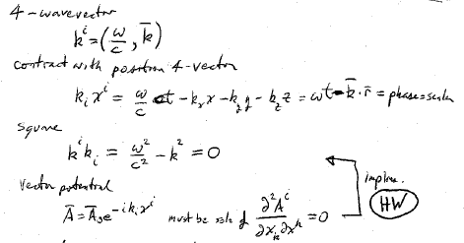
4-wavevector
Contract with the position 4-vector
=the phase,
a scalar
Square it.
Vector potential
Implies…
Must be a solution of

Slide 12
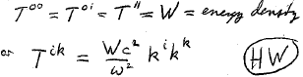
For any plane wave with k || X
the non-zero energy momentum tensor components are
Energy density

Slide 13
Doppler effect: Lorentz transform of wave 4-vector.
What is ω in frame K moving at –V relative to K₀.
Define ω₀ as the proper (“true”) frequency of the source in its rest frame K₀

Slide 14
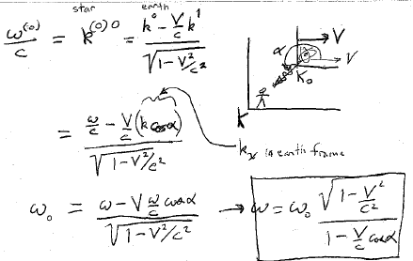
star
Earth
In Earth frame

Slide 15
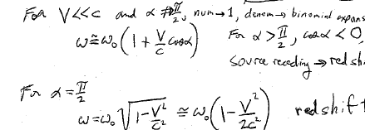
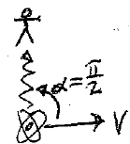
Numerator -> 1,
denominator -> binomial expansion
≠
Source receding gives red shift
Redshift
But now V/c must be larger to get a significant change in ω compared to the α = π case.

