Slide 1
Spectral resolution
LL2 section 49

Slide 2
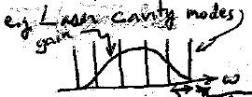



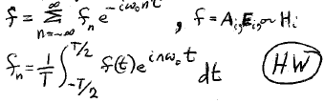
Any arbitrary wave is a superposition of monochromatic plane waves
Case 1: Expansion formed of discrete frequencies
Cavity round trip frequency
Gives periodic wave
Field is a usual Fourier series with integral multiples of the fundamental ω₀ = 2π/T
Multiple fundamental frequencies give a more complicated periodic wave

Slide 3
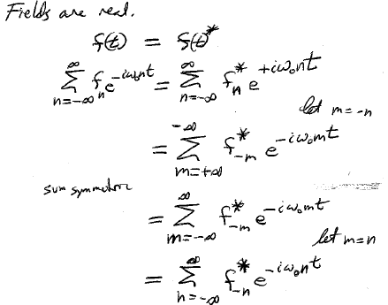







Actual fields have to be real.
Let m = -n
The sum is symmetric
Let m = n

Slide 4





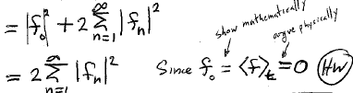

Square and time average (e.g. total laser intensity)
Only terms with m = -n survive. All others oscillate and average to zero.
Show mathematically
Argue physically

Slide 5
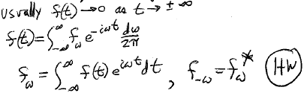



Case 2: field is a superposition of a continuous sequence of frequencies, e.g. a wave packet
Usually

Slide 6
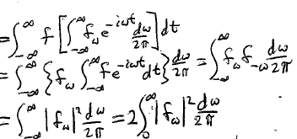



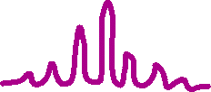


Total intensity of the wave
Total intensity of wave = sum of squares of the Fourier components

