Slide 1
Section 5
Transformation of velocities

Slide 2
1. How does x-component of velocity of material particle transform when changing to a new inertial reference system?
V
K’
K
In the limit c →∞, we must get the classical result: v_{x} = v_{x}’ + V

Slide 3
2. From Lorentz transform formulas of section 4:
3. Sub into

Slide 4
v_{y} and v_{z} also change!
V
K’
K

Slide 5
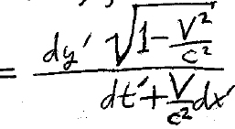
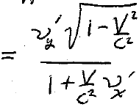
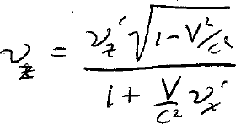
In the limit c →∞, we get the classical result:
The change in v_{y} and v_{z} does not happen classically

Slide 6
4. Special case
Then
V and v’ enter symmetrically in this case
5. Use this to show that the sum of two velocities never exceeds c. HW

Slide 7
6. Approximate velocity transformation formulas for V << c.

Slide 8
v’ and V enter unsymmetrically when they are not parallel.
This is due to the non-commutativity of the Lorentz transform, namely sequential rotations about different axes in 4-space depend on the order of operation.
For example, we get a completely different formula if we interchange
But we get the same formula if we interchange

Slide 9
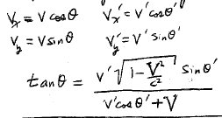
8. The apparent direction of motion for material particles depends on the reference frame.
V
K’
K
Transformation of the direction of motion (homework)

Slide 10
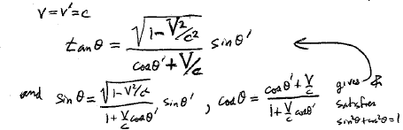
9. Aberration of light
Even though light always travels at speed c in every inertial reference system, it does not travel in the same direction.
In equation for material particles, put

Slide 11
10. Approximate aberration formula for V << c. (HW)
θ < θ’ if θ’ is positive
Aberration angle
No difference in observed direction
Max difference in observed direction

