Slide 1
Partially polarized light
LL2 section 50

Slide 2
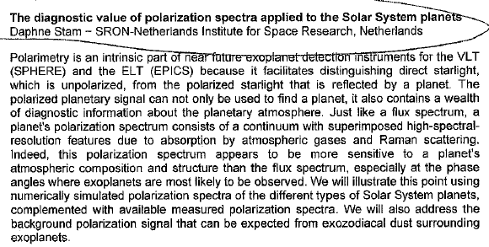

Slide 3




monochromatic plane wave
Constant complex vector,
defines polarization state,
which is definite (elliptical)

Slide 4



Approximately monochromatic plane wave
Contains frequencies in some interval Δω
Let ω = average frequency
At a fixed point in space
Slowly varying complex vector, e.g. beats of two closely spaced frequencies.
Polarization is now not definite.
It changes with time.
“partially polarized”.

Slide 5
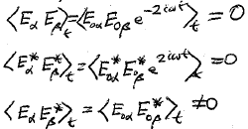

Experiment
Polarization is determined using an analyzer and measuring intensity, not field.
Polarization is determined from <quadratic functions of field>_{t}
Three possible quadratic functions
Due to fast oscillating exponentials
Polarization properties are determined by the tensor

Slide 6
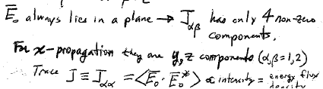
E₀ always lies in a plane, so J_{αβ} has only 4 non-zero components.
For X-propagation, they are the y, z components
(α,β) = (1,2)
Trace is proportional to intensity = energy flux density

Slide 7
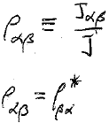

“Polarization tensor”
Is directly related to polarization properties independent of intensity
Hermitian: ρ₁₁ and ρ₂₂ are real, while ρ₂₁ = ρ₁₂*
ρ_{αα} = 1.
ρ₁₁ depends on ρ₂₂
Polarization is characterized by 3 real parameters:

Slide 8




Completely polarized light (monochromatic case)
E₀ is a constant complex vector
= product of components of a constant vector
HW: Necessary and sufficient condition for complete polarization is

Slide 9


Completely Unpolarized light (natural light)
All directions in y-z plane are equivalent
HW:

Slide 10


Arbitrary polarization
P = “degree of polarization”
0 ≤ P ≤ 1

Slide 11






Divide polarization tensor into symmetric and antisymmetric parts
Symmetric part
Anti-symmetric part
Pure imaginary since polarization tensor is Hermitian
Pseudo scalar
Unit antisymmetric tensor
e₁₂ = -e₂₁
Every antisymmetric tensor of rank equal to the number of dimensions reduces to a pseudo scalar.

Slide 12


Circular polarized wave (limiting case of definite elliptical polarization)
E₀ is a constant complex vector
= Exp[± i π/2] E₀₁
HW:

Slide 13
Linear polarization (limiting case of definite elliptical polarization)
E₀₁ and E₀₂ have the same phase.
We can choose E to be real
Then A = 0
General definite elliptical polarization
-1 ≤ A ≤ 1
Left circular
Right circular
“degree of circular polarization”

Slide 14





Any symmetric tensor can be brought to principal axes with principal values λ₁ and λ₂
Principal axes are mutually perpendicular, n⁽¹⁾ & n⁽²⁾
n⁽²⁾
HW:
using
Since 0 < detρ_{αβ} < 1/4, λ₁ and λ₂ are positive.
0 < (λ₁, λ₂) <1

Slide 15



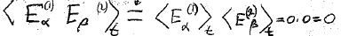
Linear polarization: A = 0.
Product of two components of a constant vector
Product of two components of a different constant vector
+
Each term separately corresponds to linearly polarized light.
The two parts are independent: “incoherent”.

Slide 16

For linearly polarized wave (E₀ real and A = 0), the partially polarized light (E₀ slowly varying) is a superposition of two incoherent waves with intensities proportional to λ₁ and λ₂, linearly polarized along mutually perpendicular directions.
In the general case (A ≠ 0, ρ_{αβ} complex), partially polarized light is a superposition of incoherent elliptically polarized waves with similar but perpendicular polarization ellipses

Slide 17



S_{αβ} can be expressed in terms of the rotation that brings S to principal axes
For arbitrary choice of y & z, polarization of partially polarized wave is expressed by
  A = degree of circular polarization
  l = degree of maximum linear polarization
  φ = angle between direction of maximum polarization and the y axis.

Slide 18

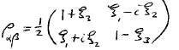
Stokes parameters
Each is in the range -1 to 1

Slide 19
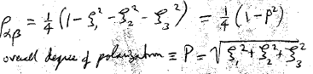
ξ₃ characterizes linear polarization along the y axis.
ξ₃ = 1 → complete linear polarization along y.
ξ₃ = -1 → complete linear polarization along z.
ξ₁ characterizes linear polarization along direction at 45 degrees to the y axis.
  ξ₁ = 1 → complete linear polarization at φ = π/4.
  ξ₁ = -1 → complete linear polarization at φ = -π/4
det
Overall degree of polarization

Slide 20
Does polarization depend on reference frame?
Do intensity and components of polarization tensor form elements of a four-vector so that they transform into each other under Lorentz transformation?

Slide 21


Pseudo scalar
Invariant under
Lorentz transform
Scalar
Degrees of circular and linear polarization are invariant

Slide 22
How many numbers are needed to specify the polarization of an electromagnetic wave?
What are the three sets of these numbers that we introduced in this lecture?

Slide 23
3 independent components of polarization tensor.
A = degree of circular polarization
l = degree of maximum linear polarization
φ = angle between direction of maximum polarization and the y axis.

