Slide 1
Fourier resolution of electrostatic field
LL2 section 51

Slide 2
The Fourier integral is an expansion in waves.
This can be applied to the field of static charges.

Slide 3



Static field does not satisfy the homogeneous wave equation
Since
But
The same holds for each term in the linear expansion of the static field in terms of monochromatic plane waves,
so the usual dispersion relation does not apply.

Slide 4
The planes waves used in the expansion of a static field must have zero frequency, since
But the wavevectors of these plane waves are not zero, since

Slide 5
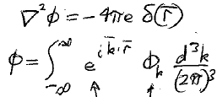
Field of a point charge
Poisson’s Equation
Fourier integral
Plane waves with ω = 0
Coefficients.
“Amounts” of each Fourier component.
A function of wavevector k.

Slide 6
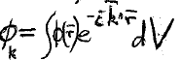
Inverse transform
How we find the “amount” that each plane wave contributes to the expansion.
We “project” the potential on to each plane wave with wavevector k.

Slide 7
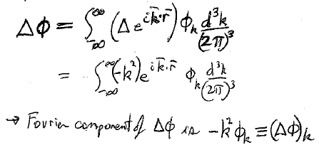
Apply Laplace operator to both sides of expansion of potential
Fourier component of Δφ is

Slide 8
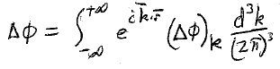
Expansion of Laplacian of potential

Slide 9
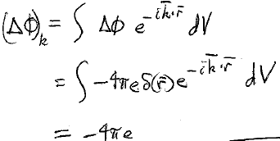
This gives a second expression for the Fourier component of the Laplacian of point-charge potential
Inverse
Poisson’s equation for point charge

Slide 10



Equate the two expressions
Fourier coefficient in plane-wave expansion of potential of a point charge
Terms with slow spatial variations (small k) dominate.
φ
No wiggles
Q

Slide 11






Expansion of electric field
But

Slide 12

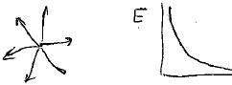
For point charge
Waves that superpose to give the Coulomb field are polarized parallel to their wavevectors: Longitudinal.
Electric field points in the same direction as the change in E with r.
r

